Slide 1
Women in Dynamics
Peter Vach
Muriel Léglise
Olga Ingolfsdottir
Ivy Bumanglag & Bo Lundqvist

Slide 2




Slide 3


Integrity: We conduct business and treat colleagues with honesty
and transparency.
Innovation: We value creativity and encourage new ideas and better problem-solving.
Empowerment: We empower our employees to take ownership, grow and excel in their roles.
Customer Focus: We prioritize meeting customer needs and enable them to grow their businesses.
Partners: We have the leading retail and hospitality community that we take active steps to strengthen.
Teamwork: We value and encourage collaboration internally, across teams and regions, and with partners and customers.
Professionalism: We provide high-quality products and services in a professional and respectful manner.
Accountability: We are responsible for our actions.
Fun: We encourage a positive work environment and enjoyable workplace.
Diversity and Inclusion: We believe in the unique strength of every individual to reach their full potential.
Environmental care: We promote sustainability and minimize
environmental impact.
Manifesto
LS Retail provides innovative software solutions for the retail and hospitality industries. Our approach is guided by a set of 11 core principles.
These principles guide our strategy and ensure we provide exceptional solutions that meet industry needs while maintaining our commitment to excellence, integrity, and sustainability

Slide 4


Facts & Challenges
Diversity in leadership roles
Little opportunity for C-level positions & career advancement
To attract and recruit diverse talents
Representation of women in tech estimated 26.7%,
annual growth 0.9%
50% of women in tech leave their job before the age of 35

Slide 5
WID partnership entails
Using our platforms to spread awareness and promote the cause
Assessing ourselves internally and adopting inclusive practices
Knowledge-sharing with others in Dynamics Community
Aim to become a role model for our Community

Slide 6
Our main goals
1) Create a network of like-minded individuals (male, female & nonbinary) within the global Dynamics community
2) Identify & understand the challenges in our community so we can help drive a positive change
3) Promote Dynamics as a totally inclusive community and a wonderful place to work

Slide 7


Slide 8


Slide 9
Track
To know your numbers
Create a D&I taskforce leadership representation
Create a D&I reporting & targets
Produce inclusion survey and implement changes

Slide 10
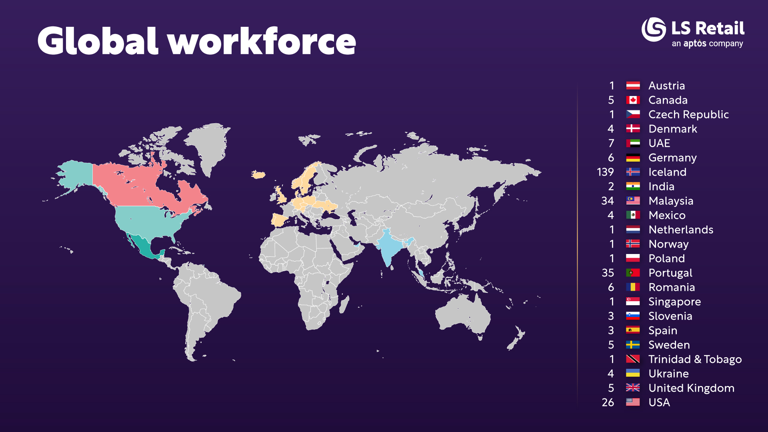

Slide 11
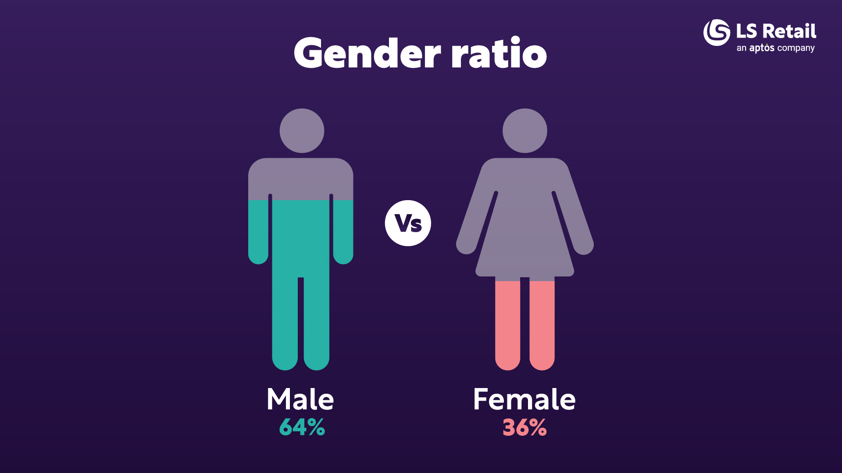

Slide 12

Actions for a more inclusive environment ?
Mentorship program
In progress: expansion
Online trainings for employees
In progress: developing LS Academy
DEI survey
In progress

Slide 13


Slide 14

Inclusive environment: Recruitment
Hiring manager training
  In progress with DEI component
Branding our values
  People-centric, inclusive language and images in ads and website
Building recruitment channels
  University collaboration (Iceland, Malaysia, to some extent the U.S.)
  Future Leaders Program

Slide 15



Slide 16
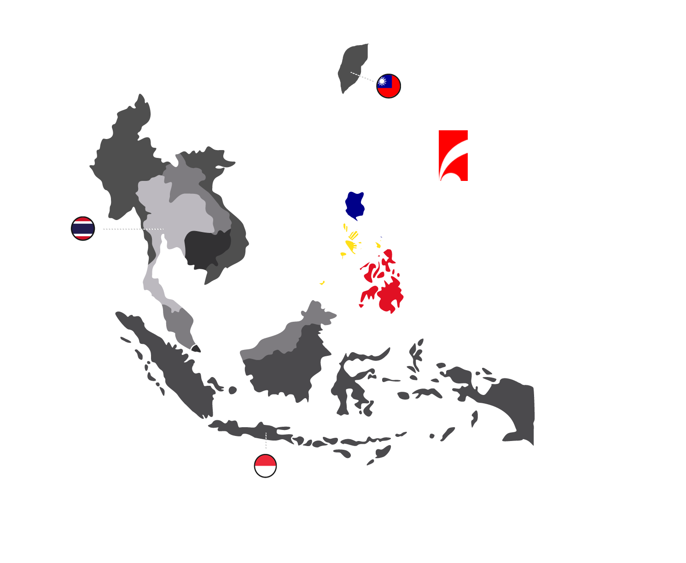
PHILIPPINES
PERLAS NG SILANGANAN
(Pearl of the Orient)
110M Population
Male/Female Ratio:
50.1% / 49.9%
Median age: 25 years

Slide 17
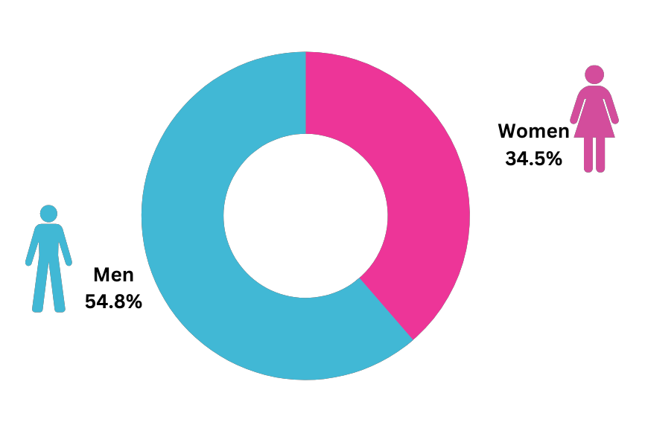
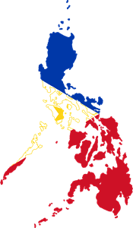
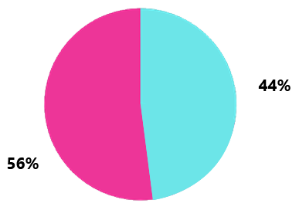
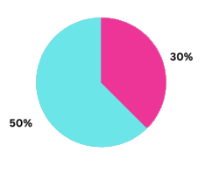
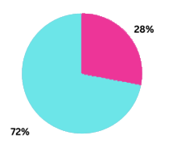
WHAT WE‘RE UP AGAINST
Female Representation on the Board
University graduates
Philippines Labor Force
Women in the IT Industry

Slide 18


EMPOWERMENT

Slide 19



OUR ACHIEVEMENT
50
50

Slide 20

Diversity makes business sense
Recruitment
Retention
Branding
Delivery

Slide 21
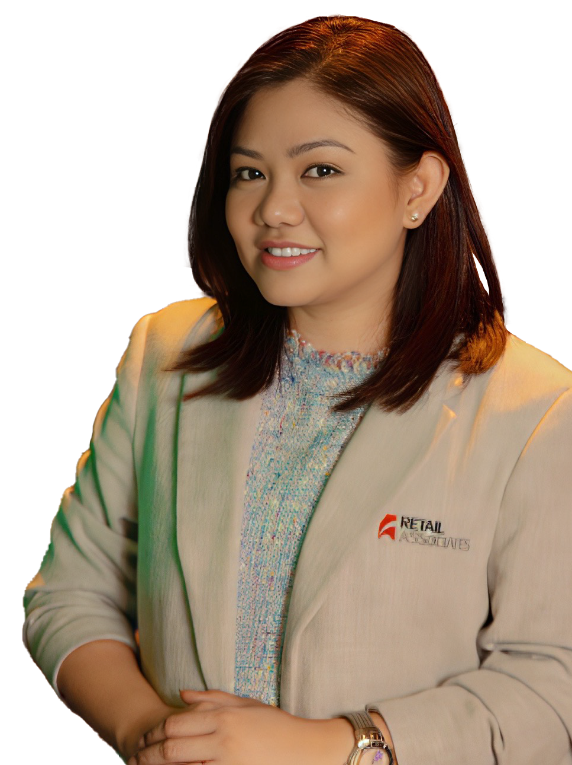

“The strength of Retail Associates lies in the diversity of its workforce.
We have built a culture that promote and encourage expertise,
experiences and perspectives that both genders bring to the table.
Providing equal opportunities based on merit, not
gender, is part of our ethical values.
In an environment that allows them to, it is surprising to
see women striving and achieving of excellence. This is
how empowerment of women is achieved!”
IVY GEMMA BUMANGLAG
CHIEF OPERATING OFFICER

Slide 22









THE REALITY

Slide 23
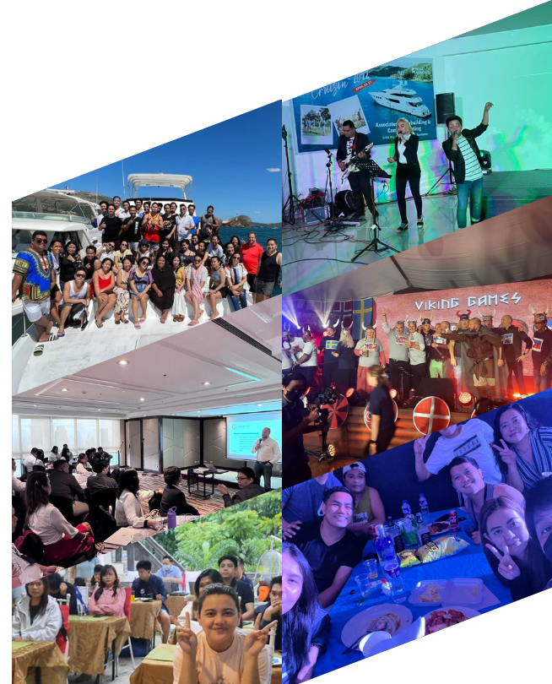
OUR DELIBERATE STRATEGIES
Recruitment and Compensation Package Policies
Company Events and Activities
Established a conducive work environment

Slide 24




A conducive environment for women
Mom
Wife/Partner
Leader
Me

Slide 25
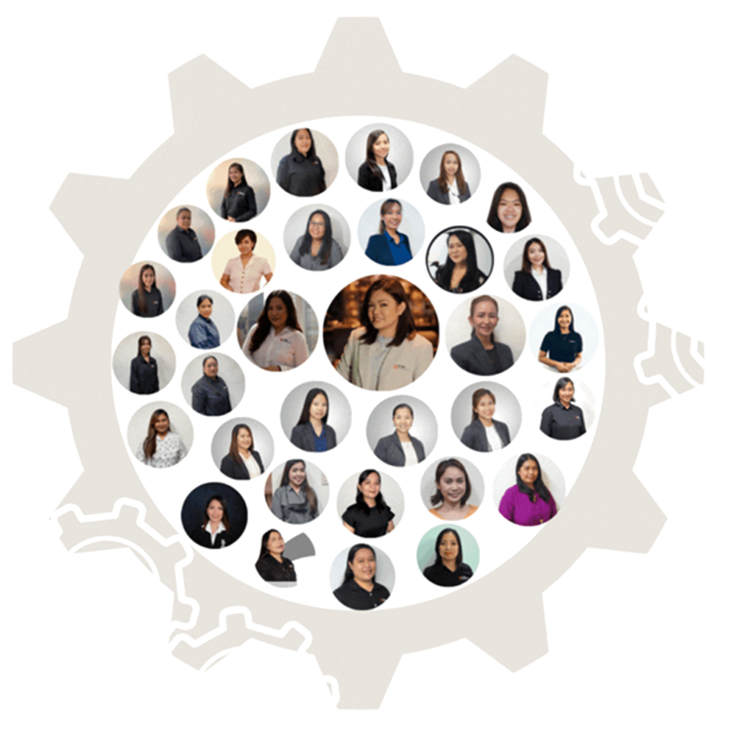
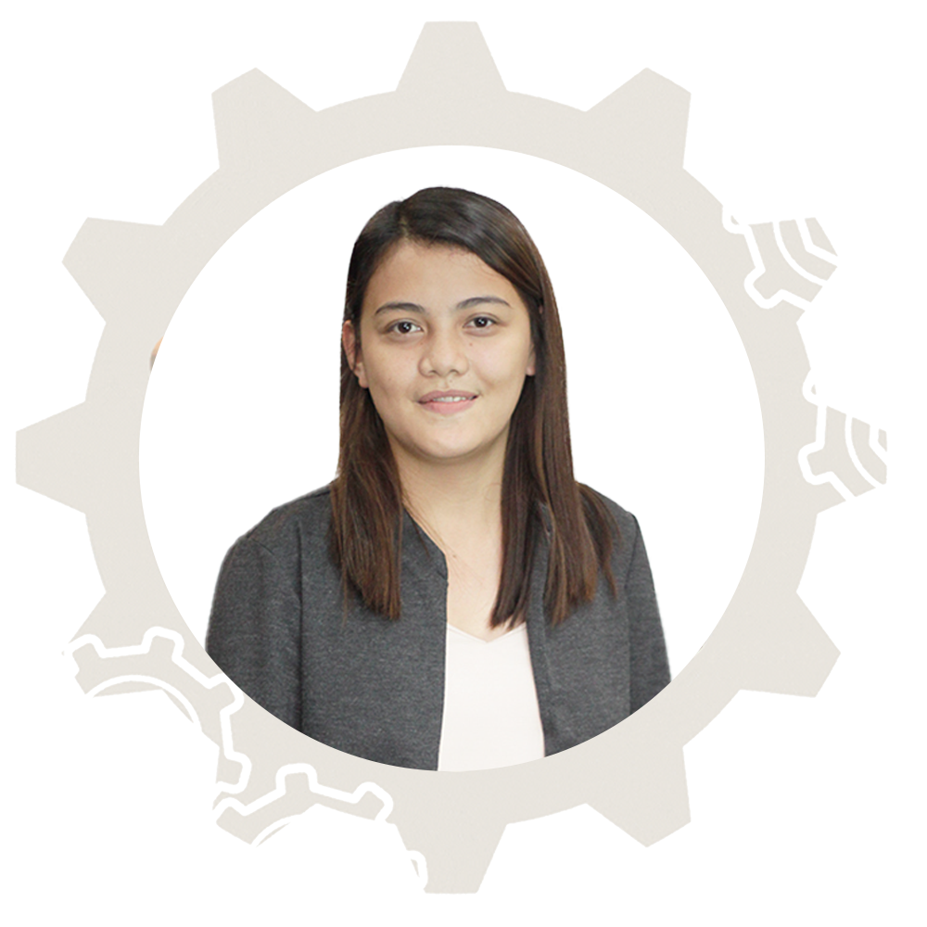
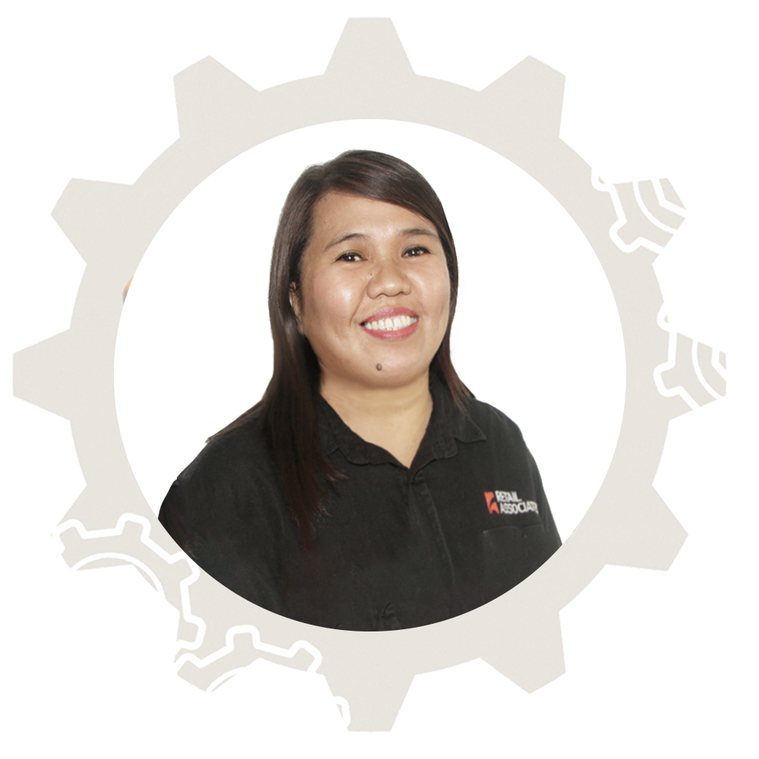
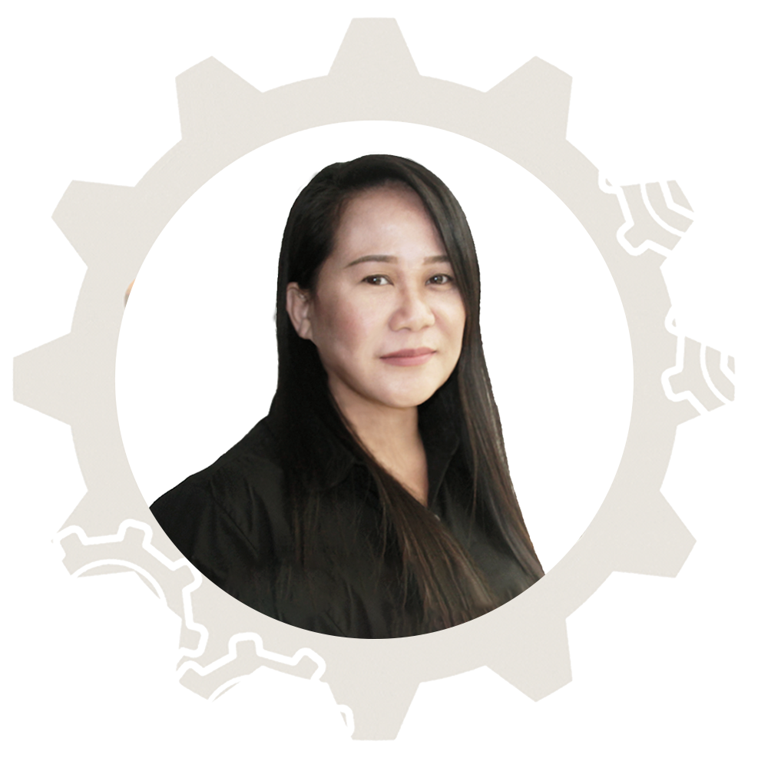
OUR DYNAMIC FEMALE LEADERS
Roxzannie Añosa
Retail and Commerce Consultant
Andry-Rose Tonog
Project Manager
Happie Roncal
Ikea Operations Manager

Slide 26


Slide 27
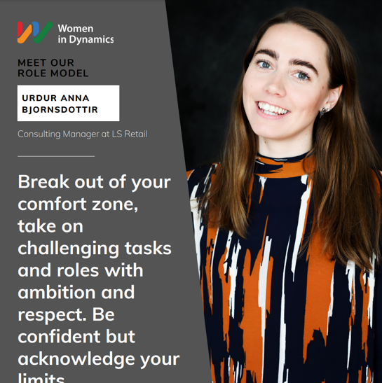
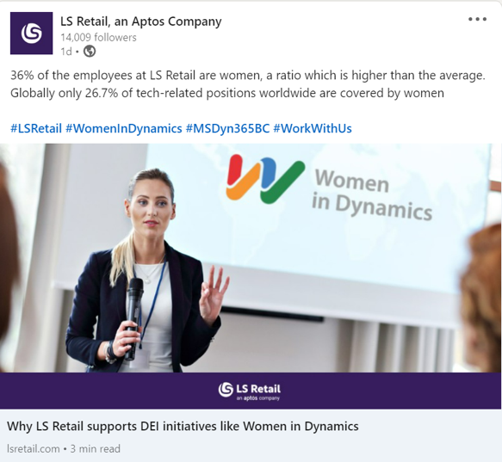
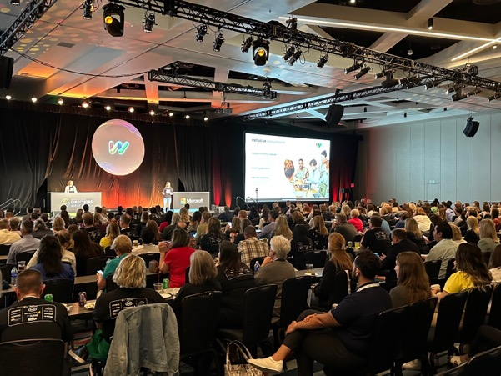
SHINE –Strengthen your team

Slide 28

Empower - Change in last years
Analyzed the hiring practices and leadership policies to increase the DEI
Encourage Women to take new challenges, and step outside of their Comfort Zone.
Women have been promoted and set as a role model within LS Retail
Provide External Training Programs

Slide 29
Has the glass ceiling been broken?
The door to the C-suite is wider for Females today than it was 10 years ago.
More Female working for LS Retail than Globally
What can be the reason that the gender ratio is not higher?
Firms with more women in senior positions are:
  More Profitable
  More socially responsible
  Provide safer, higher – quality

Slide 30
Reason for Gender difference
Is it more men in the world than women?
Gender ratio:
  Women 49,58%
  Men 50,42%
This is a
  Business Decision
  That needs strategy
That Needs
  Continually Improvement

Slide 31
Our Goal
Create a network of minded individuals (male, female & nonbinary) within the global Dynamics community
Expand our definition of leadership
Encourage women to take on new challenges
Provide mentorship and coaching opportunities for women
Provide external training program with:
  Networking opportunities
  Leadership Boot Camp
Personal Brand for Women
  Communicate their value

Slide 32
Why is this Important
Empowering women and achieving gender equality are not only moral imperative
Its crucial for creating inclusive, open and prosperous societies
We also need men and people in power to sponsor women

Slide 33
Thank you

