Slide 2

LS Central SaaS Onboarding
Adalbjorg Karlsdottir
Onboarding lead
Harry Yaw
Functional Consultant

Slide 3
Your Journey to LS Central Saas
Overview Session
Onboarding Guide
SaaS Training
Implementation Guide
Onboarding Buddy and CAP

Slide 4
Your Journey to LS Central Saas
Overview Session
Onboarding Guide
SaaS Training
Implementation Guide
Onboarding Buddy and CAP

Slide 5

SaaS Overview session
https://calendly.com/lsconboarding/onboarding

Slide 6
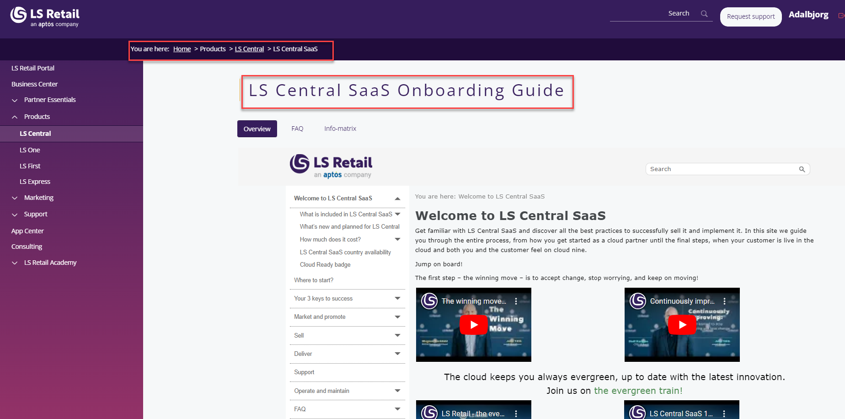
LS Central SaaS Onboarding Guide

Slide 7
LS Central SaaS Onboarding Guide

Slide 8

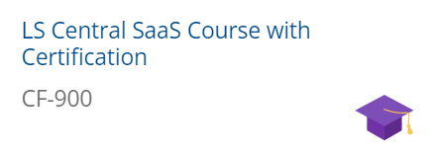
LS Retail Academy – SaaS Training
Partner Center
Delegate Admin role
Admin Center
Administrative tasks for tenants
Online POS vs. Hybrid POS

Slide 9
LS Retail Academy – SaaS Training
Partner Center
Delegate Admin role
Admin Center
Administrative tasks for tenants
Online POS vs. Hybrid POS
Update Service - NEW

Slide 10
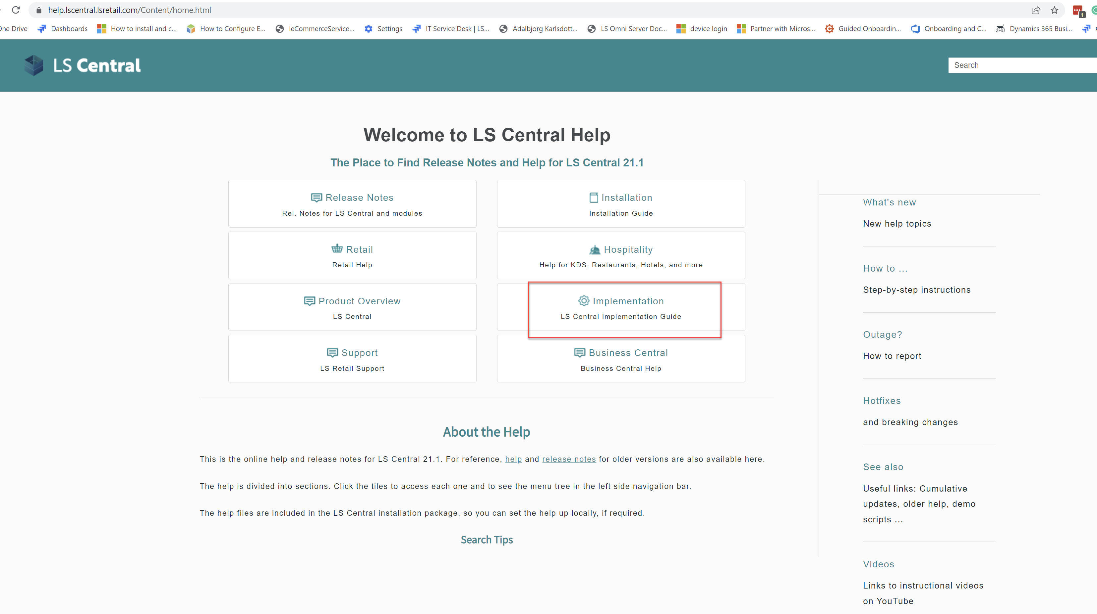
Implementation Guide

Slide 11

Customer story

Slide 12
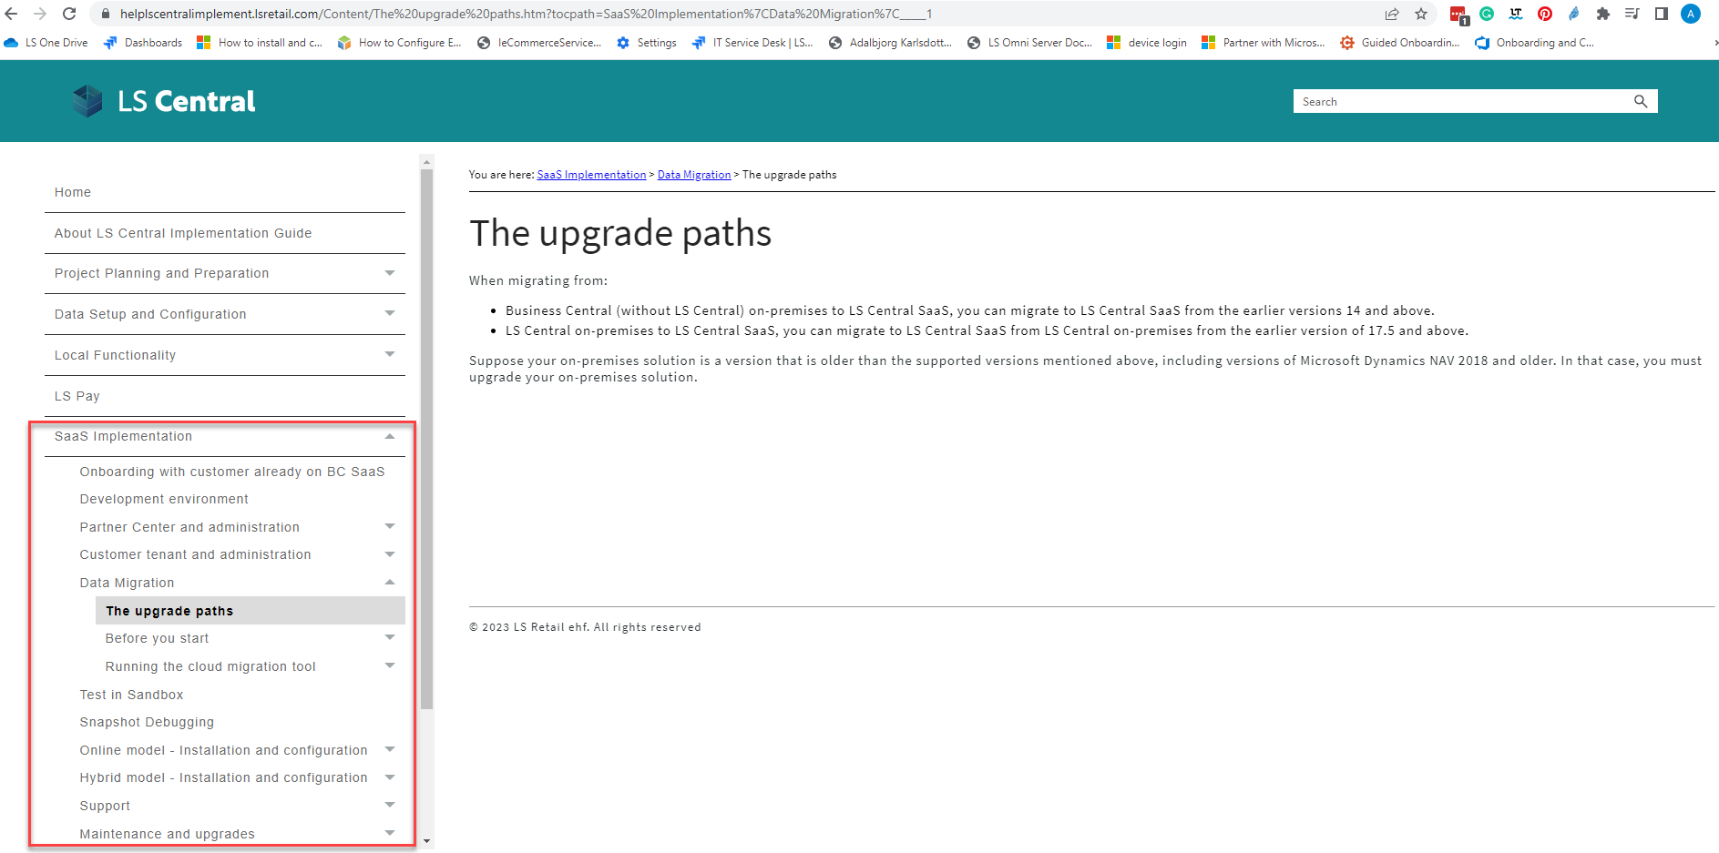
How to move your data to SaaS?

Slide 13
How to move your data to SaaS?
Older than LS14.2
LS Central 14.2 and later
LS Central latest
LS Central SaaS
Using Upgrade Codeunits
Using Table Migration Extensions
Using Cloud Migration Tool
On-premises
SaaS

Slide 14
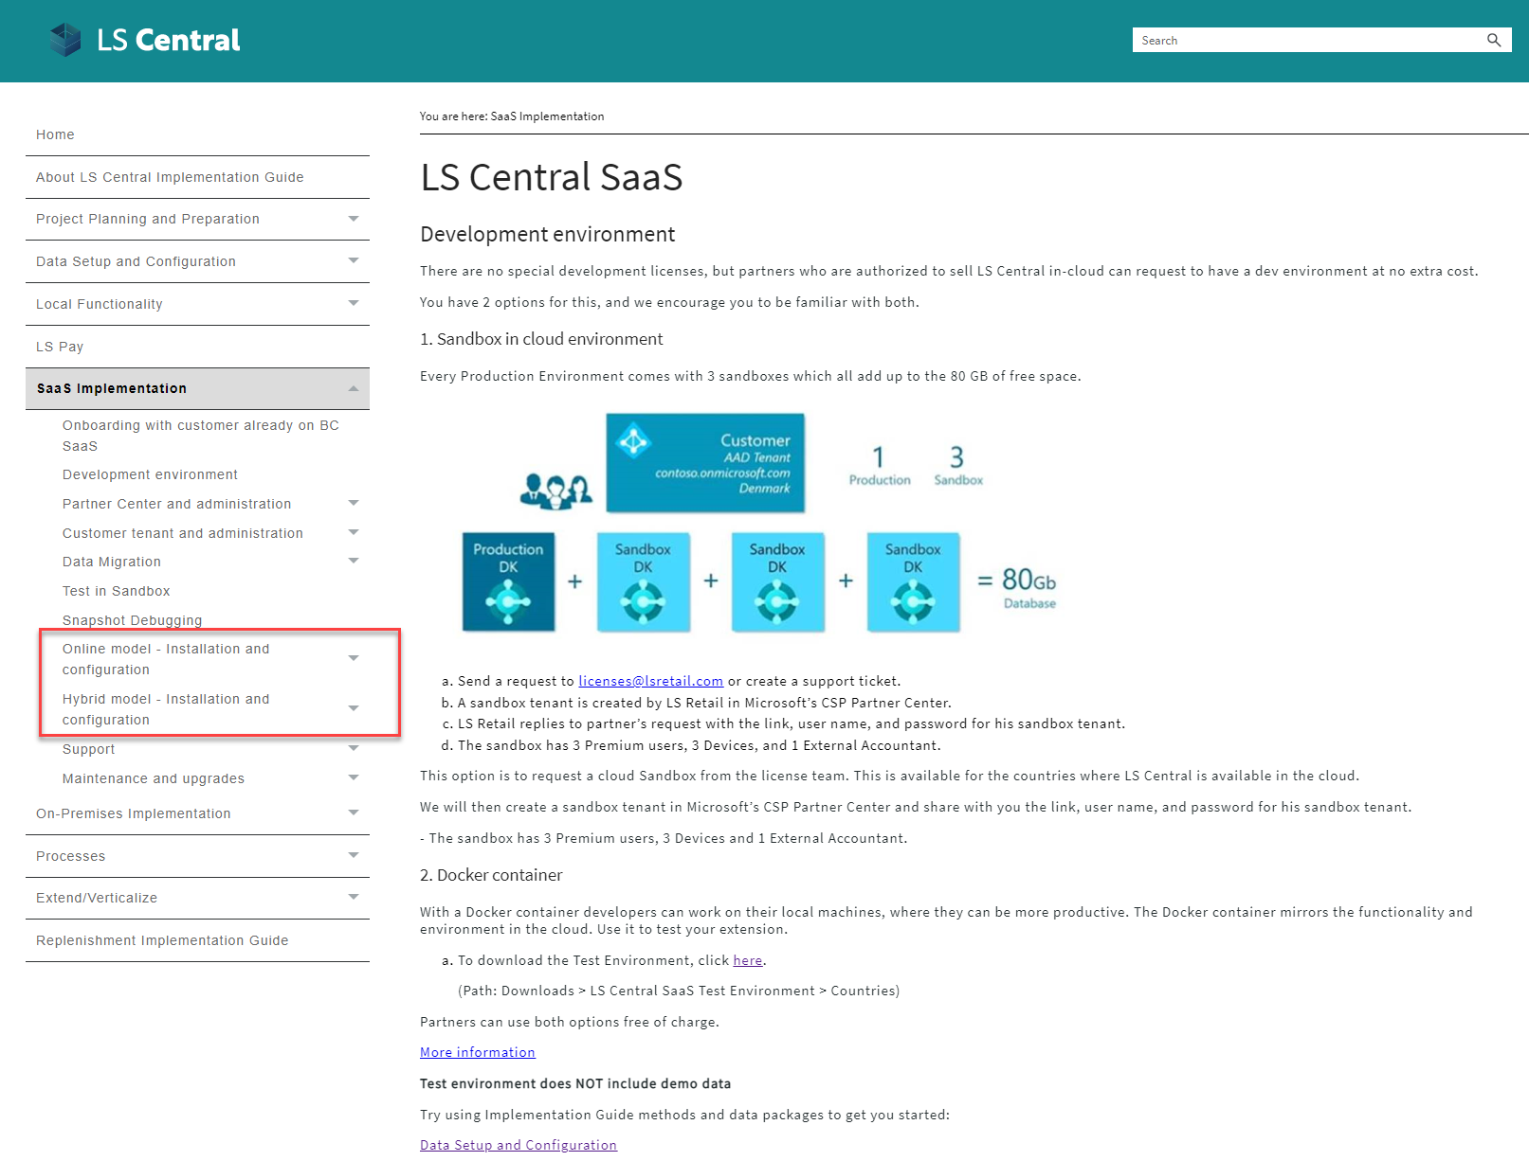



Online or Hybrid?
Web
Replication
LS Central in SaaS
HQ
Hybrid component server
Store
Online POS
Offline POS
Offline POS Service

Slide 15
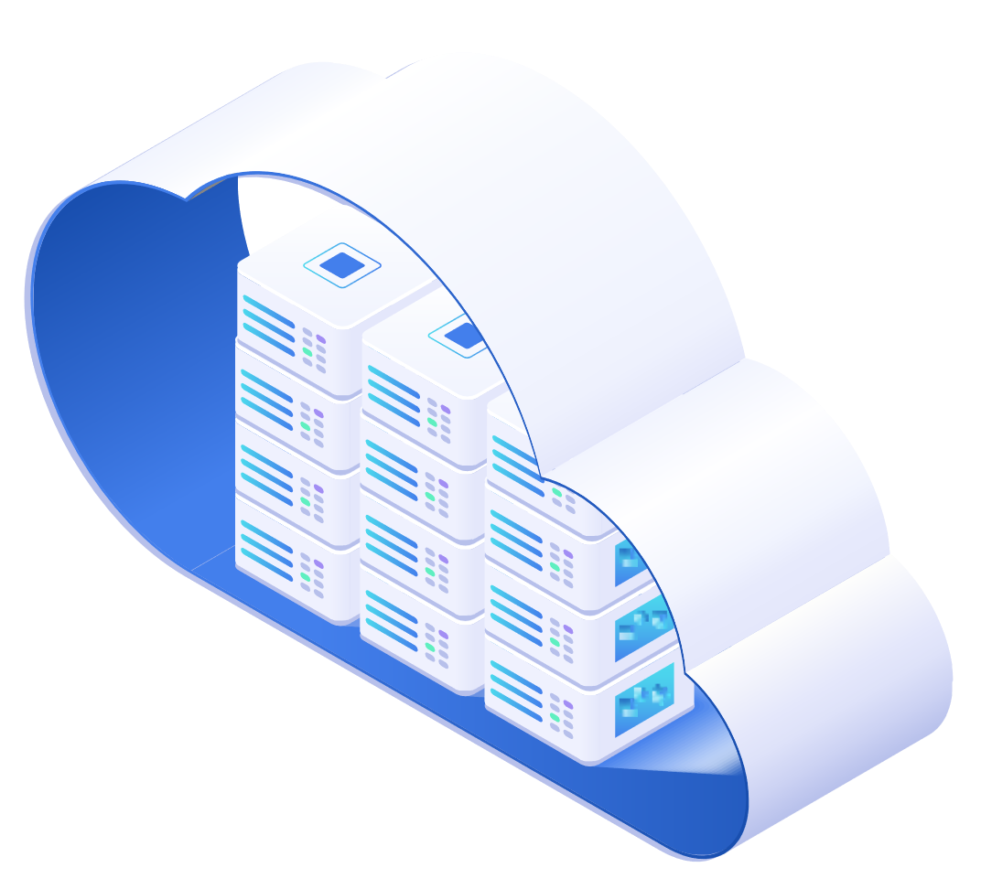

Online POS
HEAD OFFICE IN THE CLOUD
BACK OFFICE
ONLINE POS
ONLINE POS
ONLINE POS

Slide 16











Online POS
Microsoft Dynamics 365
Business Central
HQ
Store
POS 1
POS N
LS Hardware Station
…

Slide 17
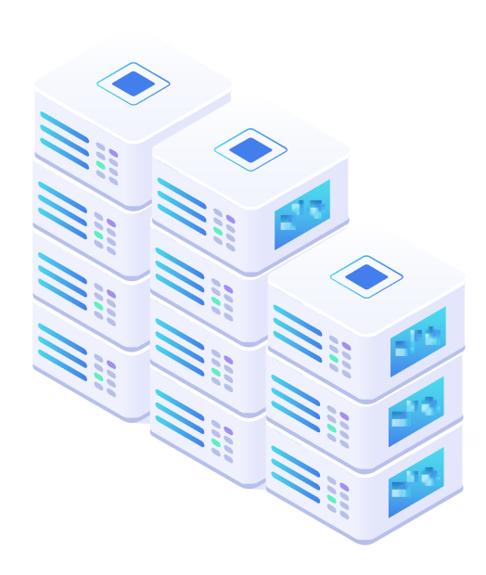


Hybrid POS
BACK OFFICE
HEAD OFFICE IN THE CLOUD
Sales data pushed after each sale
(Webservice)
Sales data pushed after each sale
(Webservice)
Master data pulled from HQ
(Scheduled Webservice job)
STORE 1
STORE 2
Master data replicatied to POS
(Data Director)
HYBRID CLOUD
COMPONENT SERVER
Master data replicatied to POS
(Data Director)
POS MASTER
Offline POS
Offline POS
DATA DIRECTOR
Offline POS
Offline POS
UPDATE SERVICE

Slide 18
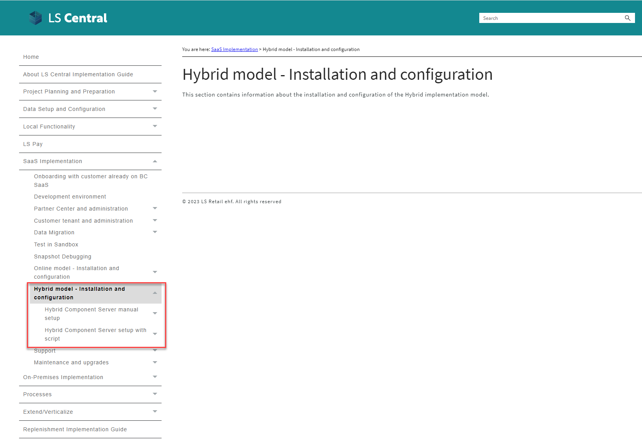
Hybrid POS

Slide 19
Hybrid POS

Slide 20
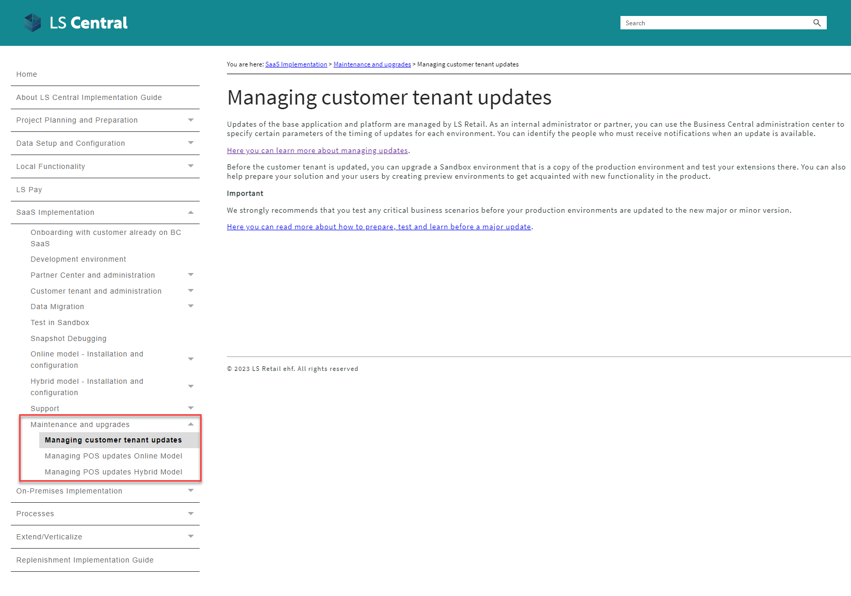
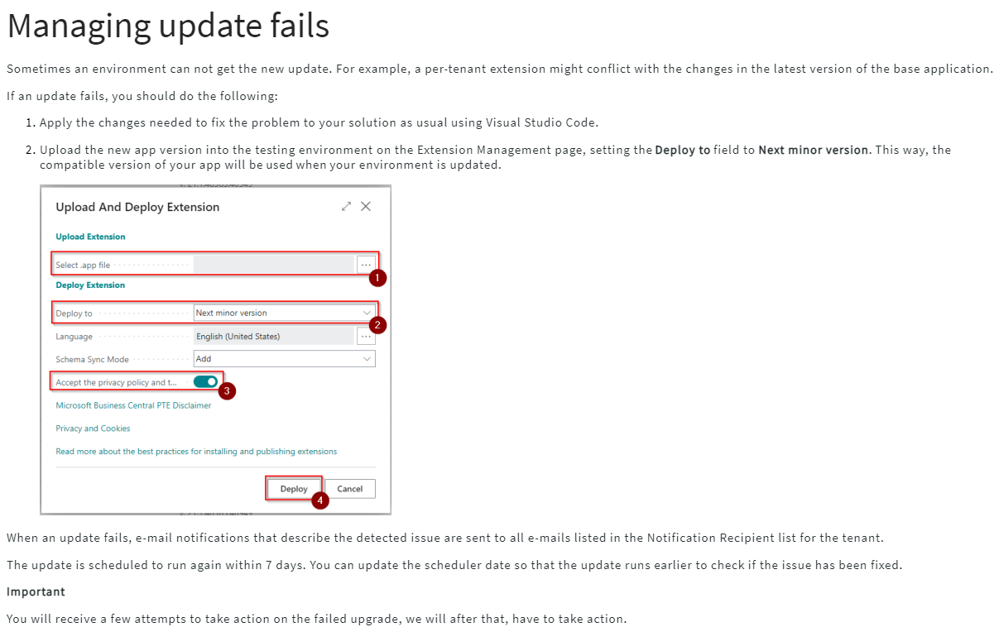
Updates in SaaS
Last selectable Scheduled Update date
Update is available
Outside upgrade window
Within upgrade window
Test window
Upgrade starts*
Day 1
Day 14
Day 21
* If Scheduled Update date has not been set earlier within the upgrade window
The day when the version of LS Central SaaS becomes available
The day when the update is automatically scheduled
The last day you can choose to extend your upgrade date to.

Slide 21
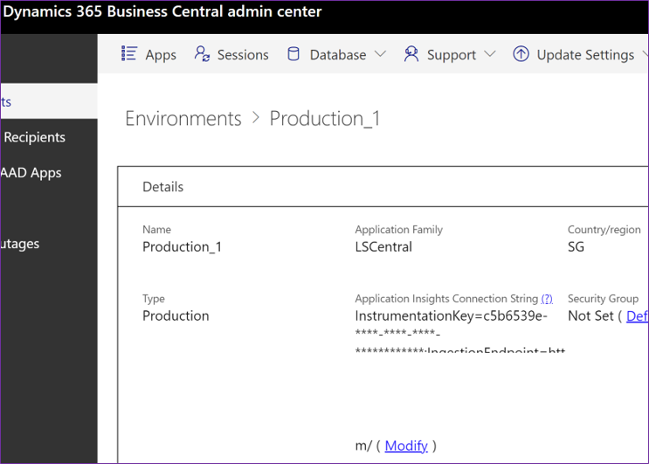
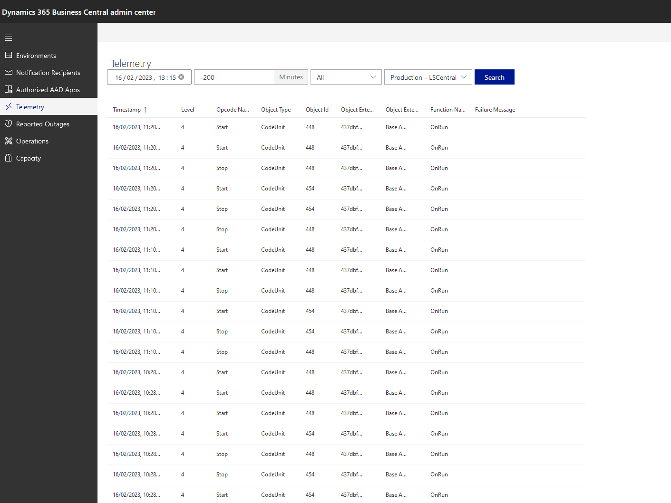
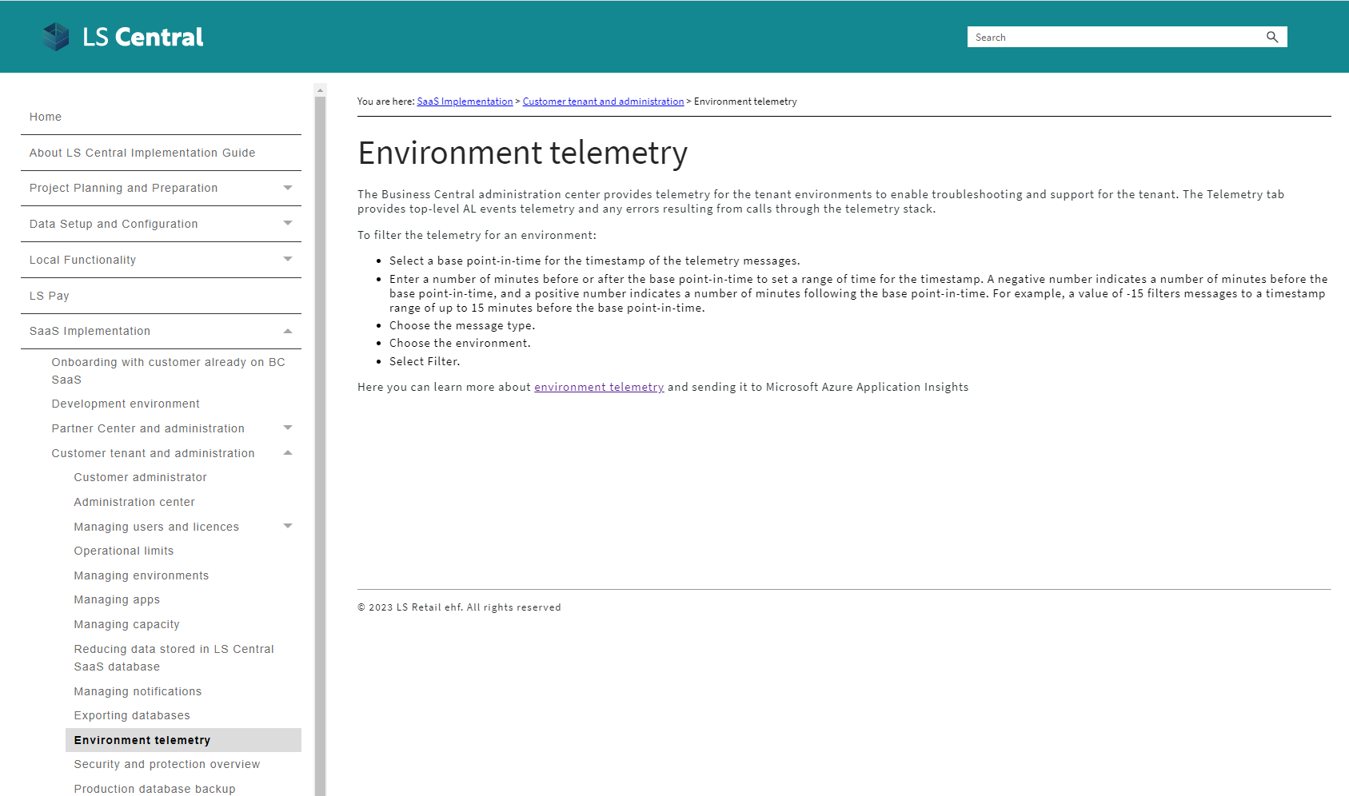
Telemetry

Slide 22
How are we supporting you in
your SaaS journey?

Slide 23



Partners journey to SaaS
Phase 1 – CSP Partner
Over 130 onboarding
sessions with partners
CSP
Overview
Training

Slide 24

CAP
Cloud Acceleration Program

Slide 25
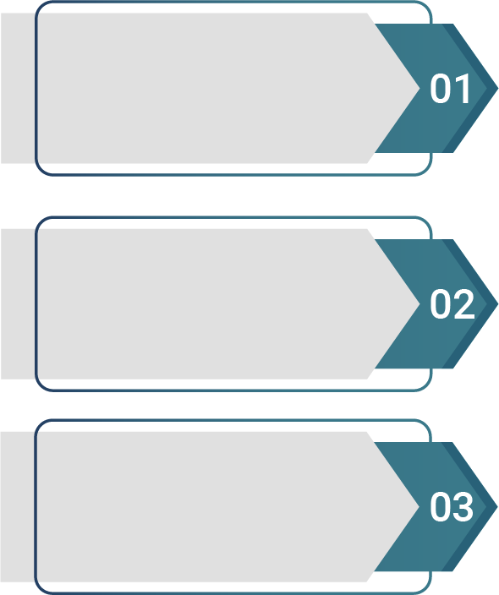

Partners journey to SaaS
Phase 2 – Cloud Acceleration Program (CAP)
  Onboarding with
  Buddy Support
SaaS License
SaaS Project
Evaluation Meeting
  Guided Onboarding
  Onboarding with
  Consulting Team

Slide 26

Onboarding with Buddy Support
Ad hoc support
Teams sessions
Support option for experienced partners

Slide 27
Onboarding with Buddy Support
Ad hoc support
Teams sessions
Support option for experienced partners

Slide 28
CAP – Guided Onboarding
Migration
Test environment

Slide 29


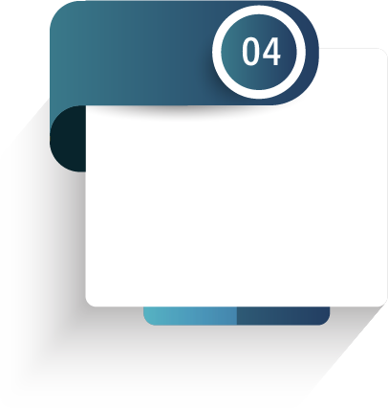
CAP – Guided Onboarding
First Store/
POS
Q&A Session
Migration
Test environment
First HO/POS
Update

Slide 30
CAP – Guided Onboarding
First Store/
POS
Q&A Session
Migration
Test environment
First HO/POS
Update

Slide 31

Onboarding with consulting

Slide 32
How much does it cost?

Slide 33

Book a session with the Onboarding team
  https://calendly.com/lsconboarding/onboarding
  https://calendly.com/lsconboarding/30minsession

Slide 34
Recap
Overview Session
Onboarding Guide
Implementation Guide
SaaS Training
Onboarding Buddy and CAP

Slide 35
Questions?

Slide 36
Thank you

