Slide 1


Slide 2

Replenishment for LS Central
What’s New
Martin Kleindl
Product Director

Slide 3

Replenishment for LS Central
what’s new
Martin Kleindl
Product Director
Martin.Kleindl@LSRetail.com

Slide 4


Slide 5


Slide 6


Slide 7


Slide 8




Slide 9


Slide 10

Speed (aka. performance)

Slide 11
Replenishment - Performance
Basic Replenishment process
Out of Stock Calculation
Replen. Item Quantity Calculation
Replen. Journal Calculation
Detect current OOS situations
Calculate current stock situation
Calculate historical sales performance
Calculate demand
Calculate proposals for Purchase or Transfer

Slide 12
Replenishment - Performance
Basic Replenishment process
Out of Stock Calculation
Replen. Item Quantity Calculation
Replen. Journal Calculation
Detect current OOS situations
Calculate current stock situation
Calculate historical sales performance
Calculate demand
Calculate proposals for Purchase or Transfer

Slide 13



Parallel calculation
Existing flow (with NAS)
Master Scheduling Job Linked Scheduler Jobs (run by NAS)
CU 10012221 “LSC Replen. Parallel Master”
CU 10012200 “LSC Replen. Calc. Qtys”
On-premise
Assigns next check date/time
New flow (without NAS, but Background sessions)
Master Scheduling Job Linked Scheduler Jobs
CU 10012214 “LSC Replen. Parl. Master SaaS”
CU 99001467 “LSC Scheduler Util”
Cloud
Starts background sessions
On-premise
CU 10012200 “LSC Replen. Calc. Qtys”

Slide 14




Parallel Replenishment Calculation Tests in SaaS
Test Environment
Performance Test Results:
Items: 10.000
Locations: 50
ILE records: 36 Mio.
Replenishment Calculation | Baseline Calc. Time | 10 Parallel Calc. Time | Improvement
RIQ | 4 hours 3 mins | 38 mins | 84.50 %
OOS | 6 hours 25 mins | 1 hour 18 mins | 79.08 %
Calculated Entries RIQ entries: 523.315
OOS entries: 5,6 Mio.

Slide 15


Parallel Replenishment Calculation Tests in SaaS
Test Environment
Performance Test Results:
Items: 10.000
Locations: 50
ILE records: 36 Mio.
Replenishment Calculation | Baseline Calc. Time | 10 Parallel Calc. Time | Improvement
RIQ | 4 hours 3 mins | 38 mins | 84.50 %
OOS | 6 hours 25 mins | 1 hour 18 mins | 79.08 %
Calculated Entries RIQ entries: 523.315
OOS entries: 5,6 Mio.

Slide 16
Replenishment - Performance
Basic Replenishment process
Out of Stock Calculation
Replen. Item Quantity Calculation
Replen. Journal Calculation
Detect current OOS situations
Calculate current stock situation
Calculate historical sales performance
Calculate demand
Calculate proposals for Purchase or Transfer

Slide 17
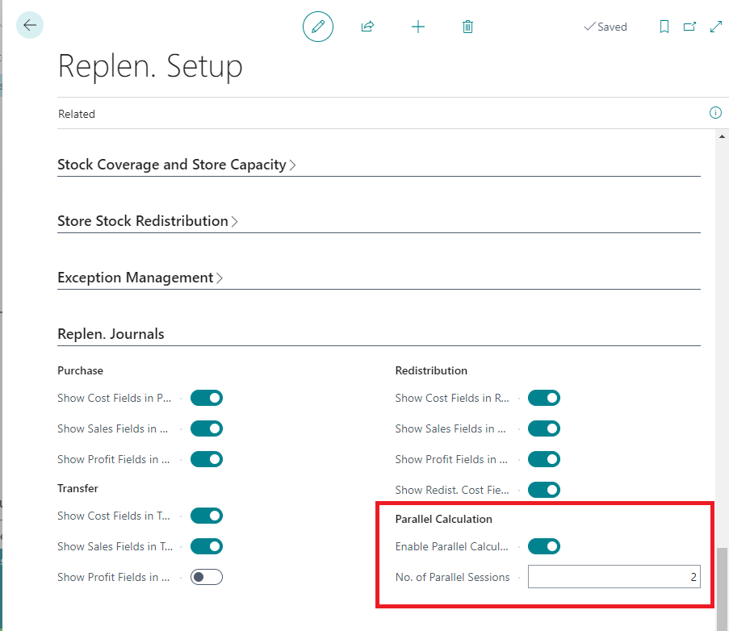
Replenishment - Performance
Replen. Journal Calculation
Code optimizations
Usage of TempTables and flush late in code
Parallel calculation

Slide 18


Parallel Replenishment Journal Calculation
Calculate Journal
Replen. Journal Lines
Child Journal 1
Background session 50 Items (1001.. 1050)
Replen. Journal
100 Items (1001..1100)
2 Parallel sessions
Item No. | Location Code
1001 | S0001
1051 | S0001
Child Journal 2
Background session 50 Items (1051.. 1100)

Slide 19
Parallel Replenishment Journal Calculation
Replen. Journal Lines
Child Journal 1
Background session 50 Items (1001.. 1050)
Replen. Journal
100 Items (1001..1100)
2 Parallel sessions
Item No. | Location Code
1001 | S0001
1002 | S0001
1051 | S0001
1052 | S0001
Child Journal 2
Background session 50 Items (1051.. 1100)

Slide 20
Parallel Replenishment Journal Calculation
Replen. Journal Lines
Child Journal 1
Background session 50 Items (1001.. 1050)
Replen. Journal
100 Items (1001..1100)
2 Parallel sessions
Item No. | Location Code
1001 | S0001
1002 | S0001
1003 | S0001
1051 | S0001
1052 | S0001
1053 | S0001
Child Journal 2
Background session 50 Items (1051.. 1100)

Slide 21
Parallel Replenishment Journal Calculation
Replen. Journal Lines
Child Journal 1
Background session 50 Items (1001.. 1050)
Replen. Journal
100 Items (1001..1100)
2 Parallel sessions
Item No. | Location Code
1001 | S0001
1002 | S0001
1003 | S0001
1004 | S0001
1051 | S0001
1052 | S0001
1053 | S0001
1054 | S0001
Child Journal 2
Background session 50 Items (1051.. 1100)

Slide 22
Parallel Replenishment Journal Calculation
Replen. Journal Lines
Child Journal 1
Background session 50 Items (1001.. 1050)
Replen. Journal
100 Items (1001..1100)
2 Parallel sessions
Item No. | Location Code
1001 | S0001
1002 | S0001
1003 | S0001
1004 | S0001
1051 | S0001
1052 | S0001
1053 | S0001
1054 | S0001
Child Journal 2
Background session 50 Items (1051.. 1100)

Slide 23
Parallel Replenishment Journal Calculation
Replen. Journal Lines
Replen. Journal
100 Items (1001..1100)
2 Parallel sessions
Item No. | Location Code
1001 | S0001
1002 | S0001
1003 | S0001
1004 | S0001
1051 | S0001
1052 | S0001
1053 | S0001
1054 | S0001

Slide 24


Parallel Replenishment Journal Calculation
Performance Tests
Performance Test Results
Test Environment
No. of Parallel Sessions | Original Calc. Time (mins) | New Calc. Time (mins) | Improvement %
1 | 56 | 50 | 11%
2 | 56 | 26 | 54%
5 | 56 | 12 | 79%
10 | 56 | 10 | 82%
Items: 12.000
Locations: 50
Calculated Entries Jrnl. Detail Lines: 600.000
Jrnl. Log Lines: ~8 Mio. Duration: 56 minutes

Slide 25
Replenishment
Planning & Data Maintenance
Manual Replenish- ment
Automatic Replenish- ment
Execution
Monitoring
Sales & Purchase Budgets
Allocation Plans
Buyer‘s Push, Stock Recall
Allocation Rules
Variant Weight Dim. Pattern
Demand Forecasts
Store Stock Redistribution
Purchase & Transfer Orders
Stock Requisition
Buyer‘s Workbench
Inventory and Demand
Store Capacity
Stock Coverage
Vendor Performance
Open to Buy
Assortment Mgmt.
Lifecycle Mgmt.
Replenishment Journal Calculation
Threshold Mgmt.
Lifecycle Planning WS
Cross Docking
Manual Purch. & Transfer Orders
Replen. Item Quantity Calculation
Out-of-Stock Calculation
Item Import

Slide 26



Further Improvements
Multi-company Replenishment Now also for available for SaaS (with webservices) Parallel processing (→ 80% time reduction)
Assembly Orders Consideration of Assembly Orders in Replen. calculation Advanced Lead Time handling Lead Time for Purchase Orders (vendor driven) Lead Time for Transfer Orders (location driven)
Cross Docking for partial deliveries Improved process
Manual Replenishment overhaul Complete process overhaul & UI improvements for
Allocation Plans, Buyer’s Push & Stock Recall
Cross Docking

Slide 27
Lead Time per Vendor & destination Location
Vendor
Vendor No. | Lead Time
44000 | 1D
Item Vendor
Vendor No. | Item No. | Lead Time
44000 | 10000 | 2D
NEW!
Item Vendor Dest. Location
Vendor No. | Item No. | Location Code | Lead Time
44000 | 10000 | S0001 | 3D
44000 | 10000 | S0002 | 4D

Slide 28
Further Improvements
Multi-company Replenishment Now also for available for SaaS (with webservices) Parallel processing (→ 80% time reduction)
Assembly Orders Consideration of Assembly Orders in Replen. calculation Advanced Lead Time handling Lead Time for Purchase Orders (vendor driven) Lead Time for Transfer Orders (location driven)
Cross Docking for partial deliveries Improved process
Manual Replenishment overhaul Complete process overhaul & UI improvements for
Allocation Plans, Buyer’s Push & Stock Recall
Cross Docking

Slide 29
Work in progress

Slide 30

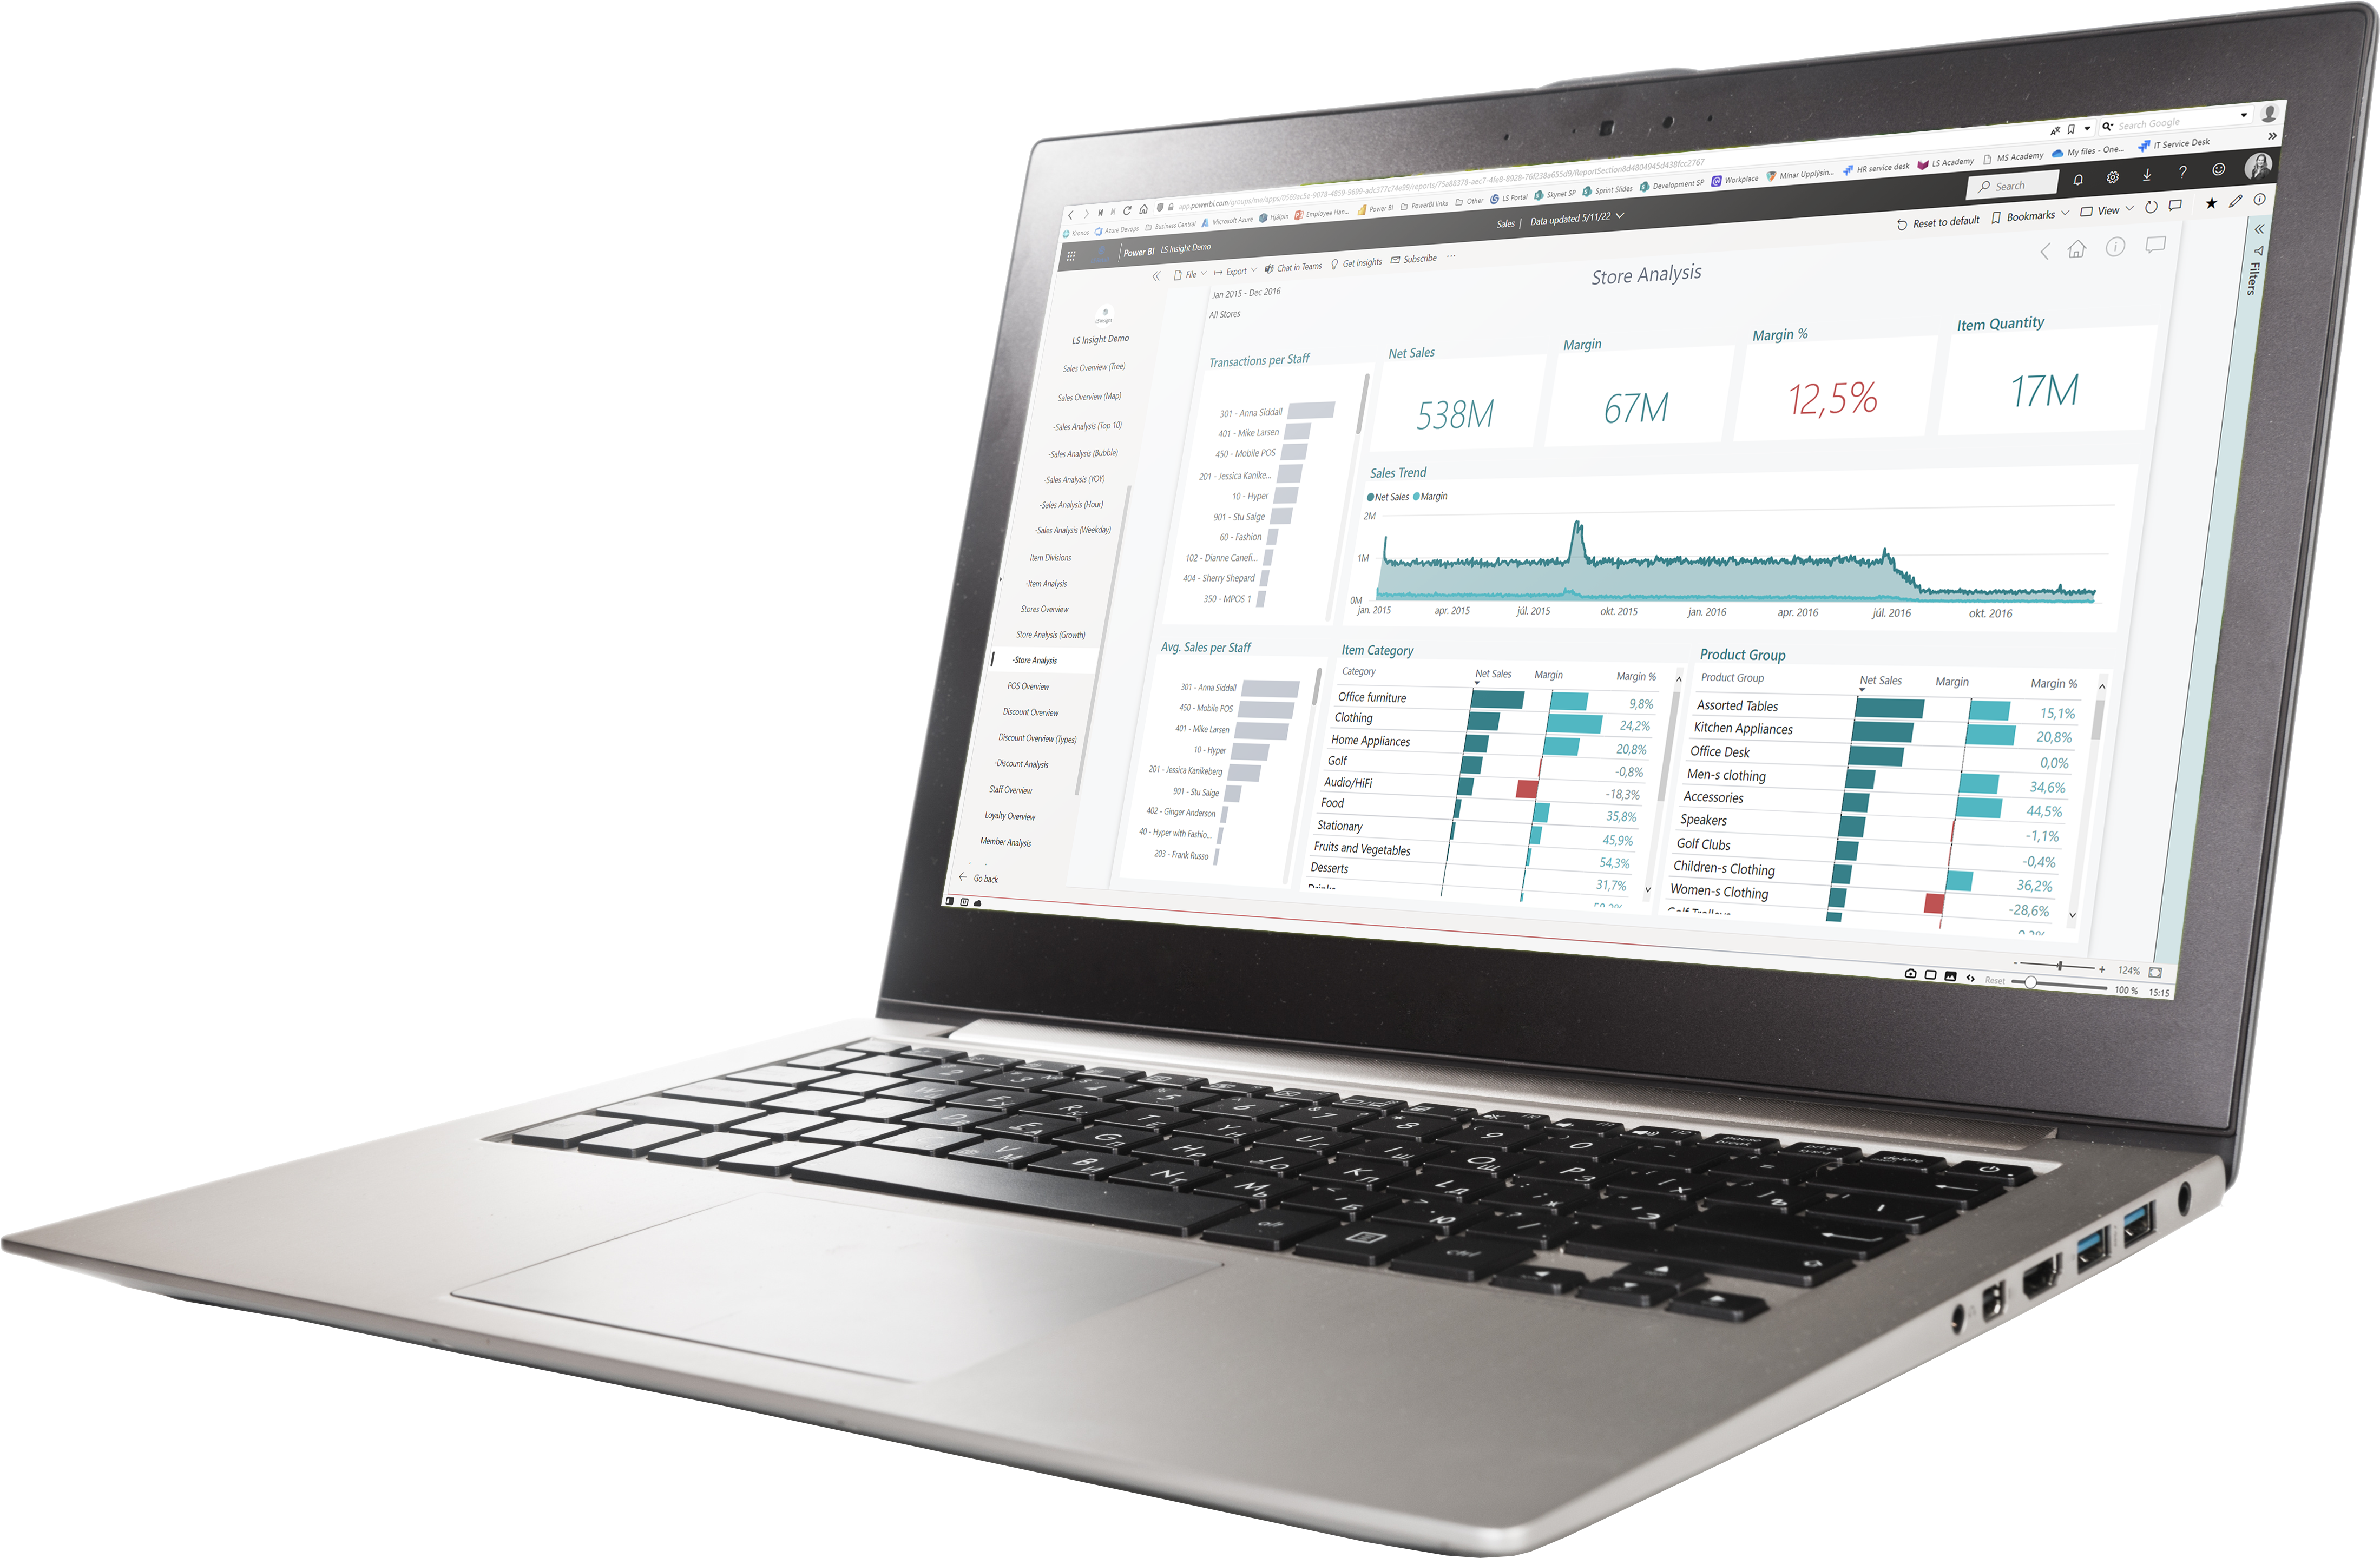
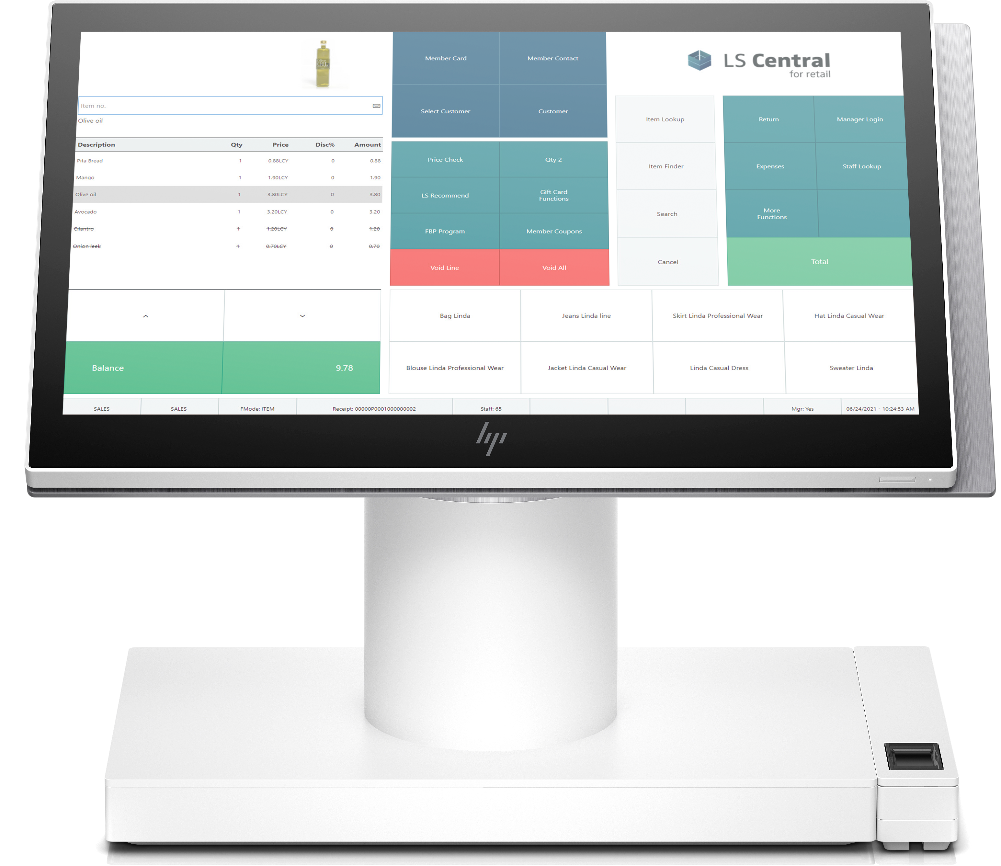

versus
Sales Meals / BOM
Replenishment (Ingredients / Components)

Slide 31


Scenarios
Recipe/BOM centric
Make to Order (QSR; Sell and produce on the fly; E.g. Burger)
Make to Stock (Produce in advance with Assembly Orders; E.g. Cake)
Plan driven (Canteens / Event business; produce and purchase in advance with daily or weekly plans)
Ingredient/Component centric (no recipes) – Fine Dining
Inventory driven (refill ingredient inventory based on stock level)
Sales driven (refill ingredient inventory based on ingredient sales history or consumption)
I am an artist !!
Recipes are for beginners ☺

Slide 32

Replenishment calculation
BOM
Components
Component (Beef Patty)
Bun
Beef Patty
Bacon
Onion
Tomato
Cheese
Salad
Cucumber
Ground Beef
Salt
Pepper
Vendor 1
Bacon, Beef
Component Replen. Journal
BOM Replen. Journal
Vendor 2
Tomato
Salad, …
Component Replen. Journal

Slide 33
Live Demo

Slide 34

Is this functionality for Hospitality only ?

Slide 35

Status
Recipe/BOM centric
Make to Order
Make to Stock
Plan driven
Ingredient/Component centric
Inventory driven
Sales driven
Planned release Q2 2023

Slide 36

What happened to LS Forecast ?

Slide 37

LS Forecast
Forecast calculation
Advanced calculation logic
LS Forecast
Master data Sales history
Forecast results
Replenish-ment
LS Central

Slide 38
LS Forecast
Advanced calculation logic
Master data Sales history
Forecast results
Replenish-ment
LS Central

Slide 39
LS Forecast
3rd party Forecasting Engine
Forecast calculation
Advanced calculation logic
Master data Sales history
Forecast results
Replenish-ment
LS Central

Slide 40
LS Forecast
3rd party Forecasting Engine
Improved integration options
Forecast calculation
Advanced calculation logic
Master data Sales history
Forecast results
Replenish-ment
LS Central

Slide 41

The future
Out-of-Stock Management improvements
Improved calculation process
Better presentation of results
Multi-Warehouse Replenishment
Improved processes for scenarios with multiple warehouses
Secondary warehouses for items
Warehouse to warehouse transfers
Season Management
End of season management (carry-overs)
Mass data management
Further performance improvements & process enhancements

Slide 42
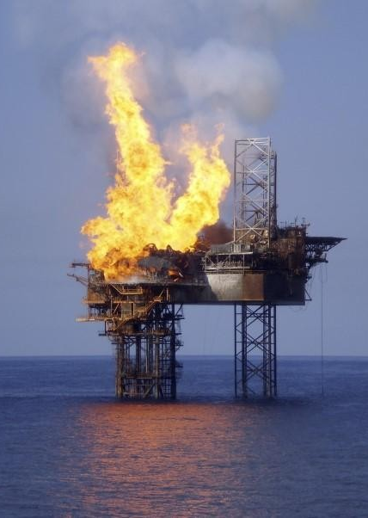
Burning platform
SaaS customer
Cosmetics
118 Stores/Locations
18.000 Items
Approx. 27.000 POS Transaction lines / day
Replen. calculation: 7 hours plus manual review
Replenishment calculation
From 7 hours down to 1,5 hours (with 4 parallel processes)
Implementation time: 10 minutes

Slide 43

UNLEASH the
speed of
Hanuman
in your Replenishment installation

Slide 44
Your Questions please! (or feedback ☺)

Slide 45
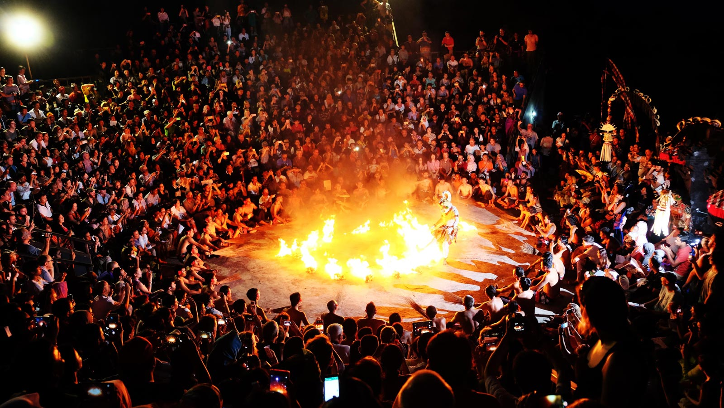
Kecak Dance Uluwatu Temple, Bali

Slide 46
Thank you

