Slide 1
(We will start 2 minutes after the full hour)

Slide 2


Martin Kleindl
LS Forecast
Advanced sales forecasting for LS Central
Product Director
Martin.Kleindl@LSRetail.com

Slide 3


Data

Slide 4
Unified Commerce infused with intelligence

Slide 5

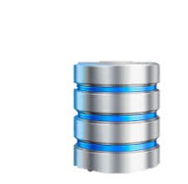
LS Intelligent Cloud
Solution portfolio
LS Recommend
LS Forecast
LS Insight
LS Central

Slide 6


Slide 7
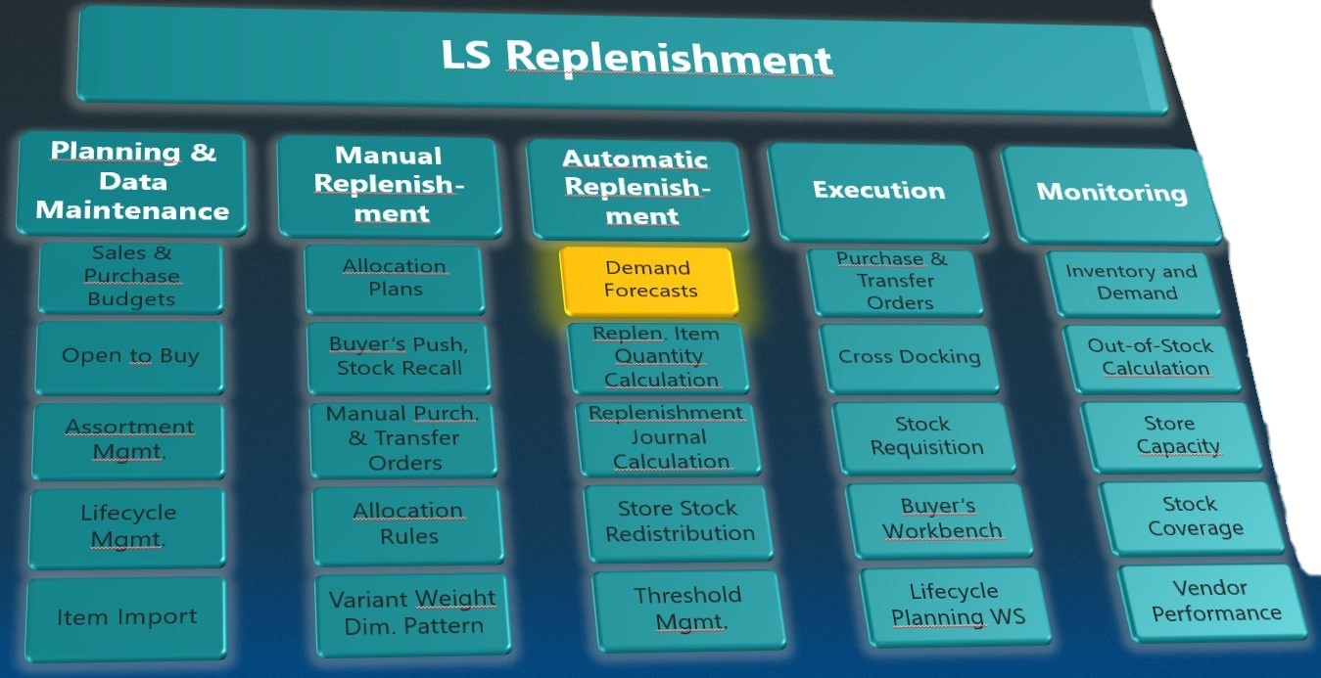
LS Forecast
Goals:
Advanced statistical methods
Turn-key solution seamless fit into Replenishment
No data scientists/experts needed
Low entry level SaaS, Pay per use
Advanced demand forecasting for everyone

Slide 8
Automatic Replenishment
Multiple Warehouses
Multiple Calculation Methods
Pull-principle
Warehouse 1
Store 1
Store 2
Store 3
Warehouse 2
Store 4
Store 5
Vendor A
Vendor C
Vendor B
To warehouse with Xdocking
To store
To warehouse
DEMAND

Slide 9
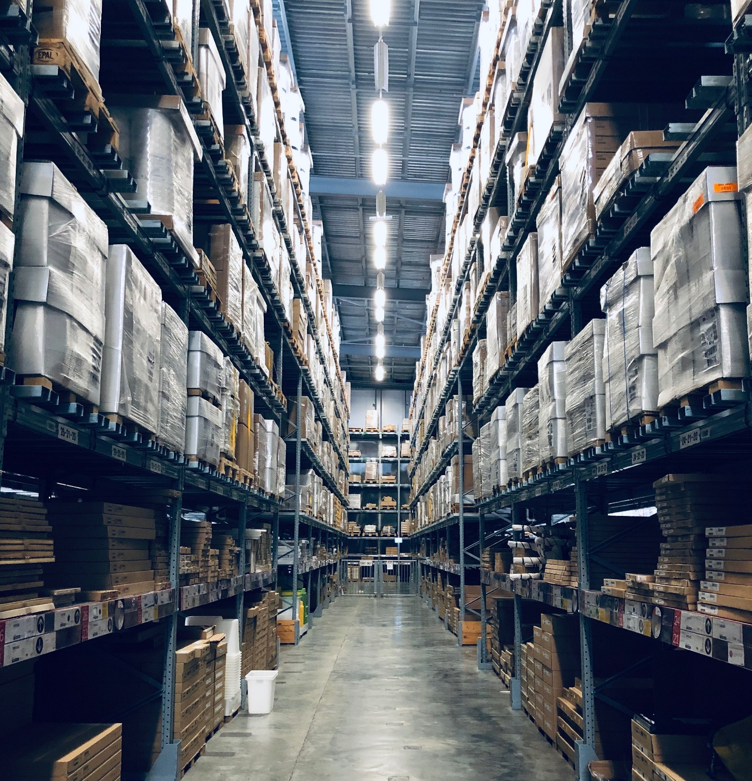
Demand Calculation Methods
Supported methods:
Reorder Point / Max. Inventory
Like for Like
Manual Estimate
Average Usage
Adaptive models
Seasonality (Forward Profiles)
Replenishment Calendars (moving events like Easter)
LS Forecast

Slide 10
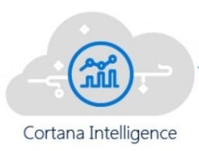
LS Forecast
2. Calculate sales forecast
Cloud based solution to calculate sales forecasts from sales history
SaaS solution, hosted by LS Retail
Built on Microsoft‘s Cortana Intelligence Suite
Available for LS Central 16.00 (AL), 14.03 (C/AL)
LS Forecast
1. Upload sales history (via LS Insight)
3. Download sales forecast (Webservices)
LS Central
4. Calculate replenishment

Slide 11
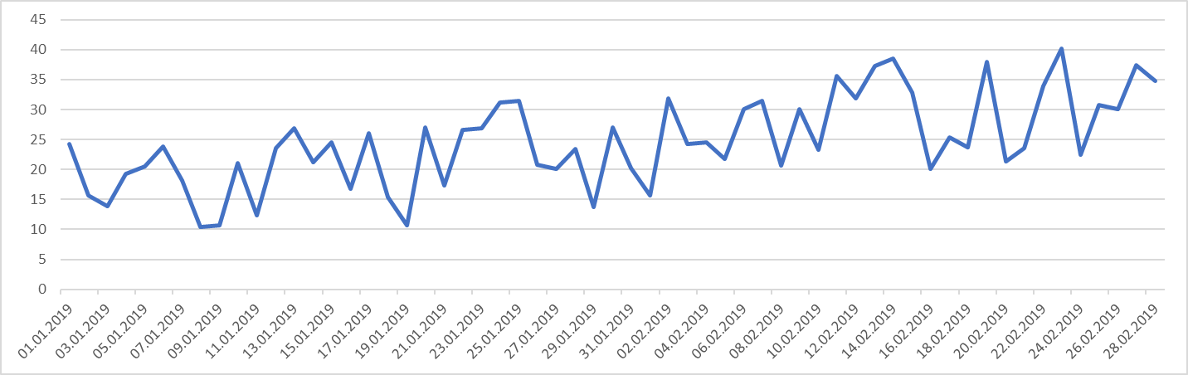
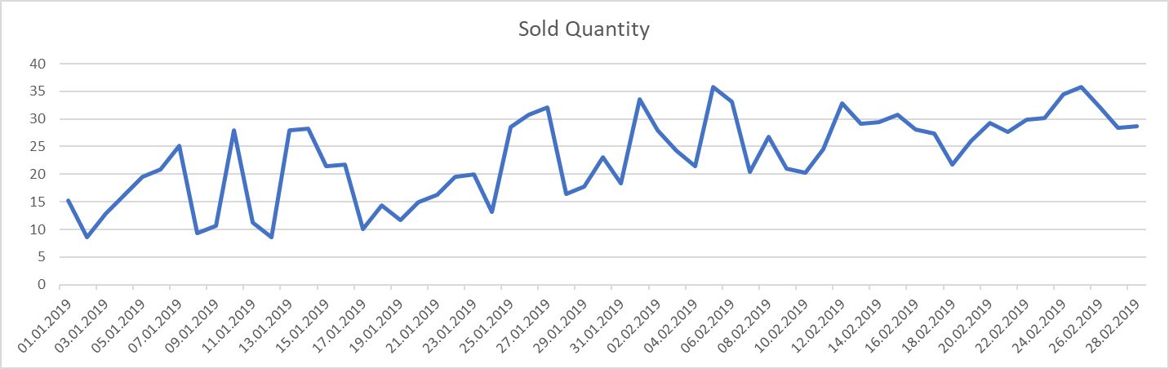
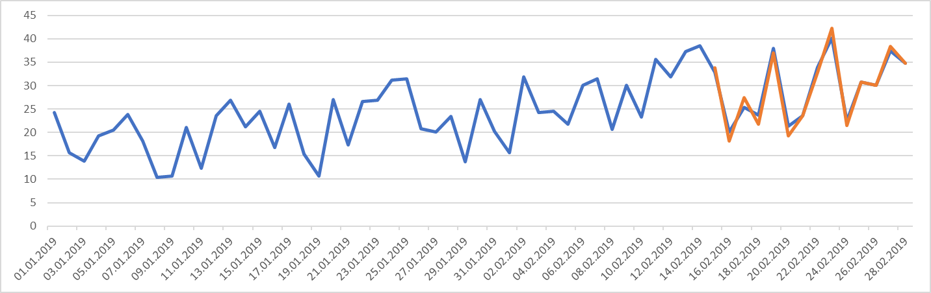
LS Forecast
LS Forecast selects the best model from these model families:
Additive Blended
Multiplicative Blended
Arima
Seasonal Arima
Alternatively, you can specify the model (in LS Central) manually to reduce calculation time.
80%
20%

Slide 12
LS Forecast
LS Forecast
LS Forecast considers the following data:
Item Ledger Entries
Sales history
Sales History Adjustments
Sales history corrections
Simulated sales history
Out-of-Stock Entries
Abnormal sales days
Calculation is always on most detailed level (Item, Variant, Location and Date)
LS Insight
Item Ledger Entries
Sales Hist. Adjustment
Base setup
Out of Stock Days
Items, Locations

Slide 13
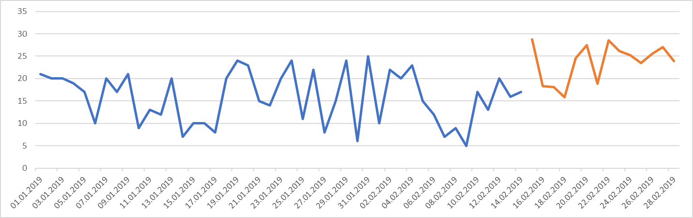
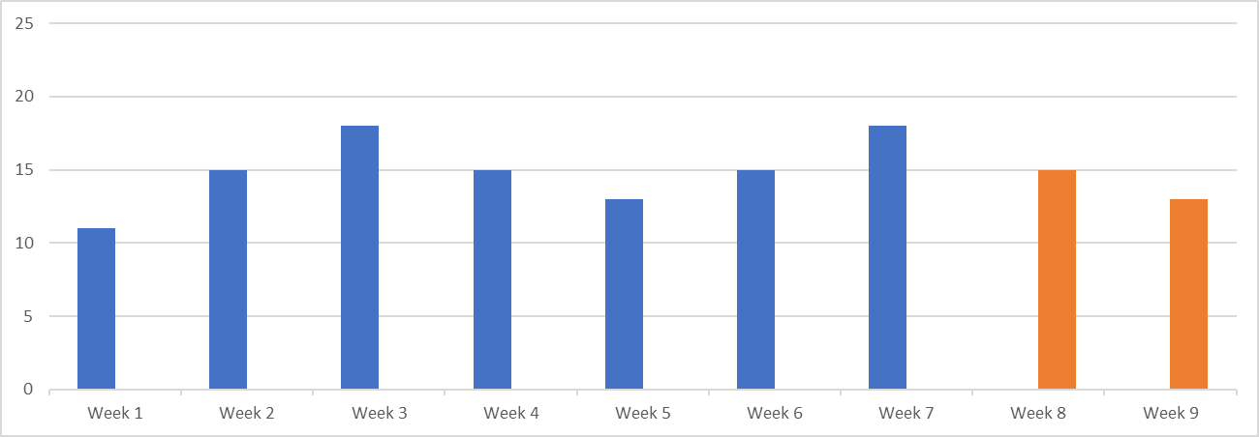

LS Forecast
Forecast granularity Specifies the detail level of the forecast output.
Day level
Week level
Forecast frequency Specifies how often the forecast is calculated.
Daily
Weekly
Bi-weekly
Monthly
Days
Weeks

Slide 14
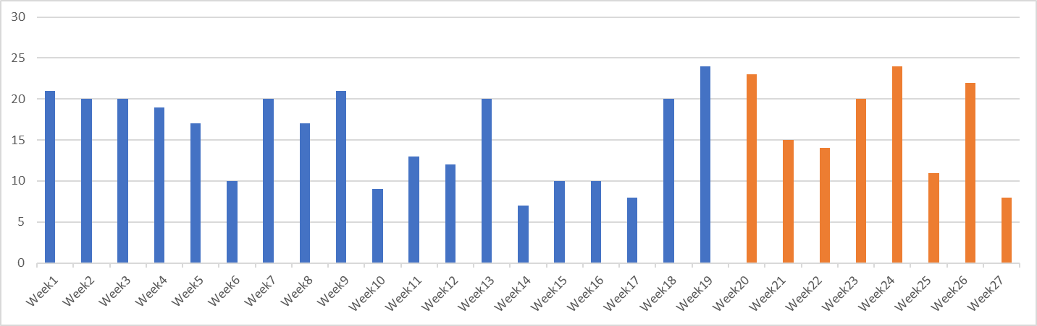
LS Forecast
LS Forecast Batch
Groups items based on
Division
Item Category
Retail Product Group
Item
Defines calculation granularity (day/week)
Defines calculation frequency
Bread
Dairy
Batch “A”
Fruits
DVD
MP3 Player
Speaker
Batch “B”
Day level granularity
Weekly calculation frequency
Week level granularity
Weekly calculation frequency

Slide 15





LS Forecast
Forecast frequency versus Replenishment interval
Replenishment interval
Transfers: depends on store replenishment interval
Purchases: depends on order cycles
Forecast frequency
Depends on item’s sales patterns
Forecast frequency ≥ Replenishment interval
Weekly forecast frequency is sufficient for most items
Replen. interval
Forecast frequency
Vendors
Purchase Replen. Journals
Forecast Calculation
Warehouse
Transfer Replen. Journals
Store

Slide 16
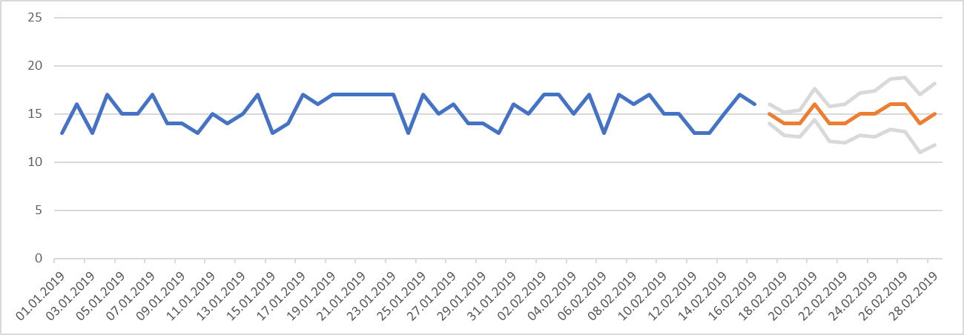
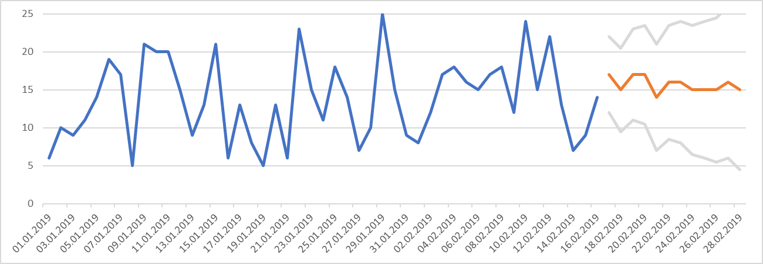
LS Forecast
Forecast accuracy Specifies the trustworthiness of a forecast
Based on confidence intervals
KPI for forecast quality
stable
volatile

Slide 17
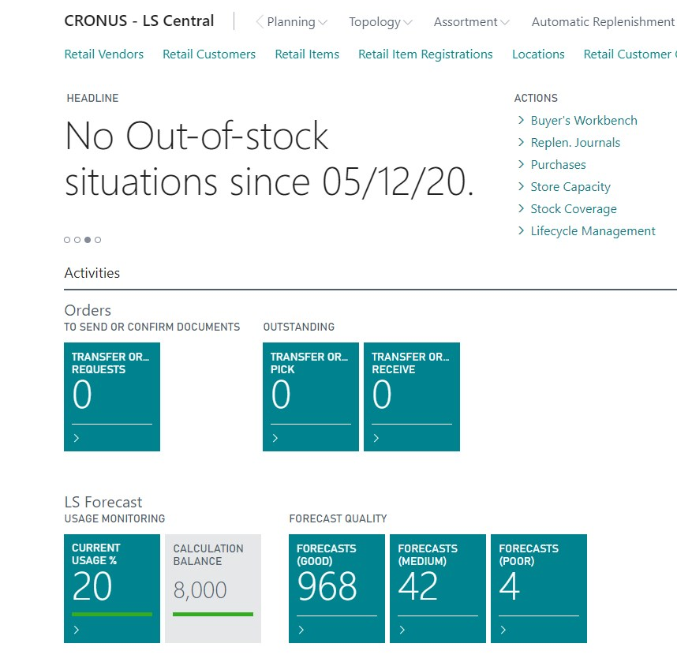
LS Forecast
Forecast accuracy Specifies the trustworthiness of a forecast
Based on confidence intervals
KPI for forecast quality
stable
volatile

Slide 18
LS Forecast
Forecast accuracy Specifies the trustworthiness of a forecast
Based on confidence intervals
KPI for forecast quality
Safety stock calculation
stable
volatile

Slide 19
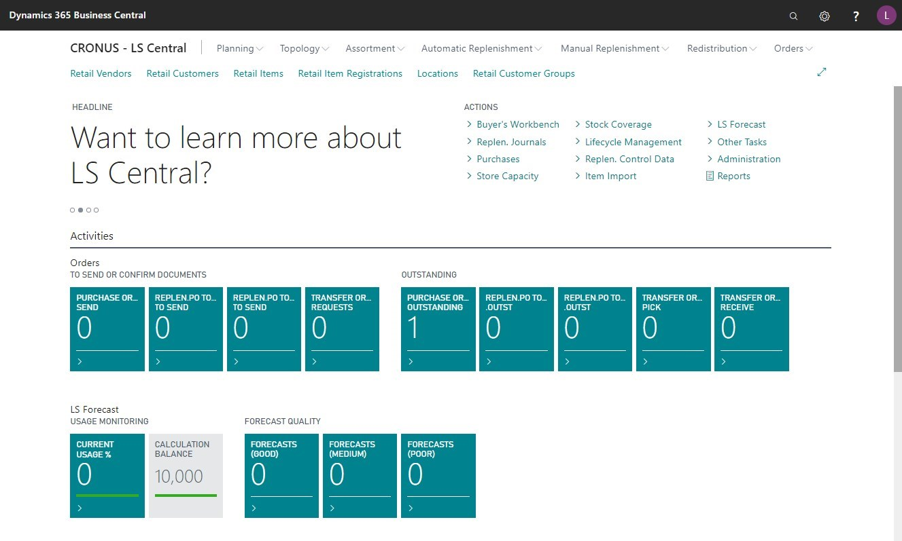
LIVE DEMO
LS Forecast

Slide 20
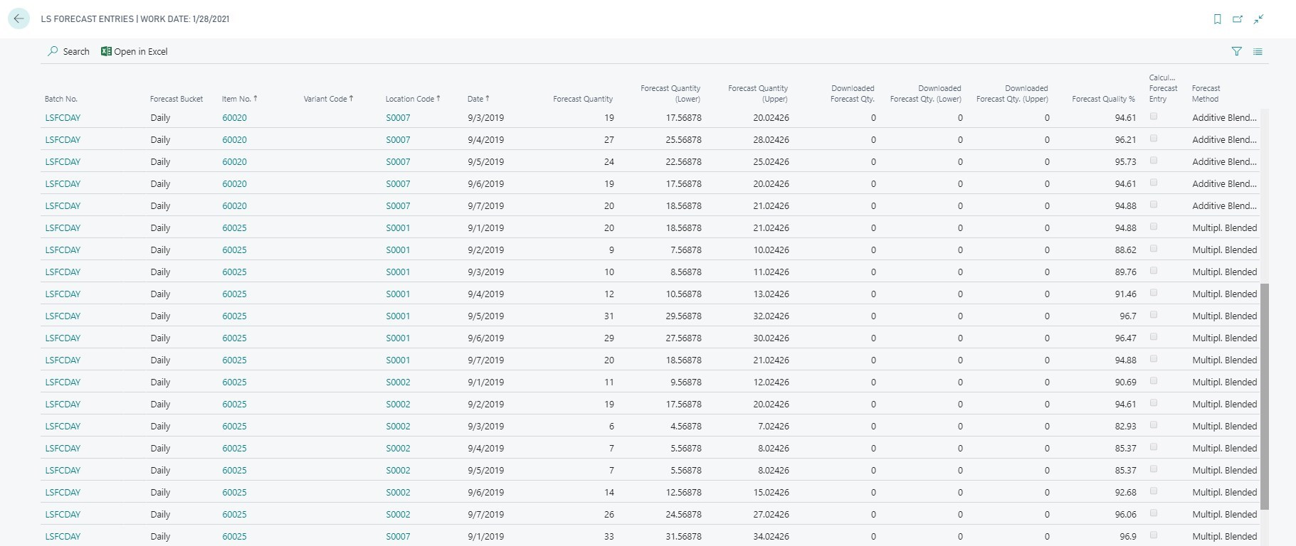
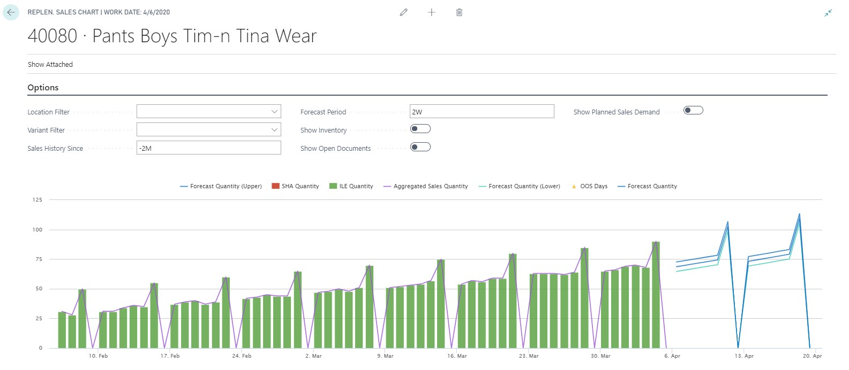
Forecasted Quantity
Forecast Quality
Selected Method
Peak on Sat, Closed on Sun
LS Forecast - Results

Slide 21
Peak on Sat, Closed on Sun
LS Forecast - Chart

Slide 22
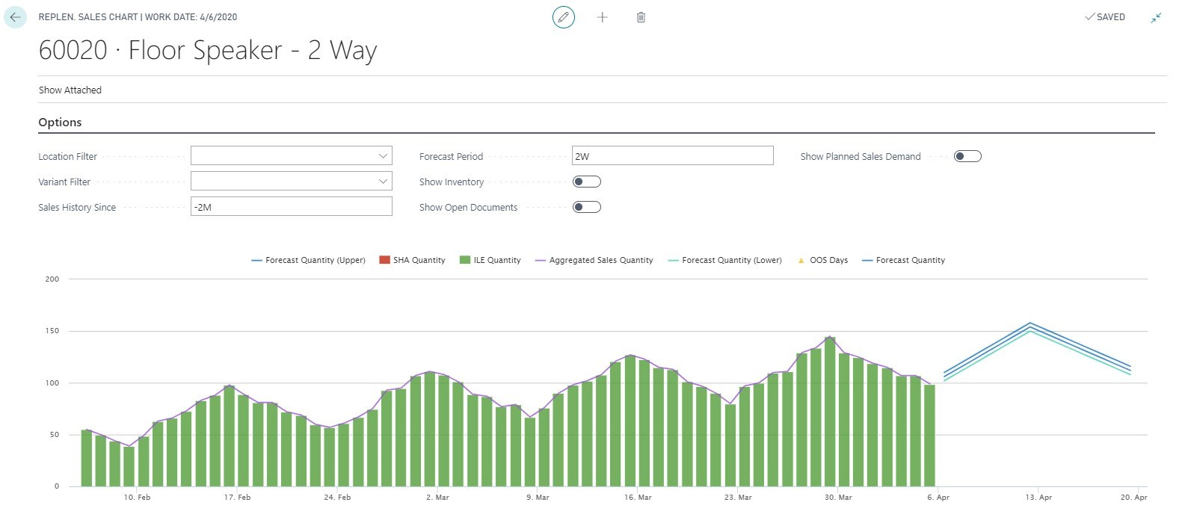
Trend plus fast seasonal effect
LS Forecast - Chart

Slide 23
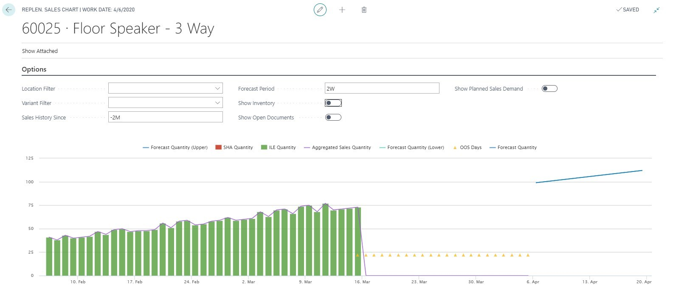
Out of stock days
LS Forecast - Chart

Slide 24
How do I get started?

Slide 25
Implementation
Steps
Prerequisites:
LS Insight installed
Automatic Replenishment set up
LS Forecast Ordering & Setup:
Order LS Forecast
Setup of Cloud Environment [LS Retail, ½ day]
Setup of LS Forecast in LS Central [~½ day]
First calculation and Review:
Manual data upload, calculation, results download and review of selected items
Go Live:
Activation of Scheduler based upload, calculation and download
LS Insight Replen. Setup
LS Forecast Setup
First Calculation and Review
Go Live

Slide 26
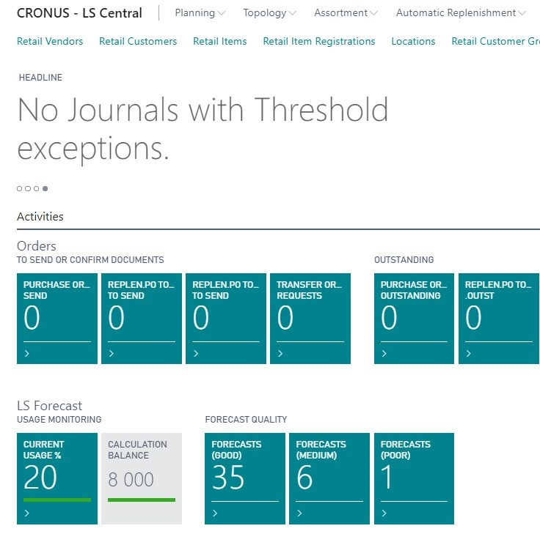
LS Forecast
Price Model
Consumption based
Billing at the end of month
Based on Forecasted SKU per month
No calculation → no cost
Packages of 10.000 Forecasted SKUs
LSFC Base pack (first 10.000 calculations)
LSFC Additional pack (10.000 calculation)
LSFC Partner evaluation pack (for test, demo; max. 5000 calc.)
Item / Variants
Locations
Calculations per month
Forecasted SKU per month

Slide 27
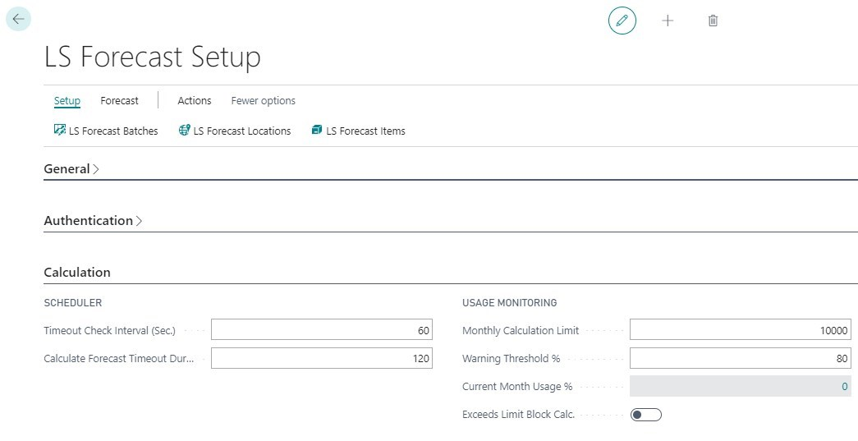
LS Forecast
Calculation cap
LS Forecast calculation can be capped to a monthly limit.
System checks, before calculating, if limit will be exceeded.
Depending on setup, this will raise a warning or block the calculation process.
System will fall back to Average Usage, if blocked.
LS Forecast – Cost control

Slide 28


Operational improvements
More accurate forecasts
Increase availability and sales
Reduce costly out-of-stock situations
Better view on your data
Interactive sales chart
Low entry risk
No hardware investments
No data scientists/experts needed
Start with few items, add more on the go
Calculation cap
Key takeaways

Slide 29

LS Forecast promotion
One, two, forecast
100% discount for first 2 months on LS Forecast base pack (first 10.000 calculation)
Valid from June 1st to December 28th
For LS Central customers on active enhancement plan or subscription
Promo code: LSFORECAST2002

Slide 30
Questions ?
Martin.Kleindl@LSRetail.com

Slide 31
Martin.Kleindl@LSRetail.com

