Slide 2

LS Forecast
make your implementation
a success!
Martin Kleindl
Product Director
Martin.Kleindl@LSRetail.com

Slide 3

Goal for this session
Knowledge transfer
Give you an understanding on LS Forecast
  Purpose / Value
  Base concept & architecture
  How to get started, recent pricelist changes
Showcase LS Forecast from first setup to calculation
Listen to your opinion
Feedback and Questions
Hear from you, what is needed to start selling/using LS Forecast

Slide 4
Knowledge transfer
LS FC overview
LS FC
setup
Setup flow from
A to Z
LS FC
new features
How to choose suitable LS FC items and keep cost low
Other points
Price list changes
Architecture
How to get started
Outlook
Additional Dimensions

Slide 5


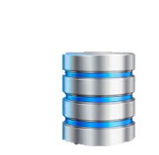
Intelligent Cloud
Suite
New release:
Q1 2022
LS
Recommend
LS
Forecast
LS
Basket Analysis
LS Insight
(Datawarehouse & Analytics)
LS Central (ERP)

Slide 6


Slide 7
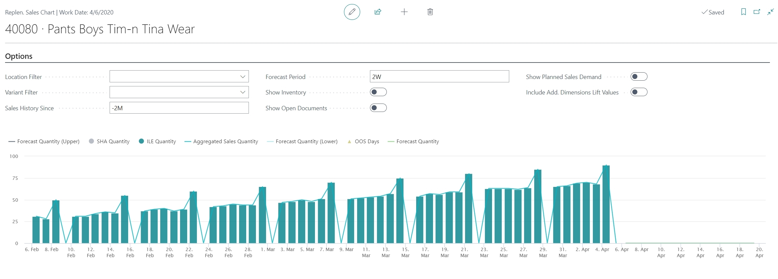
Sales History
Forecast
with
Quality measurement

Slide 8
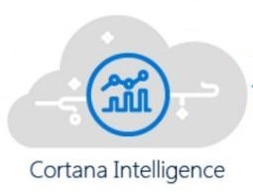
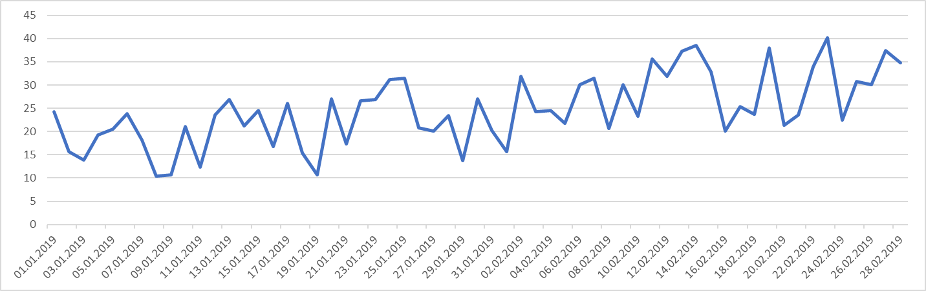
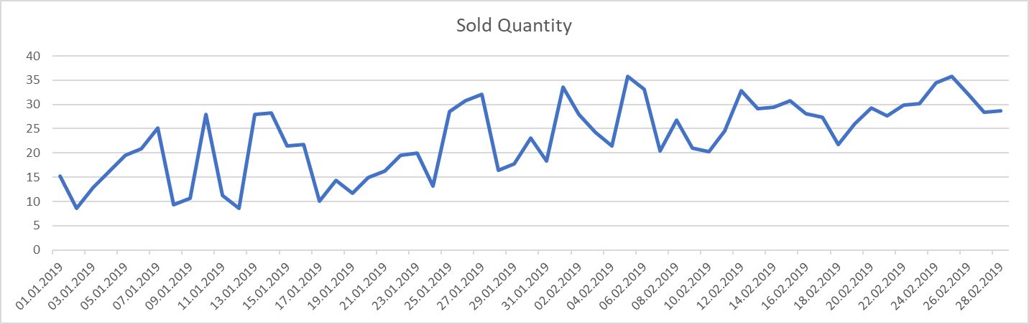
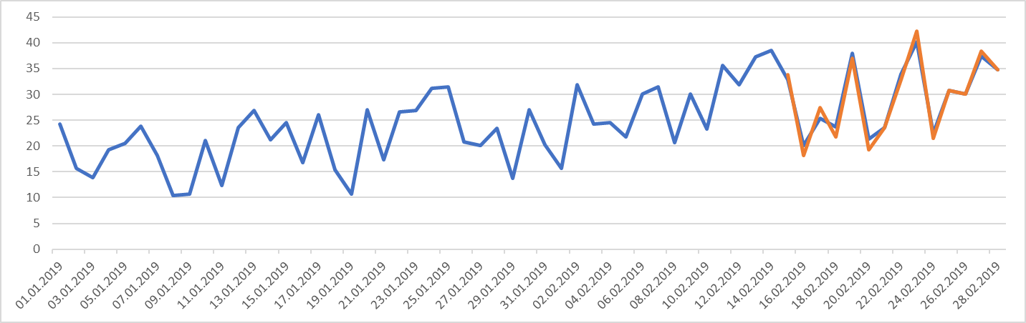
LS Forecast
LS Forecast selects the best model
from these model families:
Additive Blended
Multiplicative Blended
Arima
Seasonal Arima
Alternatively, you can specify
the model (in LS Central) manually
to reduce calculation time.
80%
20%

Slide 9
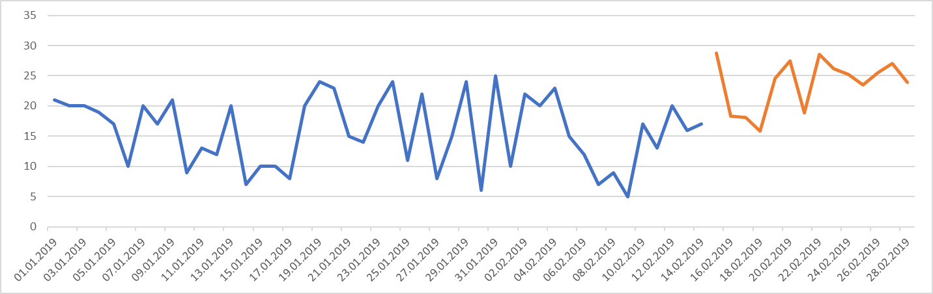
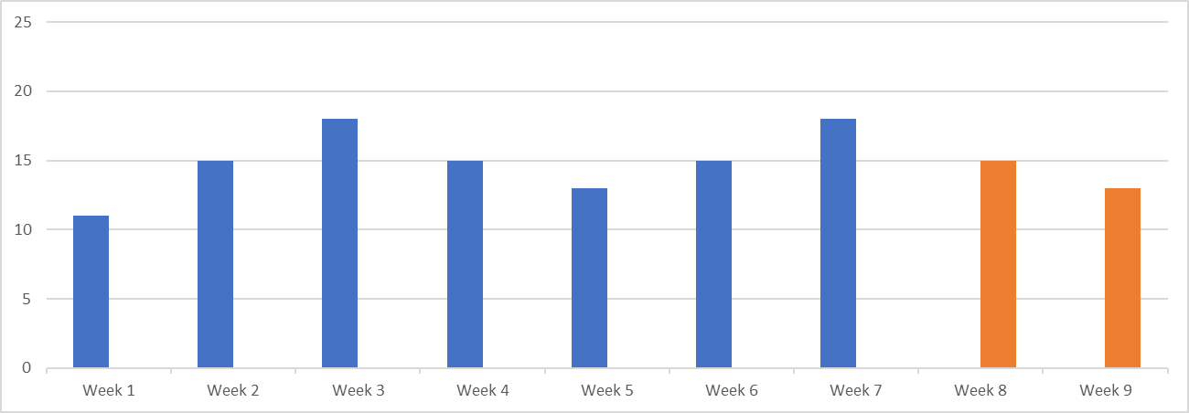

LS Forecast
Forecast granularity
Specifies the detail level of the forecast output.
  Day level
  Week level
  Month level
Forecast frequency
Specifies how often the forecast is calculated.
  Daily
  Weekly
  Bi-weekly
  Monthly
Days
Weeks
Month

Slide 10
LS Forecast Architecture
Sales History
Calculate
Calculated Forecast
LS Forecast
Master Data
Webservices
Sales History
LS Insight
Azure Data Factory Upload
Sales History Adjustment
(SHA)
Out of Stock Days
(OOS)
Synchronize
Call:
Calculate
Forecast
Call:
Download Forecast
LS Forecast Entries
Master Data
Batches
Items
Locations
LS Central
Item Ledger Entries
(ILE)
Call:
Check Calculation Status

Slide 11
LS Forecast
LS Forecast:
Turn-key solution
Seamless integration
with Replenishment
No data scientists/experts
needed
Advanced
demand forecasting
for everyone
LS Replenishment
Planning & Data Maintenance
Manual Replenish- ment
Automatic Replenish- ment
Execution
Monitoring
Sales & Purchase Budgets
Allocation
Plans
Buyer‘s Push,
Stock Recall
Allocation Rules
Variant Weight Dim. Pattern
Demand Forecasts
Store Stock
Redistribution
Purchase & Transfer
Orders
Stock Requisition
Buyer‘s Workbench
Inventory and Demand
Store
Capacity
Stock Coverage
Vendor Performance
Open to Buy
Assortment Mgmt.
Lifecycle Mgmt.
Replenishment Journal Calculation
Threshold Mgmt.
Lifecycle Planning WS
Cross Docking
Manual Purch. & Transfer Orders
Replen. Item Quantity Calculation
Out-of-Stock Calculation
Item Import

Slide 12
LS Forecast - Implementation
First calculation and Review:
Manual data upload, calculation,
results download and review of selected items
Go Live:
Activation of Scheduler based upload, calculation and download
Steps
Prerequisites:
LS Insight installed
Basic Automatic Replenishment set up
LS Forecast Ordering & Setup:
Order LS Forecast
Setup of Cloud Environment [LS Retail, ½ day]
Setup of LS Forecast in LS Central [~½ day]
LS Insight
Replen. Setup
LS Forecast Setup
First Calculation and Review
Go Live

Slide 13
Knowledge transfer
LS FC overview
LS FC
setup
Setup flow from
A to Z
LS FC
new features
How to choose suitable LS FC items and keep cost low
Other points
Price list changes
Architecture
How to get started
Outlook
Additional Dimensions

Slide 14

LS Forecast in LS Central
LS Forecast Setup Steps
Basic setup & connection
Master Data Setup
  Batches
  Locations
  Items
Synchronization
Forecast calculation

Slide 15
Live Demo
how to set up , synchronize master data
and run forecast calculations

Slide 16
LS Forecast Architecture
Sales History
Calculate
Calculated Forecast
LS Forecast
Master Data
Webservices
Sales History
LS Insight
Azure Data Factory Upload
Sales History Adjustment
(SHA)
Out of Stock Days
(OOS)
Synchronize
Call:
Calculate
Forecast
Call:
Download Forecast
LS Forecast Entries
Master Data
Batches
Items
Locations
LS Central
Item Ledger Entries
(ILE)
Call:
Check Calculation Status

Slide 17
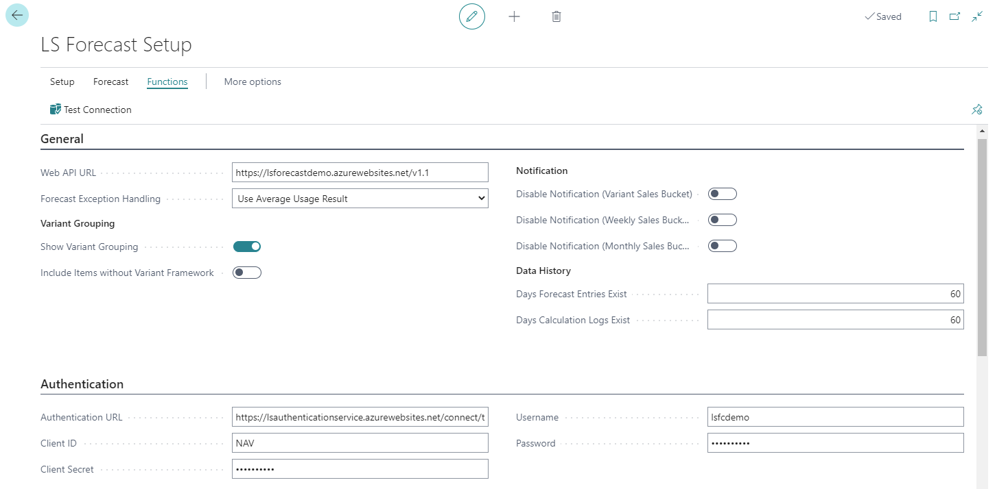
LS Forecast Basic Setup & Connection

Slide 18

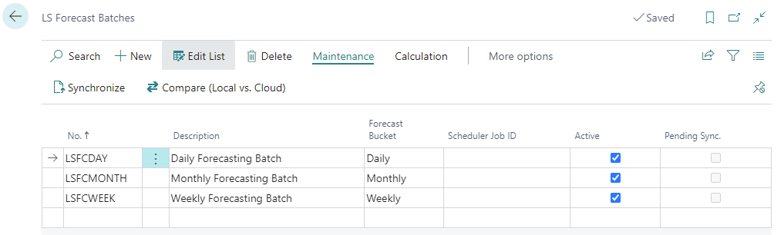
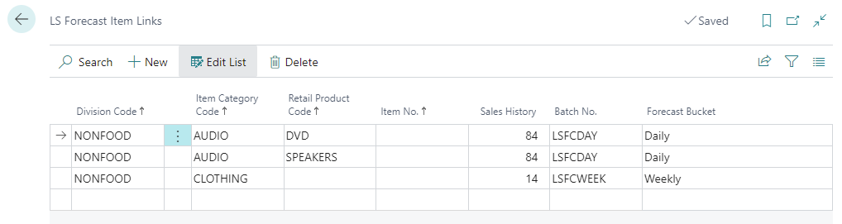
Master Data Setup
LS Forecast Batch
To group items that are forecasted based on similar rules.
LS Forecast Item Links
To map items with LS Forecast Batches.

Slide 19
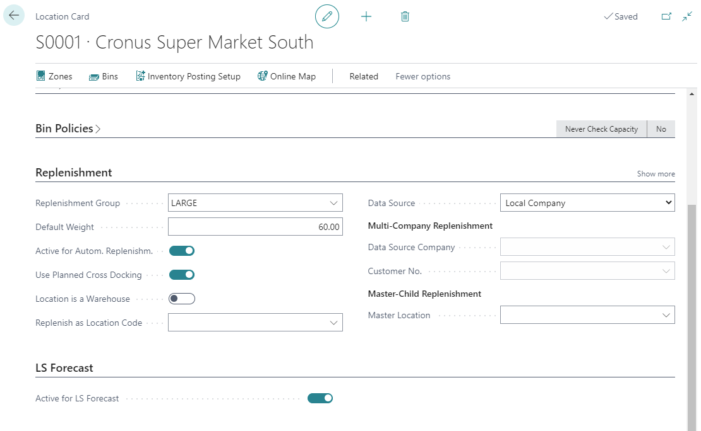
Master Data Setup
Locations
To activate a Location for LS Forecast, the following fields have to be active:
Active for Autom. Replenishm.
Active for LS Forecast

Slide 20
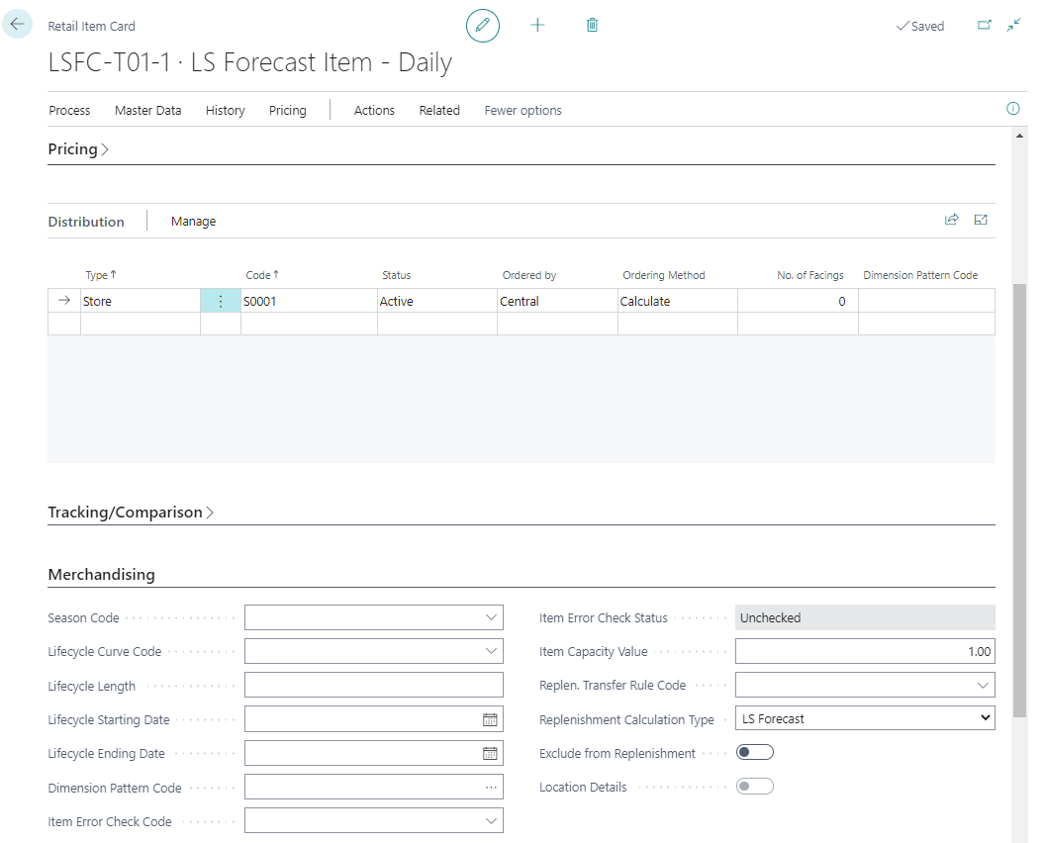
Master Data Setup
Items
To activate an Item for LS Forecast:
Replenishment Calculation Type = LS Forecast
A valid Item Distribution setup.

Slide 21
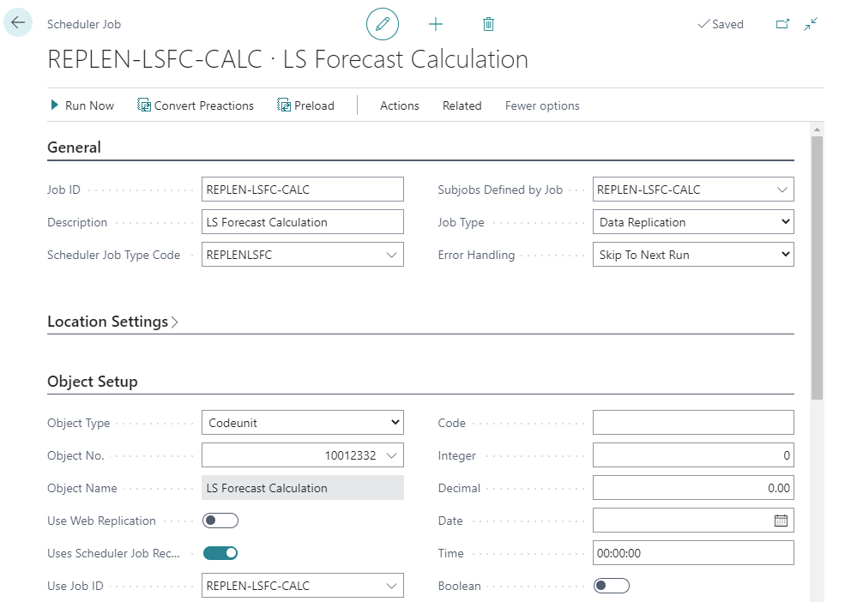
Forecast Calculation
Scheduler based calculation
The scheduler job performs the following steps:
  Master data synchronization
  Forecast calculation
  Download forecast
  Write to LS Forecast Calculation Log
The Master Data Synchronization job can be run separately, to reduce the execution time of the full calculation job.

Slide 22
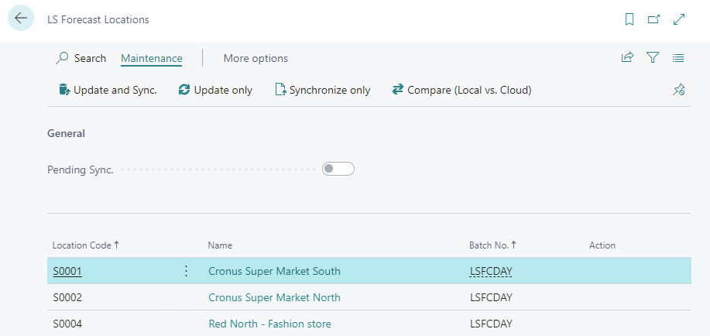
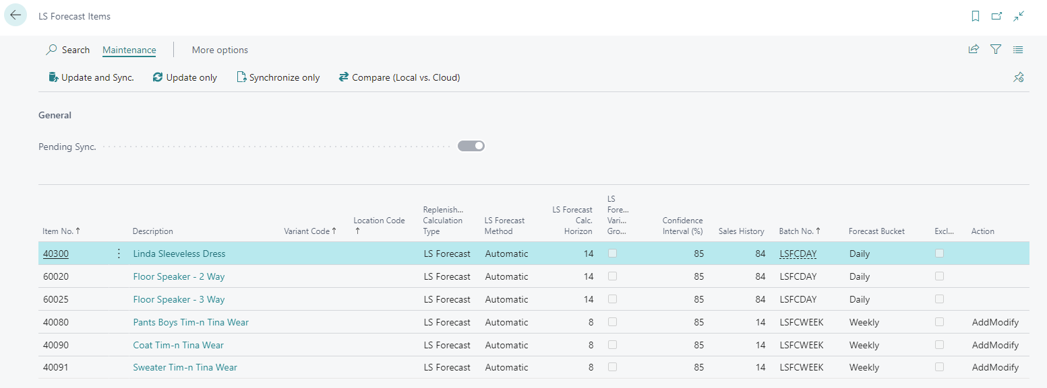
Master Data Synchronization
LS Forecast Locations & Items
Give an overview of the Locations and Items maintained for LS Forecast.
Synchronization with the cloud.

Slide 23
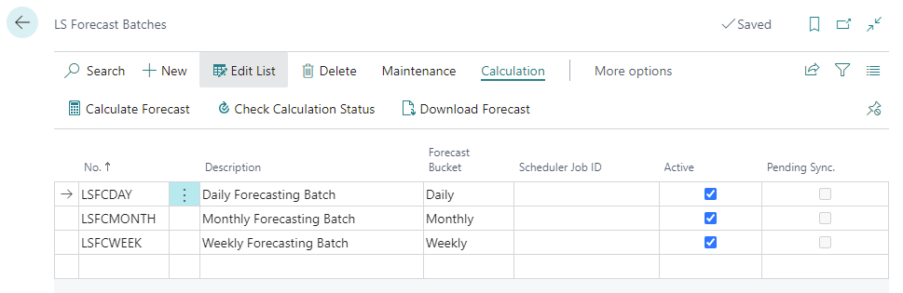
Forecast Calculation
Manual calculation
Trigger the calculation manually from the LS Forecast Batches page.
Calculate Forecast
To initiate forecast calculation for the selected Batch
Check Calculation Status
To give information if the calculation is finished or still running
Download Forecast
To download the results into the LS Forecast Entries table

Slide 24
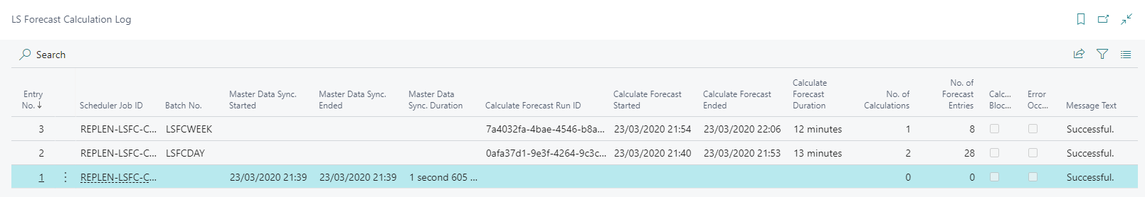
Forecast Calculation
LS Forecast Calculation Log
Calculation details are logged into the LS Forecast Calculation Log

Slide 25
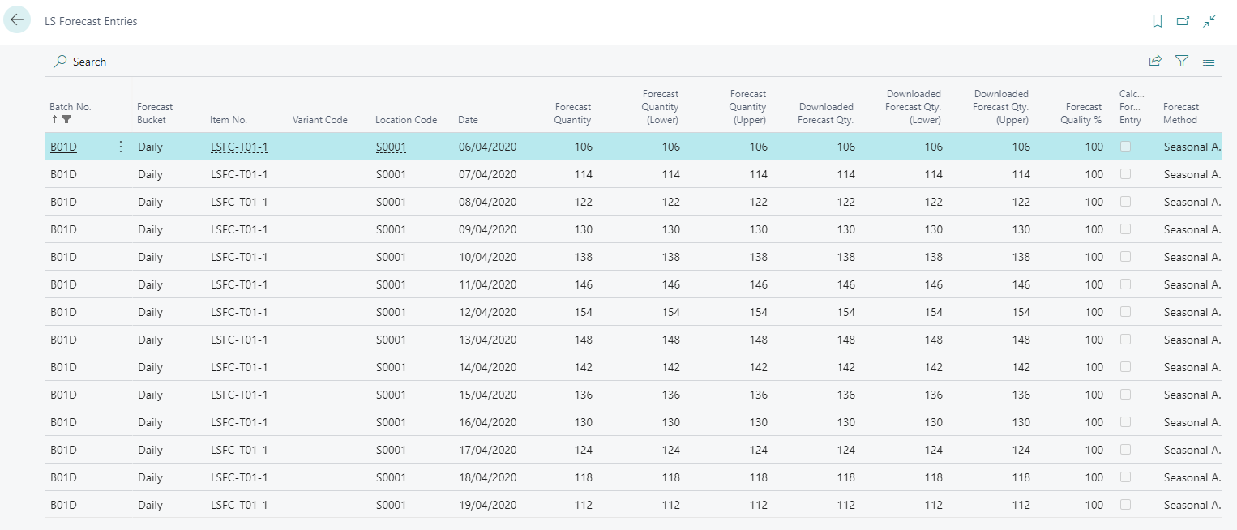
Forecast Calculation
LS Forecast Entries
Calculation results are downloaded to the LS Forecast Entries

Slide 26
Knowledge transfer
LS FC overview
LS FC
setup
Setup flow from
A to Z
LS FC
new features
How to choose suitable LS FC items and keep cost low
Other points
Price list changes
Architecture
How to get started
Outlook
Additional Dimensions

Slide 27


LS Forecast
Item / Variants
Price Model
Consumption based
Billing at the end of month
Based on Forecasted SKU
Cost based on no. of items, locations and
calculations
Big Question:
Which items are good candidates for LS Forecast?
Locations
Calculations per month
“all items” is
Forecasted SKU

Slide 28

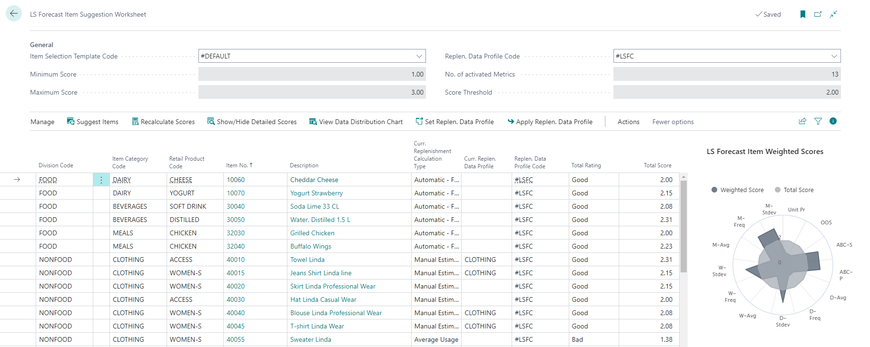
LS Forecast: Item Suggestion Worksheet
Tool for partners and customers
Identify good item candidates
Scorecard approach with weights
Easy, simple, fast
Total Rating
Total Score

Slide 29
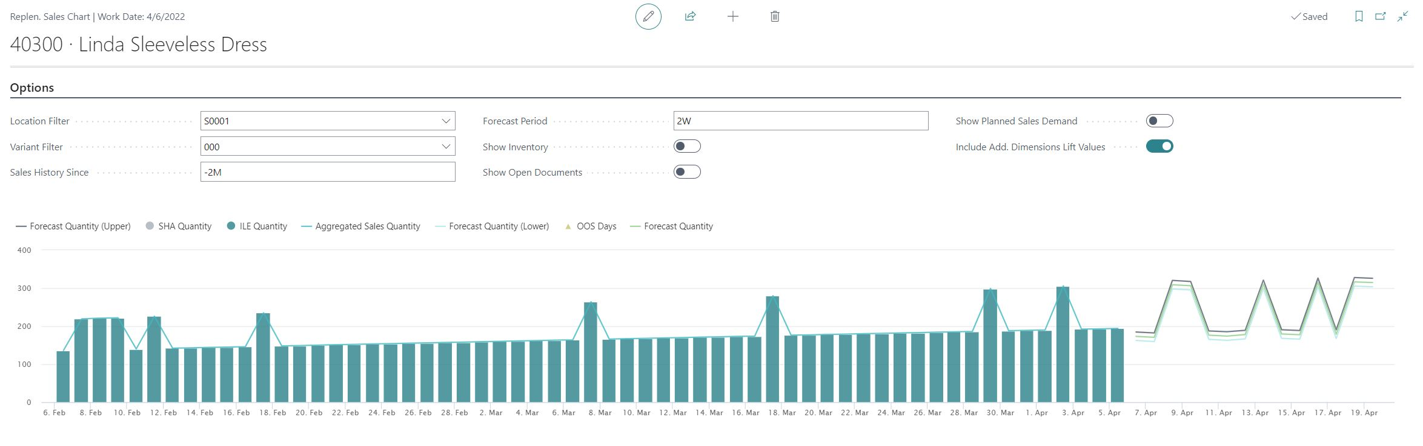
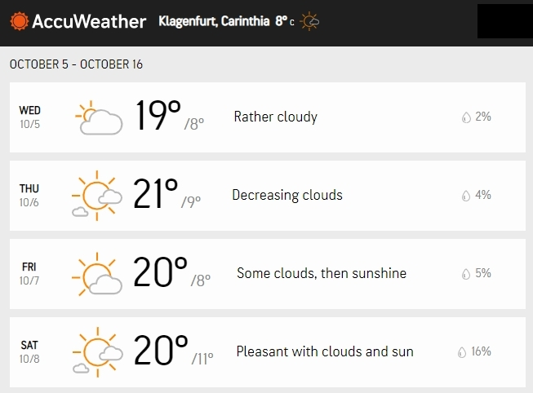
LS Forecast: additional dimensions
Additional dimensions
Affects:
Enables LS Forecast to forecast based on
weather data, etc.
Solution:
Detect dimension patterns
in time series
5 Location based dimensions
2 Item based dimensions
Integration to Replenishment
Out of the Box integration with AccuWeather ☺
Easy to extend for your dimensions

Slide 30
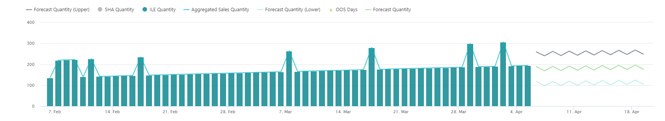
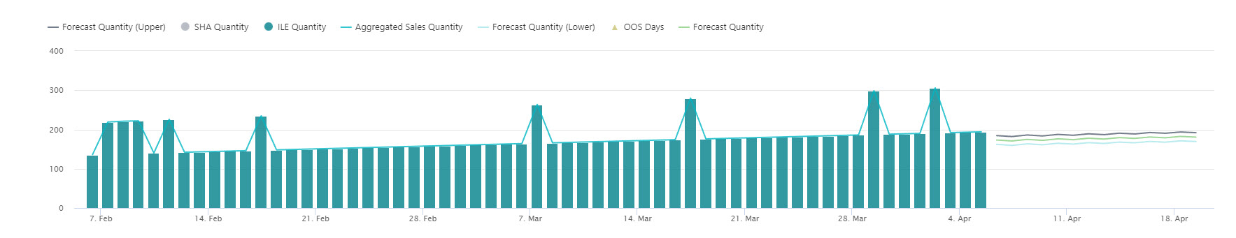
LS Forecast: additional dimensions
40300 – Linda Sleeveless Dress
Without dimension:
RRR R R R R R R
With dimension RAIN:

Slide 31
LS Forecast: additional dimensions
40300 – Linda Sleeveless Dress
Without dimension:
RRR R R R R R R
With dimension RAIN:
RR R R R

Slide 32
LS Forecast: additional dimensions
40300 – Linda Sleeveless Dress
With dimension RAIN and lift values:
RR R R R

Slide 33
LS Forecast: additional dimensions
What we do
RRR R R R R R
RR R R R
New table
for “RAIN”
history
New table
for “RAIN”
forecast

Slide 34
Knowledge transfer
LS FC overview
LS FC
setup
Setup flow from
A to Z
LS FC
new features
How to choose suitable LS FC items and keep cost low
Other points
Price list changes
Architecture
How to get started
Outlook
Additional Dimensions

Slide 35
LS Forecast
Pack | Calculations from | Calculations to | Price per 1000 calc.
LSFC-10k | 1 | 10.000 | 5,99 €
LSFC-50k | 10.001 | 50.000 | 2,98 €
LSFC-100k | 50.001 | 100.000 | 2,49 €
LSFC-500k | 100.001 | 500.000 | 1,80 €
LSFC-1M | 500.001 | 1.000.000 | 1,20 €
New price model
Old approach:
  Total number of calculations within 1 month
New approach:
  Stepwise model
  Pack (and price) is
  selected for each
  individual calculation
Calculation
(3.000)
Calculation
(18.000)
Calculation
(18.000)
1.4.
30.4.
Pack LSFC-10k
3 * 5,99€ = 17,97€
Pack LSFC-50k
18* 2,98€ = 53,64€
Pack LSFC-50k
18* 2,98€ = 53,64€

Slide 36

The future
LS Insight
New report packs
Alternative approach for data load (via Azure Data Lake)
LS Forecast
Generic forecasting
LS Recommend
Improvements based on your feedback
LS Basket Analysis
Basket analysis solution to calculate correlations in sales history
Will affect:
- Assortment decisions
- Promotions and Discount Offers

Slide 37
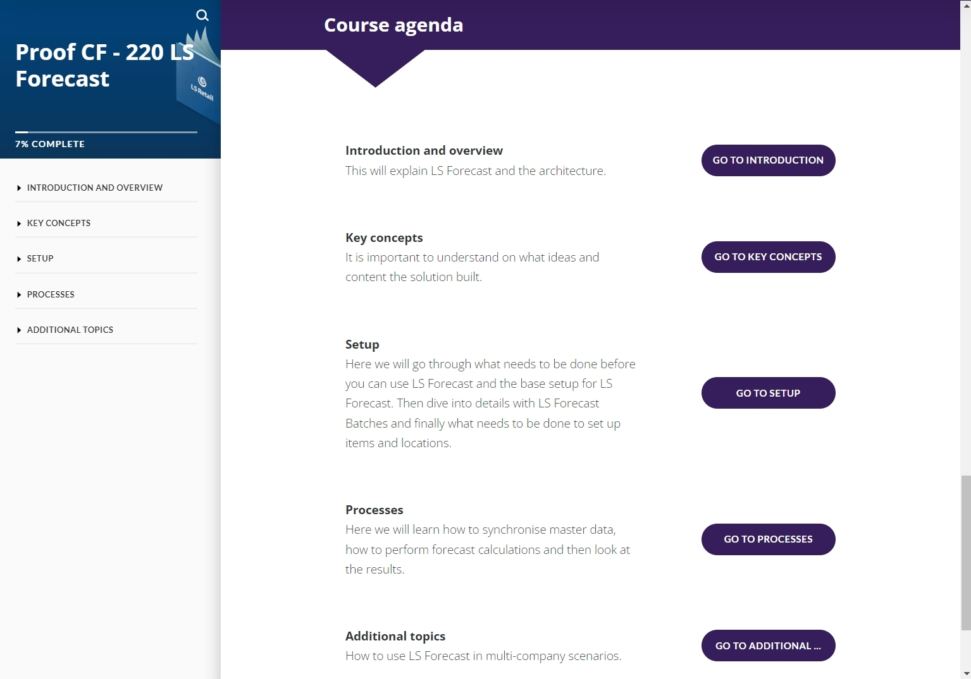
LS Forecast
Training
LS Retail Academy on-demand course
  Self paced
  Videos, explanations, exercises
  Exclusive LS Forecast training tenant
  From concept to setup and forecasting
Trainer led course (online, 4hrs)

Slide 38
Feedback, Questions
and
Discussion

