Slide 1
eCommerce for LS Central
Part I
Petur Thor Sigurdsson
Product Director

Slide 2






Our product strategy is Unified Commerce
Financials
& budgeting
Inventory & warehouse management
Map of locations with directions
Sales & marketing
Consumer experience
Personal, personalized
Business processes
Easier, simpler, faster
Reporting & analytics
Human resource management
Personalized offer and notifications
Store/POS configuration
%
Price, offer, coupon management
Mobile loyalty on various devices
Replenishment
eCommerce
& mobile
✓
Loyalty management
Social Media
Staff interactions with cross/up-sell
Business insights
Drive actions that improve customer service
Easy-to-use POS/mobile POS
Global cloud service
Providing our customers the option of the SaaS/cloud
Ordering & transfers
End-of-day
cash management
Stock management

Slide 3






eCommerce
POS
Master Data
Store Inventory
Point of Sale
Basket Calculation
Hospitality
Customer Loyalty
Click & Collect
Customer Orders
Transaction Repository
Token Vault
Gift Cards
Activity
KDS
Pharmacy
+
+

Slide 4

eCommerce API
Commerce Service for LS Central

Slide 5

eCommerce API
Commerce Service for LS Central

Slide 6
Traditional UI
Progressive Web App (PWA)
eCommerce API
Commerce Service for LS Central

Slide 7




Eco system: Available Payment Plugins
Payment Service Provider
(PSP)
Point of Sale
Transaction Repository

Slide 8
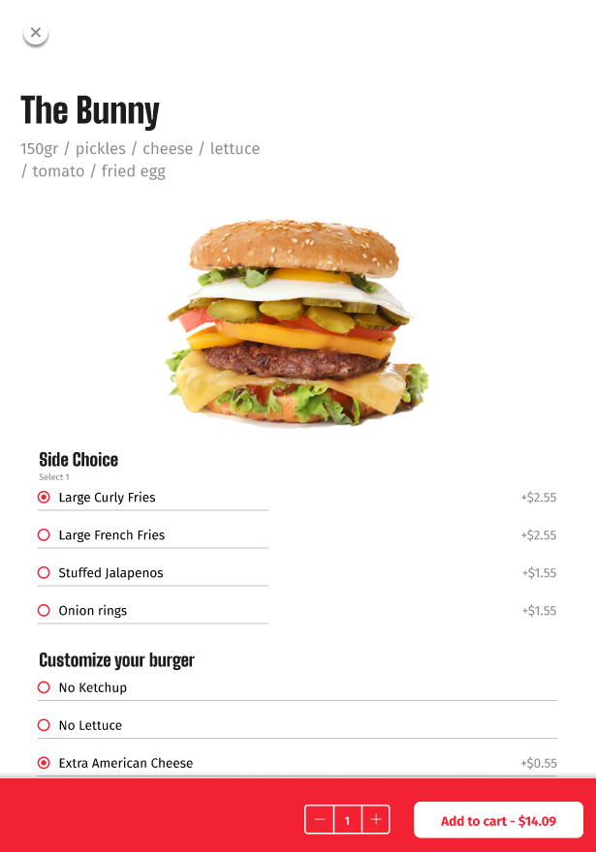
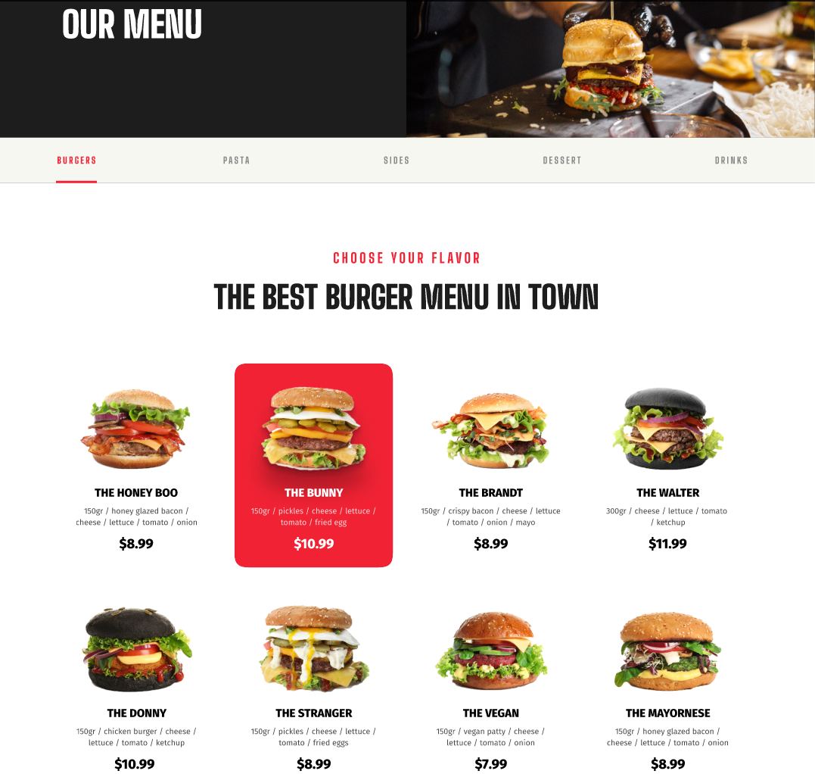
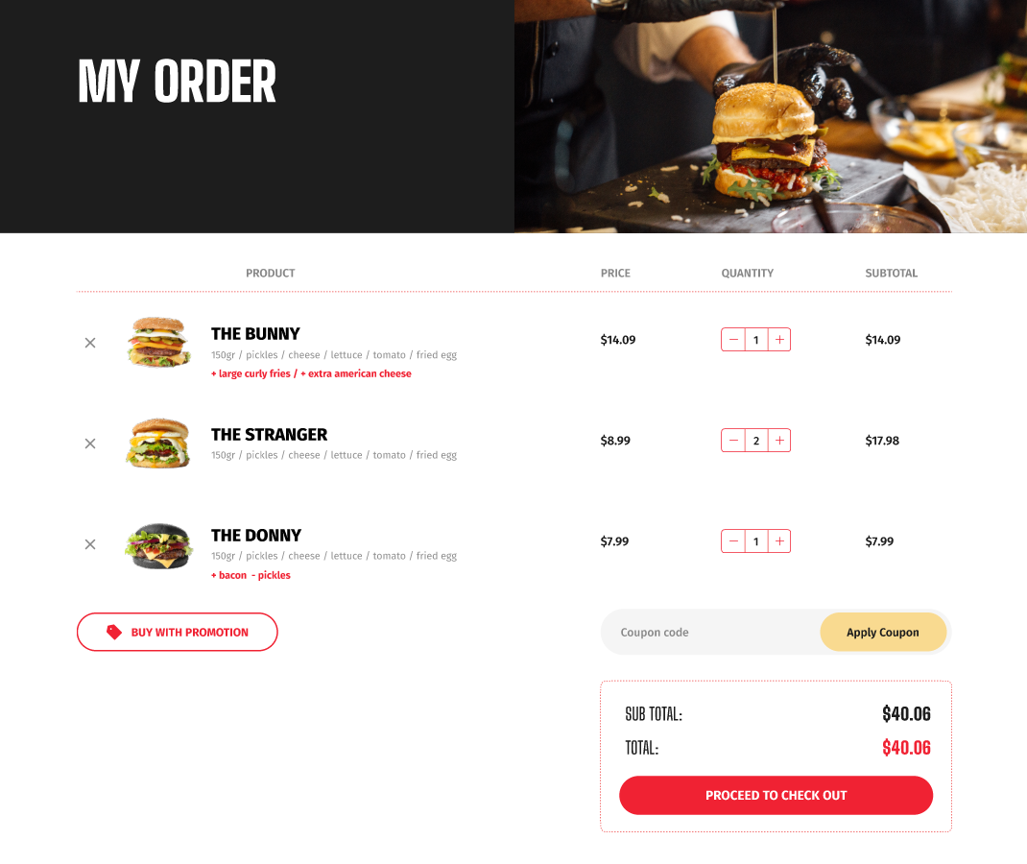
eCommerce for Hospitality – Online food ordering

Slide 9
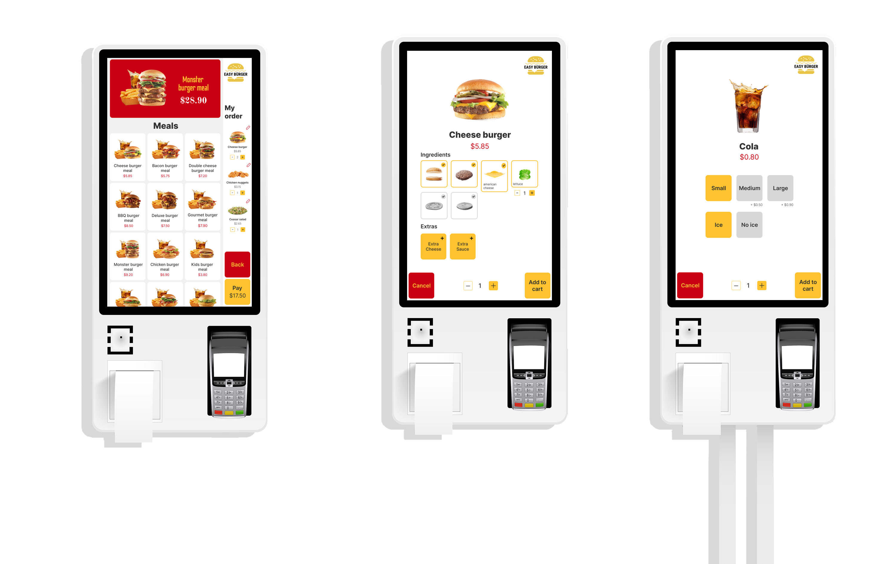

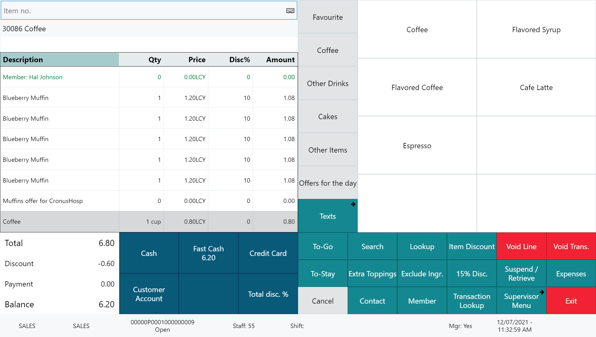






Restaurant
KDS preparation stations
Self Service Kiosks
POS 1
POS 2
LS KDS
Grill
KDS
Cold
Expeditor station
Kitchen Service
Dessert
Bar
Online ordering

Slide 10

Features
Take-away, dine-in & QR code ordering
Menu setup in LS Central
Items (Images, longer descriptions)
Deals, with price change support
Modifiers
Ingredients and allergens
Basket calculation via LS Central
Customers are member contacts in LS Central
Orders instantly posted to LS Central and routed to the KDS

Slide 11




One of the world’s leading eCommerce platforms
Non unified commerce approach
Easier – Simpler - Faster
Cloud hosted by Shopify
Extendable by partners

Slide 12
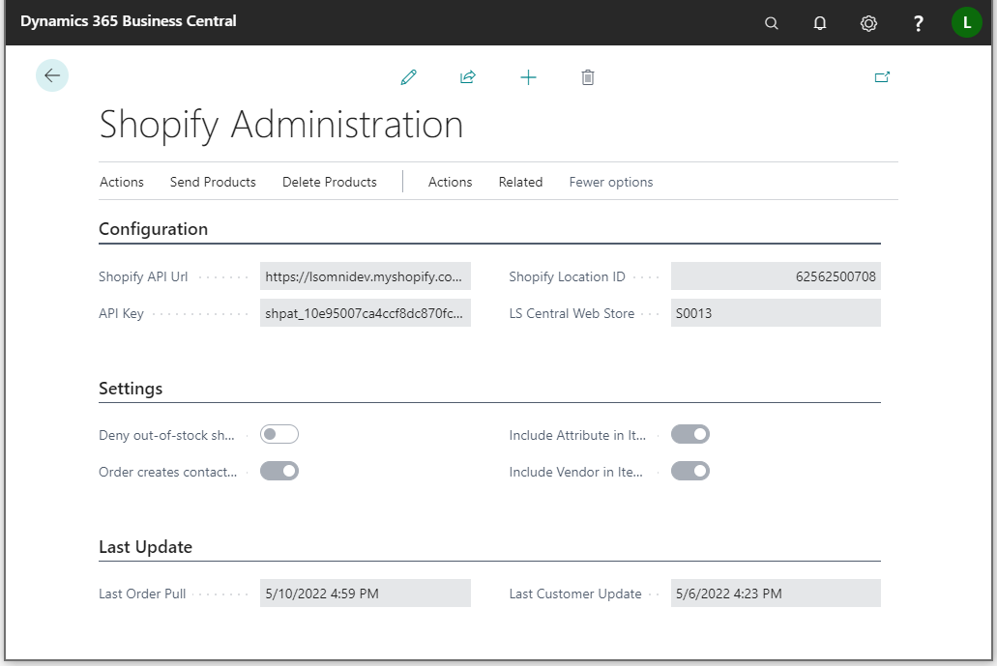
LS Central - Configuration
Basic environment configuration:
Shopify API URL
API Key
LS Central Web Store
Tender type and shipping agent mapping
Various settings, etc.
Replication driven by item distribution and scheduler jobs

Slide 13
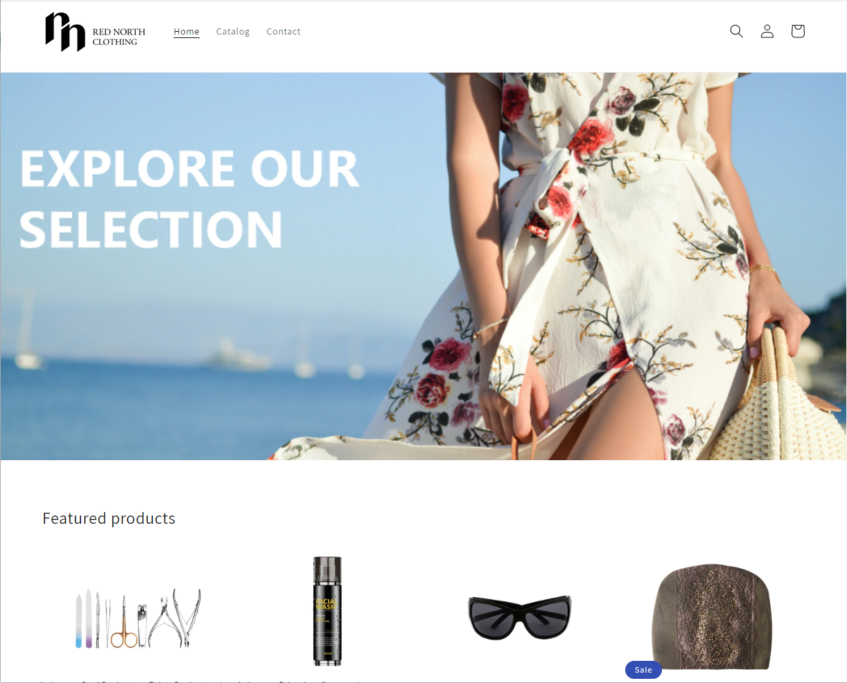
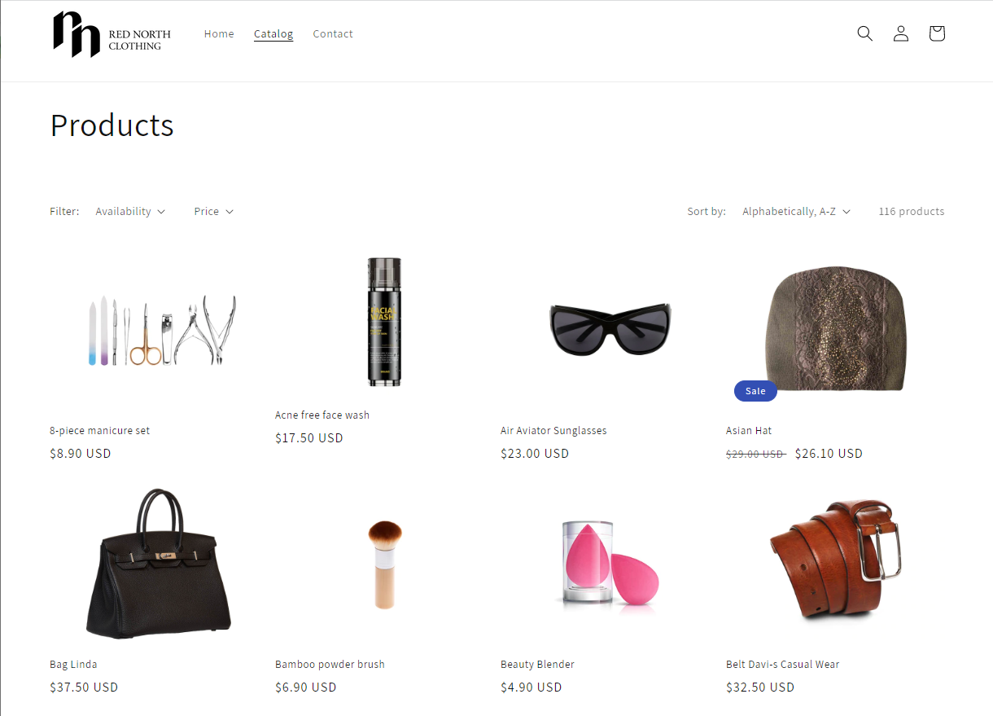
Shopify Storefront
Shopify or Shopify Plus
Choose the platform for your needs
The theme sets the context
Go with themes made for what you’re selling
Employ a digital agency

Slide 14
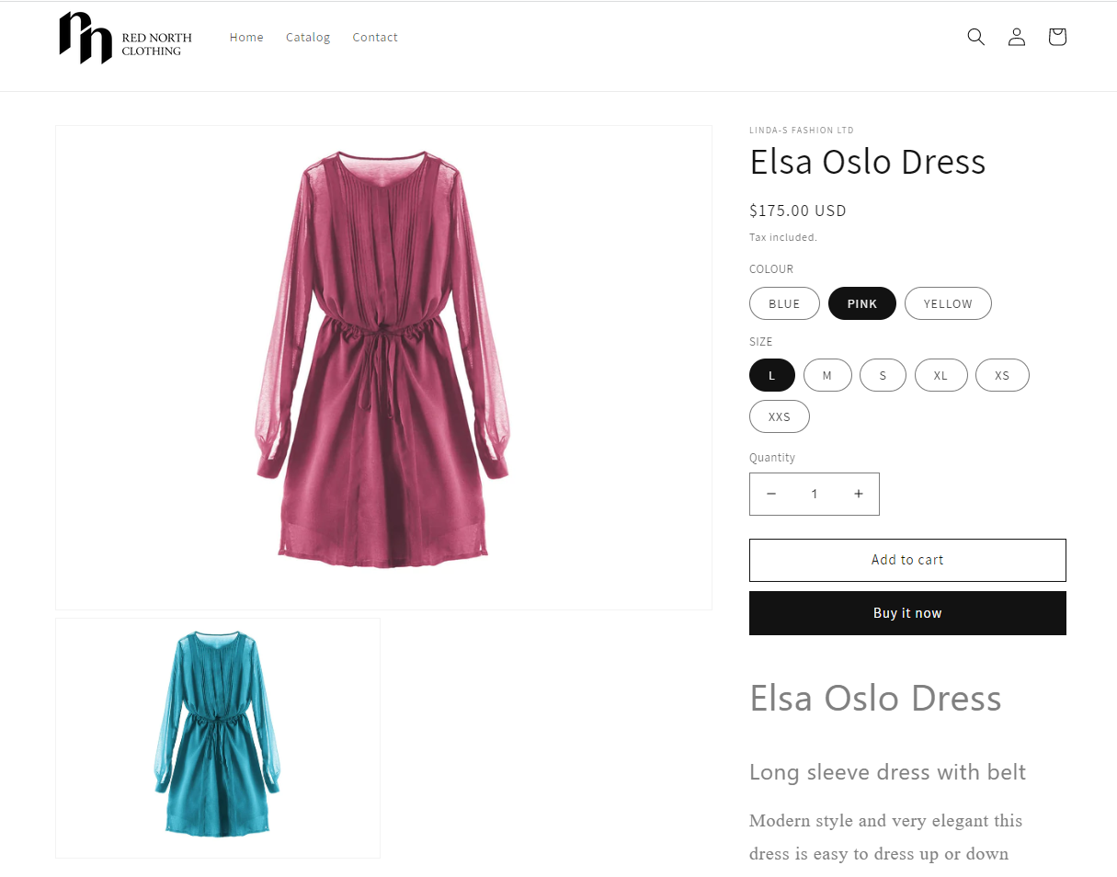
Items
Full item replication:
Name, description, images
Attributes, categories
Inventory, prices
Periodic discounts
Full variant support
Support for metafields

Slide 15
Orders
Orders from Shopify created as Customer Orders in LS Central
Support for shipping agents and amounts
Support for tender mapping
Customers in Shopify created as Member Contacts in LS Central
Batch pulling
With individual orders

Slide 16
Shopify Demo

Slide 17


Retail
Hospitality
Activity
Pharmacy
Retail
eCommerce API
Commerce Service for LS Central
3rd party
eCommerce
providers

Slide 18

Ongoing & roadmap – H1 2023
LS Retail Academy – Courses for retail and hospitality
Item vendor sourcing
Multicurrency support for gift cards and loyalty points
Online gift card purchase
Gift cards – Added security
R&D – New calculation engine
Shopify
Partner extensibility, loyalty points, coupons, gift cards & UI development
Roadmap – H2 2023
LS Retail Academy – Courses for Shopify
Hospitality – Home delivery
Online returns
Click and Collect – Feature improvements
Attribute images
Abandoned baskets and shared wish lists
Shopify
Added partner extensibility, further UI development & multistore support

Slide 19


Slide 20
Questions?

Slide 21
Thank you

