Slide 1
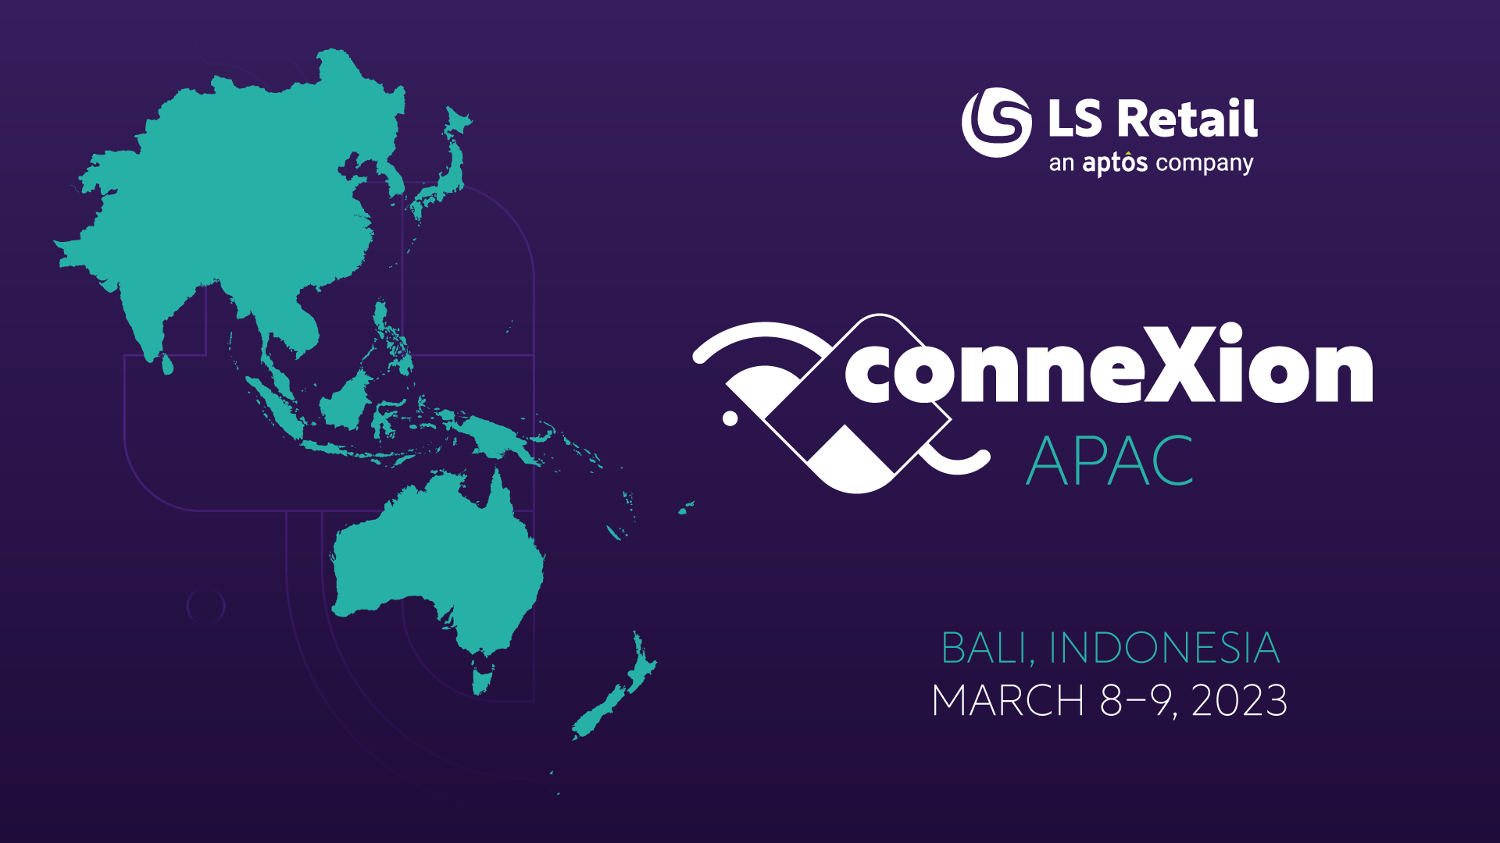

Slide 2

LS eCommerce
How to implement an eCommerce Project
Zeeshan Khuwaja Kristjan Asvaldsson

Slide 3

Our Journey Today
Introduction to LS eCommerce.
Running a Project.
Handling Customizations
LS Retail Consultancy
Q/A Sessions

Slide 4
Introduction to LS eCommerce

Slide 5
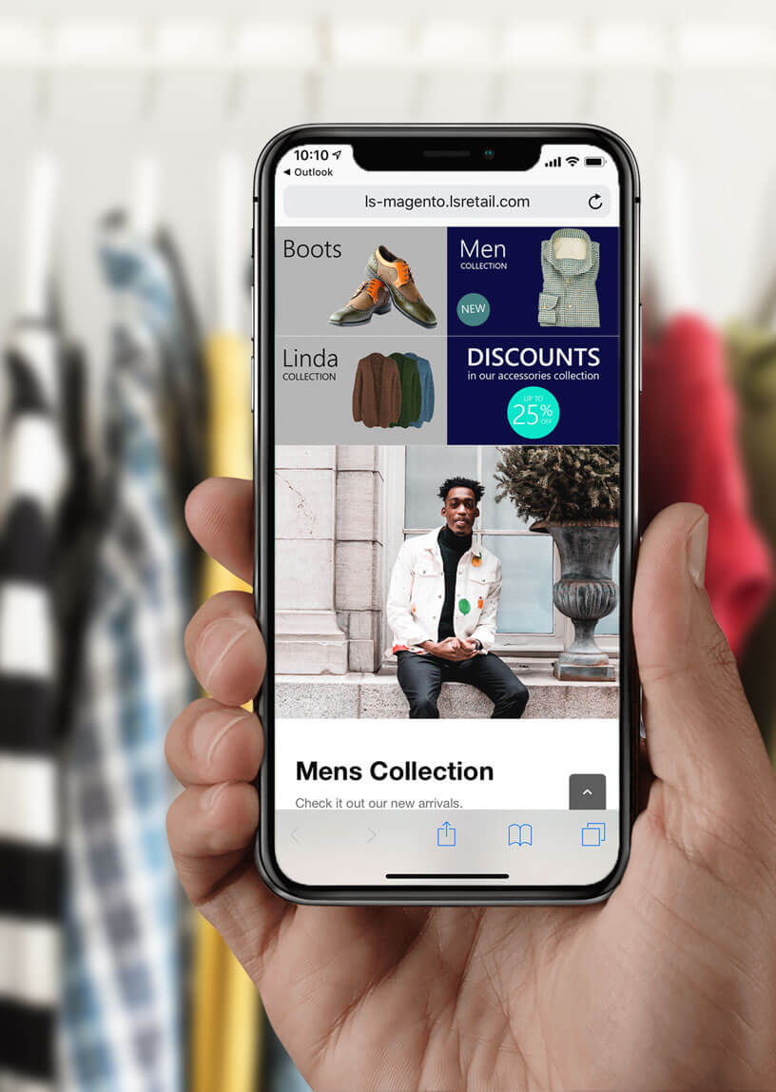
Introduction
What is LS eCommerce
Eco System
Installation
Configuration

Slide 6
Introduction
What is LS eCommerce
Eco System
Installation
Configuration

Slide 7
Introduction
What is LS eCommerce
Eco System
Installation
Standalone
Virtual Machine
Configuration

Slide 8
Introduction
What is LS eCommerce
Eco System
Installation
Standalone
Virtual Machine
Configuration

Slide 9
Introduction
What is LS eCommerce
Eco System
Installation
Configuration

Slide 10
Running a Project

Slide 11

Running a Project
Scoping
Selecting the Magento Platform
Look and Feel
Hosting

Slide 12

Scoping
Client Requirements
Supported Features
Gaps ?

Slide 13
Running a Project
Scoping
Selecting the Magento Platform
Look and Feel
Hosting

Slide 14
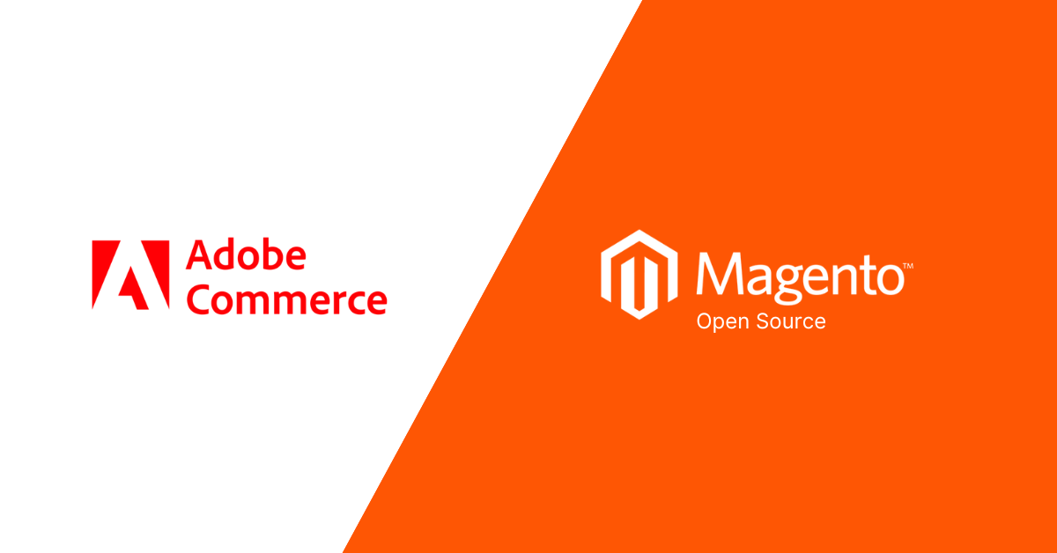
Adobe Commerce vs Magento Open Source
Client Requirements
Supported Features
Gaps ?

Slide 15
Running a Project
Scoping
Selecting the Magento Platform
Look and Feel
Hosting

Slide 16
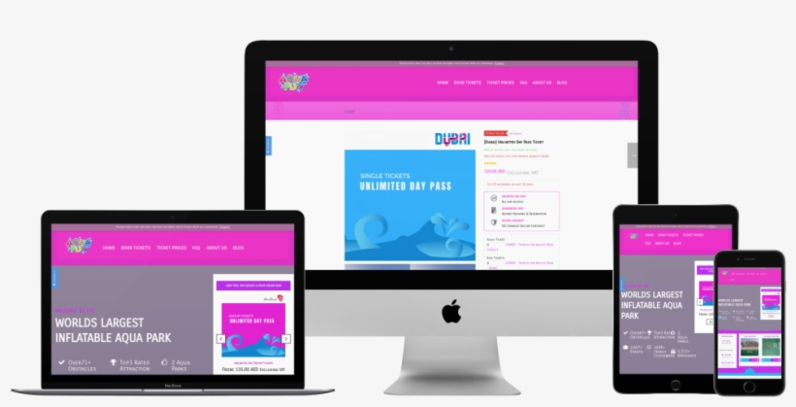
Look & Feel
Marketplace Themes.
Custom Designs
PWA

Slide 17
Running a Project
Scoping
Selecting the Magento Platform
Look and Feel
Hosting

Slide 18
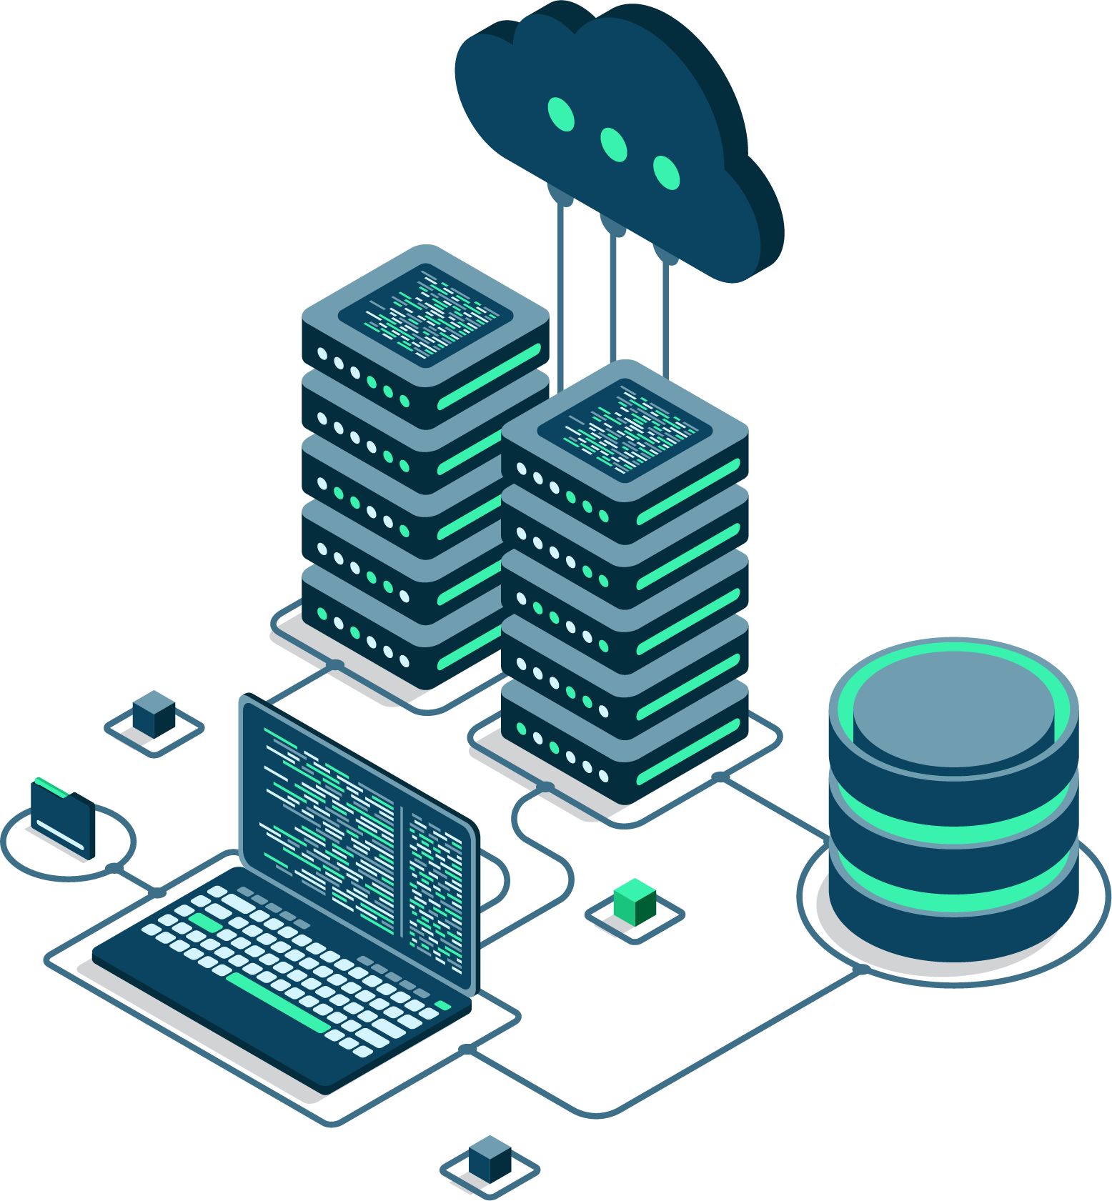
Hosting
Adobe Commerce Cloud
On Premise.
Third Party.

Slide 19
Handling Customizations

Slide 20
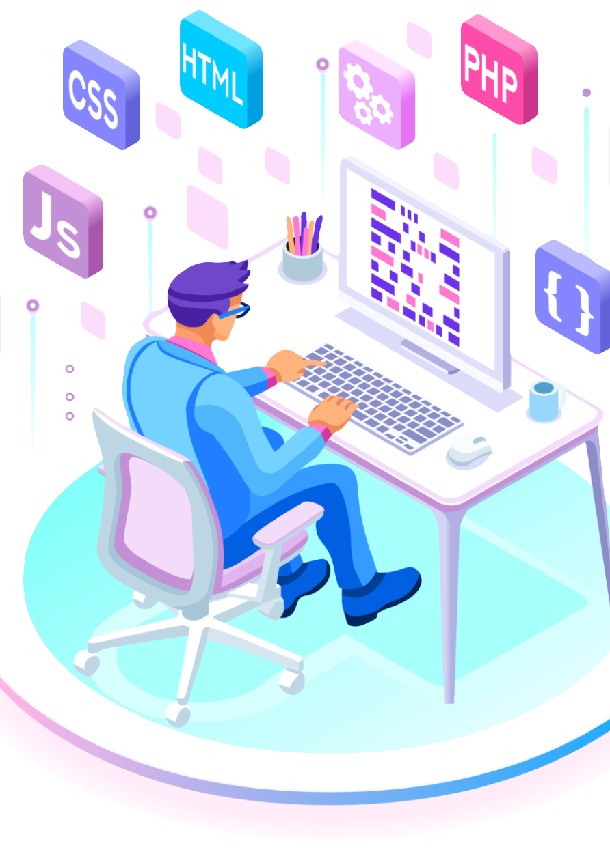
Customizations
Frontend – UI
Magento
LS eCommerce – Magento module
LS Commerce Service
LS Central

Slide 21
LS Retail Consultancy

Slide 22

LS Retail Consultancy
Discovery Workshops
Training
Customization Requests
Deployment

Slide 23
Q/A Sessions

Slide 24
Thank you

