Slide 3
Data migration and SaaS
Omair Zuberi
Bhawana Sharma
Solution Architect
Consultant

Slide 4

Data Migration
Data migration is the process of securely migrating data from your on-premises SQL Server or Azure SQL instance to your Business Central online/ LS Central SaaS.
The process uses the Azure Data Factory (ADF) to directly migrate the data between databases, meaning it does not look at any permissions within the applications you are transferring data between, only SQL permissions.
When you have finished the setup testing, you migrate the on-premises database to the LS Central SaaS tenant.

Slide 5

Data Migration
The upgrade paths
When migrating from:
Business Central (without LS Central) on-premises to LS Central SaaS, you can migrate to LS Central SaaS from the earlier versions 14 and above.
LS Central on-premises to LS Central SaaS, you can migrate to LS Central SaaS from LS Central on-premises from the earlier version of 17.5 and above.
Suppose your on-premises solution is a version that is older than the supported versions mentioned above, including versions of Microsoft Dynamics NAV 2018 and older. In that case, you must upgrade your on-premises solution.

Slide 6
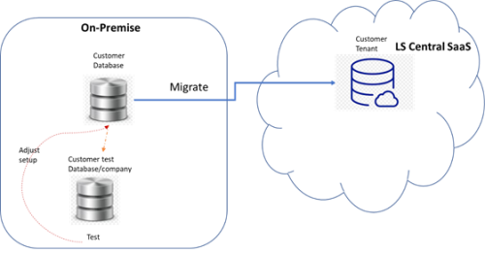
Why should we do the initial setup on-premise, instead of doing it directly in LS Central SaaS?
I
Instead of doing it directly, use:
on-premise databases
Test extensions
Debug errors

Slide 7

Things to Consider before you start
Managing database size
  Microsoft recommends that you consider reducing the amount of data you migrate to less than 30 GB in each migration run. For example, reduce the number of companies you migrate data for or delete outdated data in tables containing log entries and archived records.
Indexes and statistics
  Update statistics and reorganize indexes on all tables on the on-premises database. This will ensure that the migration runs as fast as possible
Permissions
  You must be signed in as an administrator of the Microsoft 365 tenant and Business Central online/LS Central SaaS.
  Make sure that at least one user has SUPER permissions in your Business Central online/LS Central SaaS*.
Any existing data in Business Central online/LS Central SaaS will be overwritten with data from your on-premises solution once the data migration process is run.

Slide 8

Things to Consider before you start
5. SQL Connection
SQL Server connection string
User permissions after the migration

Slide 9
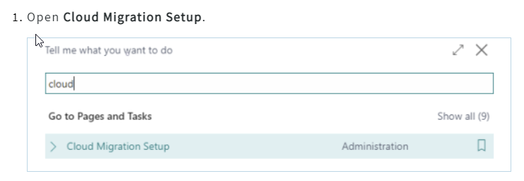
Running the cloud migration tool
Step 1 - Cloud migration setup

Slide 10
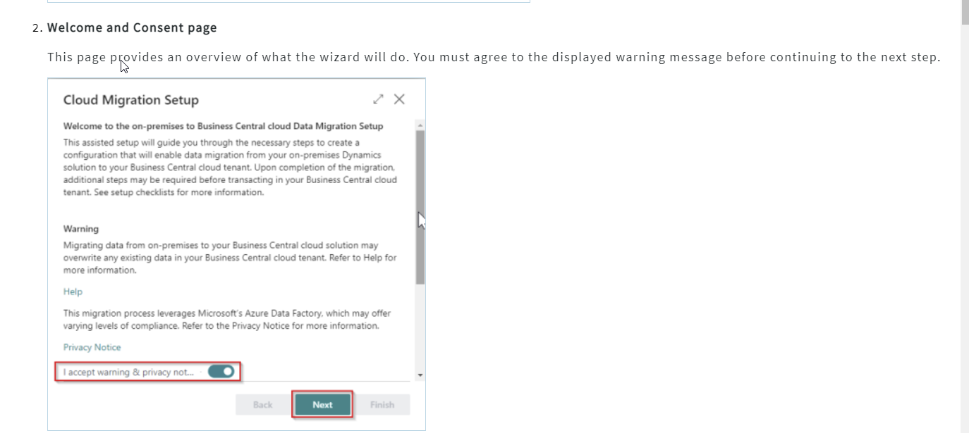
Running the cloud migration tool
Step 1 - Cloud migration setup

Slide 11
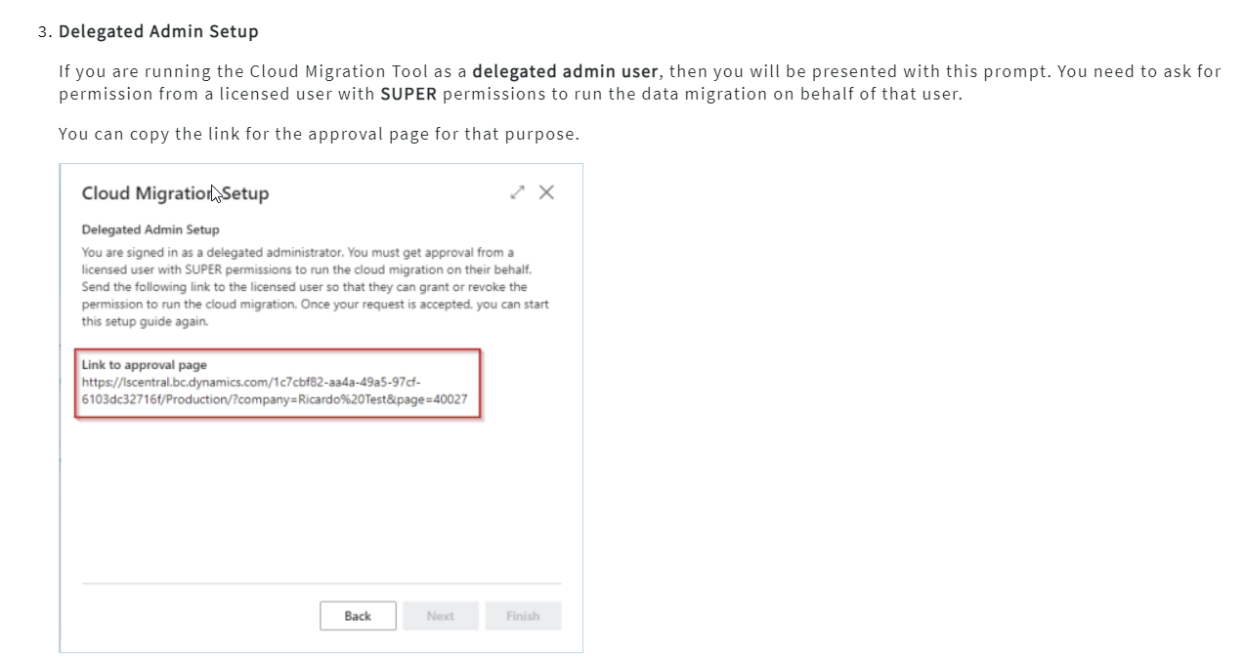
Running the cloud migration tool
Step 1 - Cloud migration setup

Slide 12
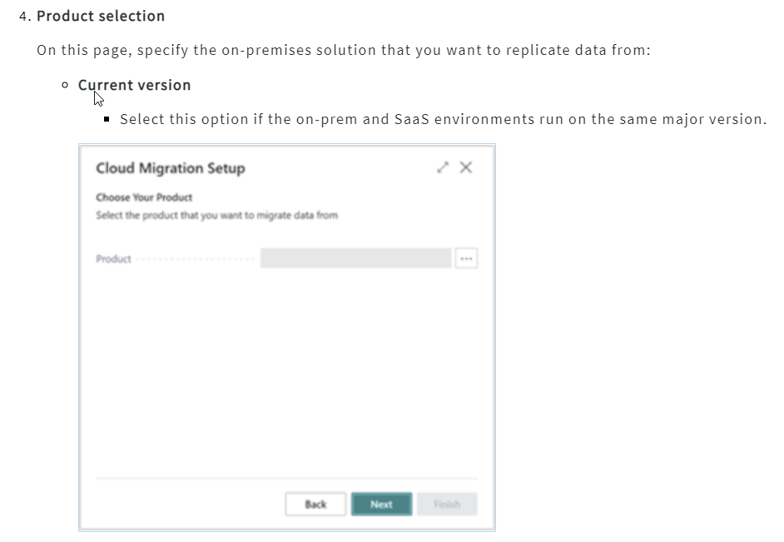
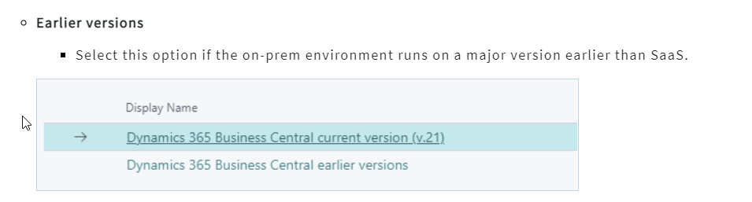
Running the cloud migration tool
Step 1 - Cloud migration setup

Slide 13
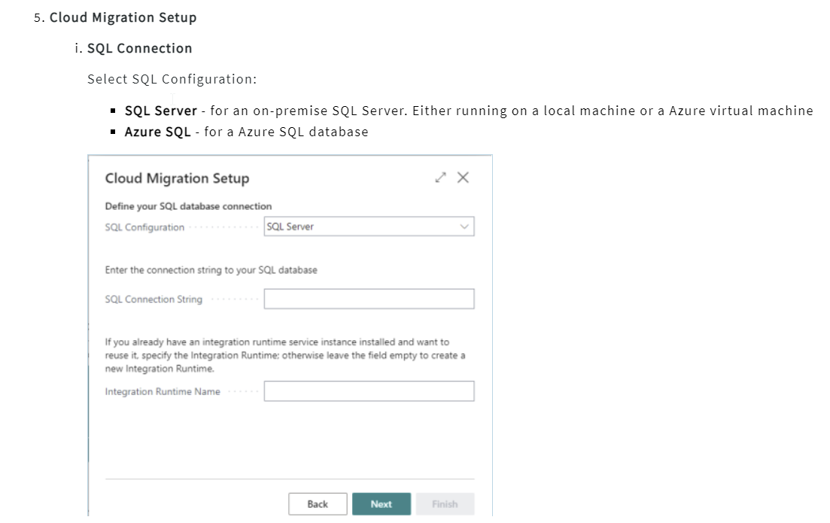
Running the cloud migration tool
Step 1 - Cloud migration setup

Slide 14
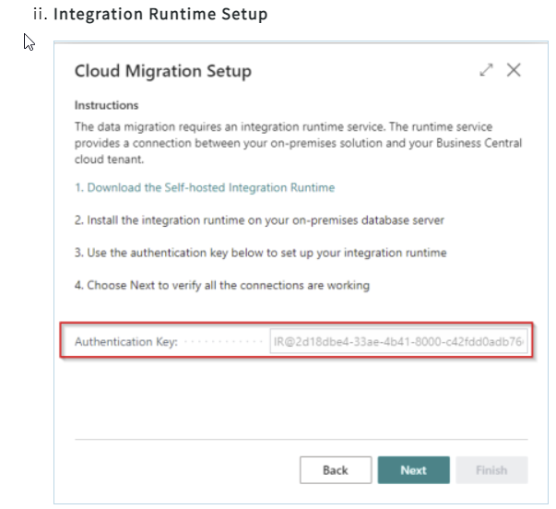
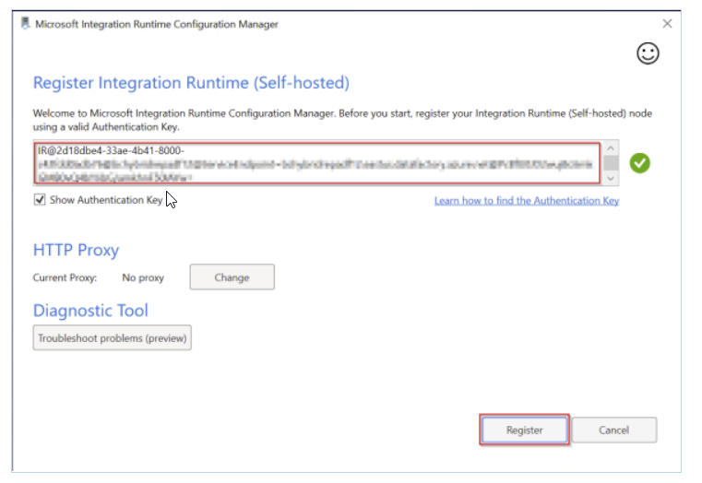
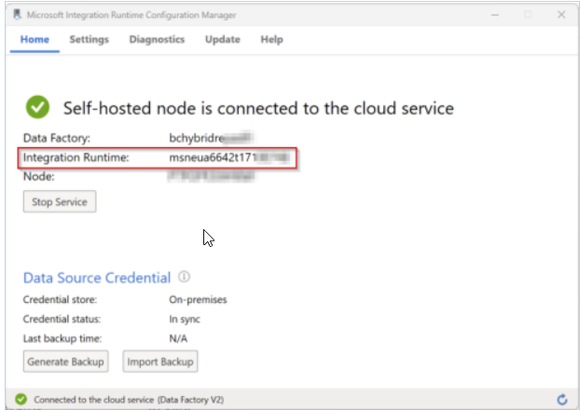
Running the cloud migration tool
Step 1 - Cloud migration setup

Slide 15
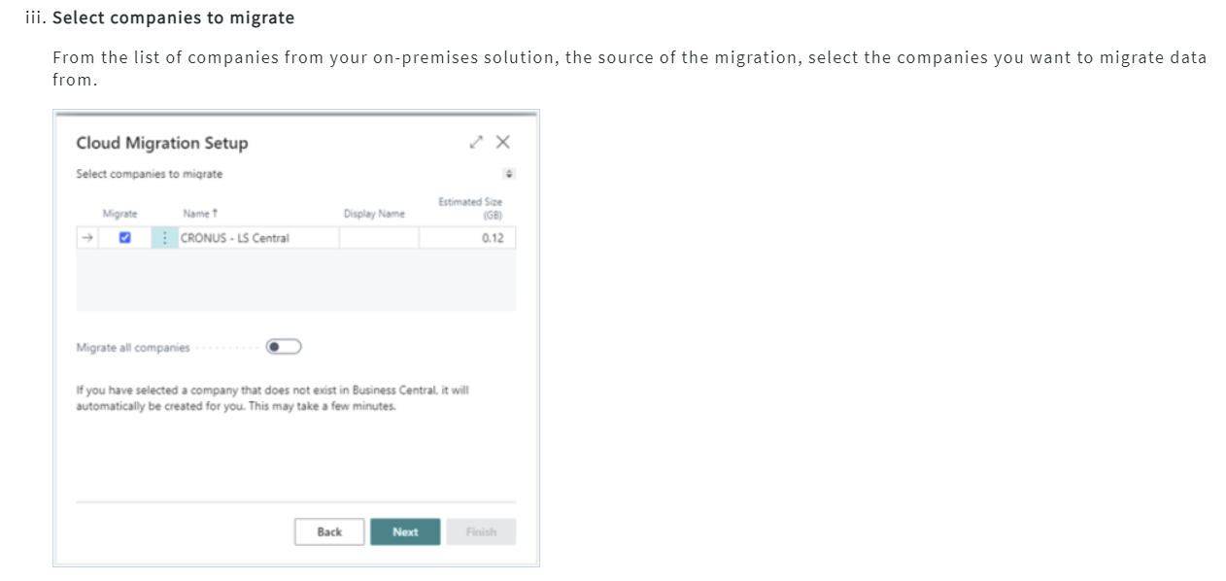
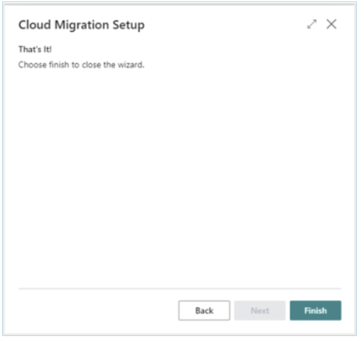
Running the cloud migration tool
Step 1 - Cloud migration setup

Slide 16
Running the cloud migration tool
Step 2 - Cloud migration management
Cloud Migration Management is where you schedule the data migration and monitor the progress. We recommend scheduling your data migration for off-peak business hours since running can take many hours.
The amount of time the migration will take to complete depends on the following:
The amount of data
Your SQL configuration
Your connection speeds

Slide 17
Running the cloud migration tool
Step 3 - Users
Once the cloud migration environment is configured, all users without SUPER permissions will be automatically assigned to the Intelligent Cloud user group with the Intelligent Cloud permission set and will have read-only access.
User groups and permissions.
The SUPER user needs to assign appropriate user groups and permissions to users.
Setting up device users for the POS.
For POS and mobile devices, there should be a shared user (device name). The device should log in using the shared user.

Slide 18
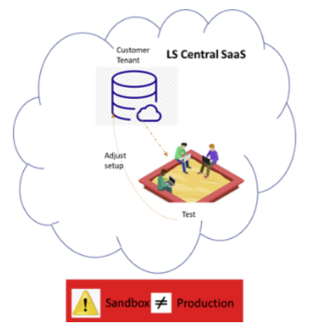
Test in Sandbox
There is a suggestion that you copy the customer tenant by creating a sandbox to test and adjust accordingly. Make sure you update the customer database with the same adjustment.

Slide 19
Thank you

