Slide 1
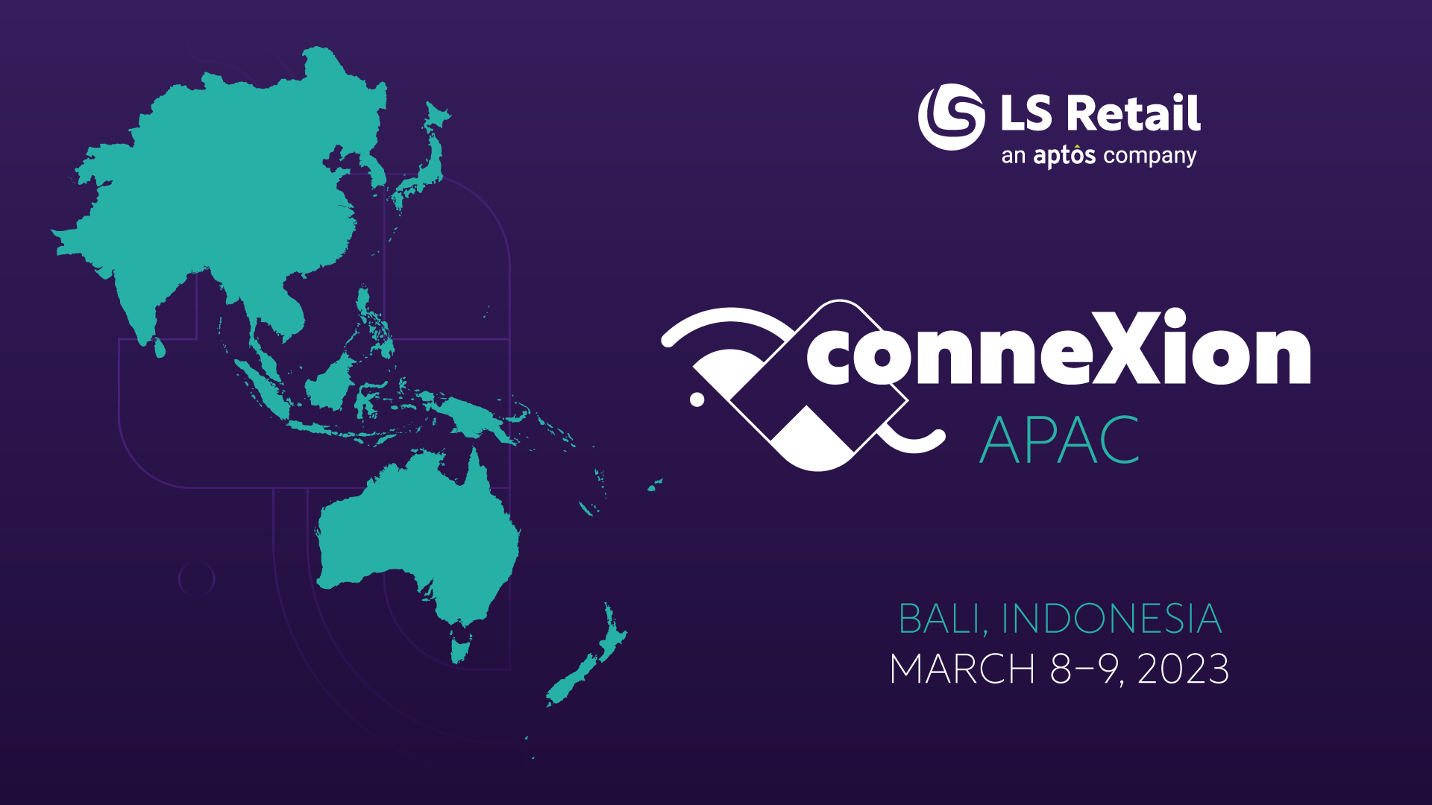

Slide 2
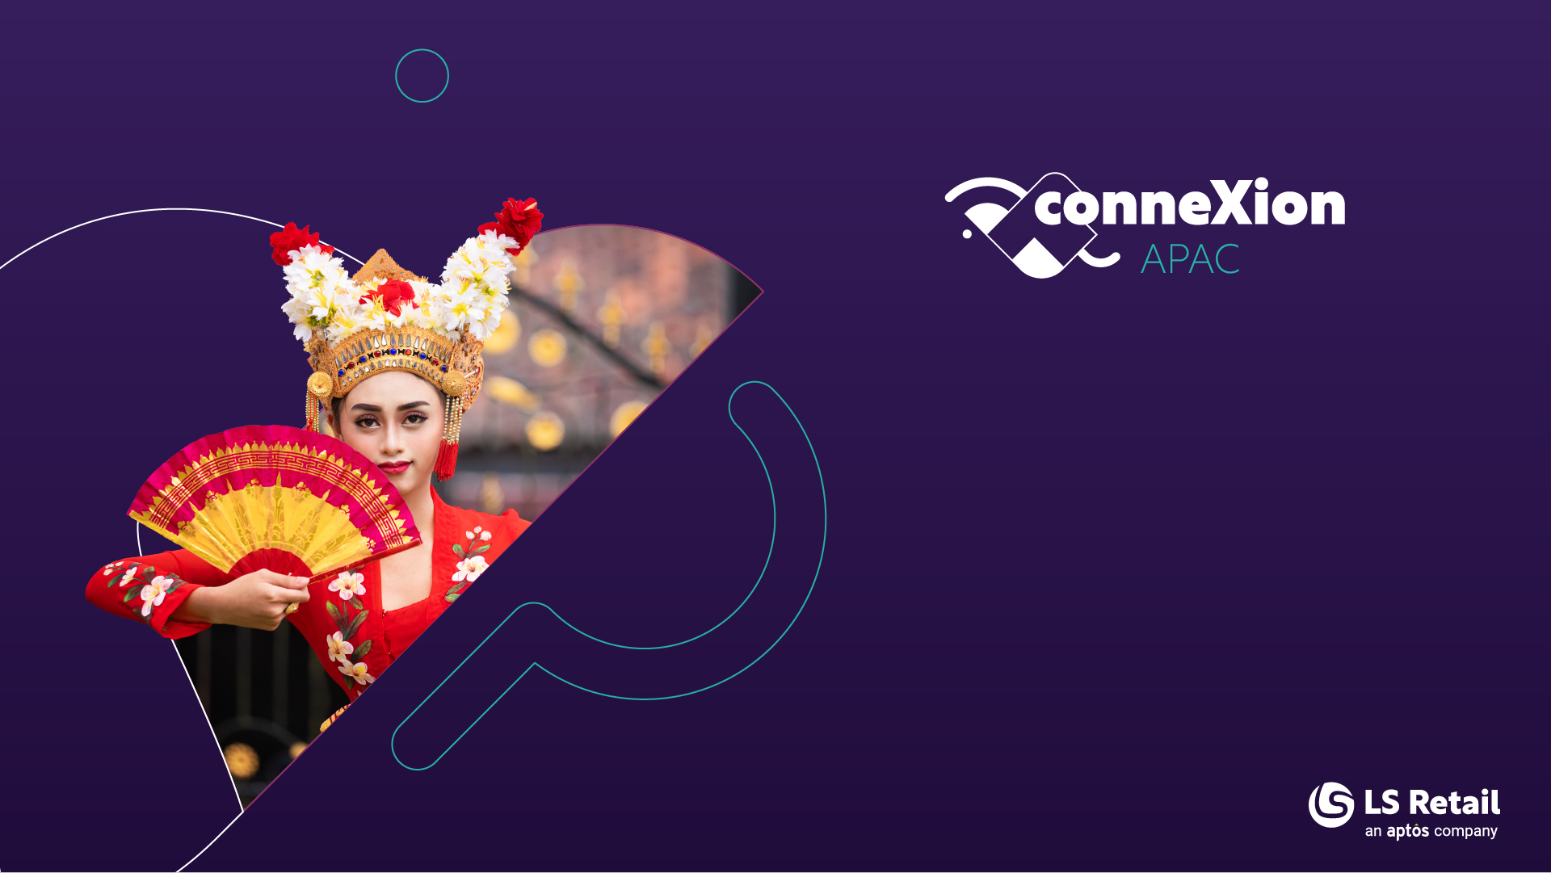
All the latest
LS Central SaaS
Matthias Matthiasson
Product Director

Slide 3
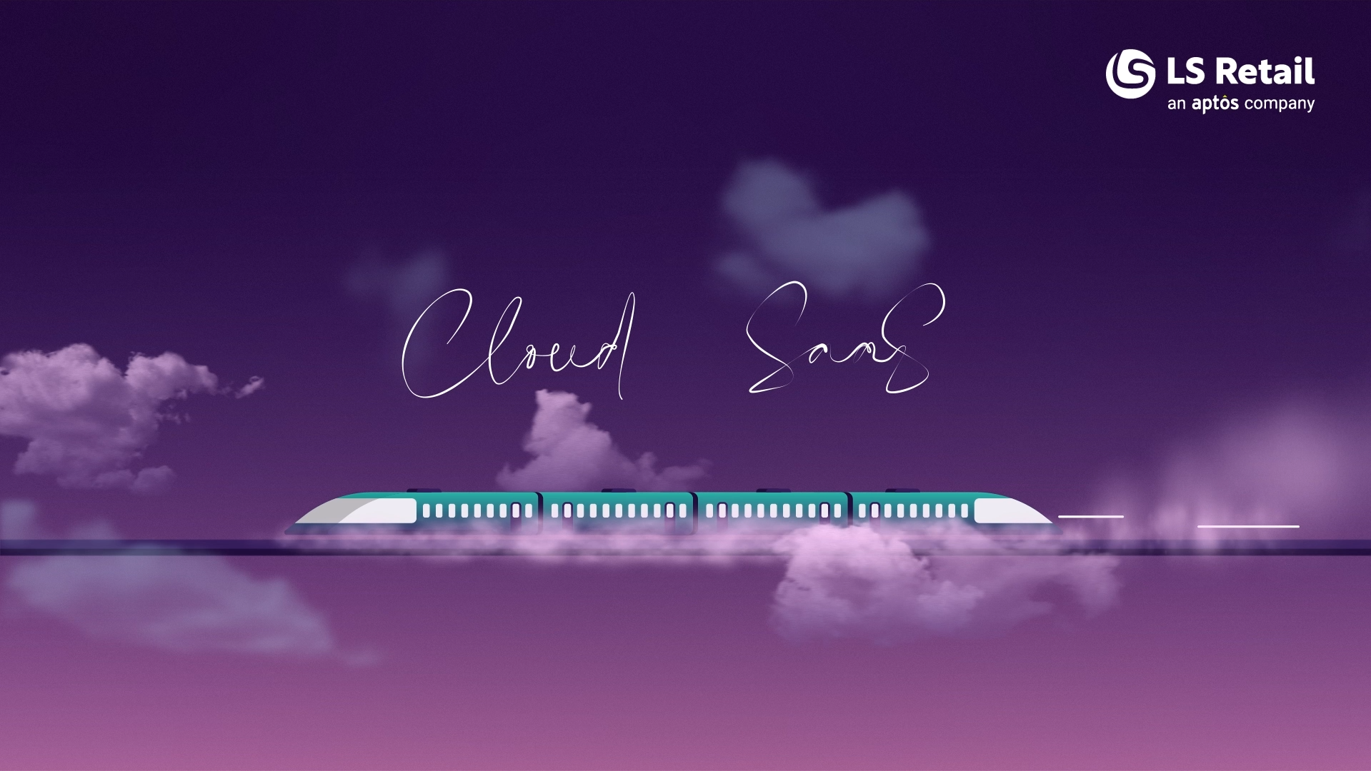

Slide 4

Subscription
Low upfront investment
Operational expenditure model (OPEX)
Adjustable monthly
Significant money savings

Slide 5

Staying current
Always updated
Short update cycles
Benefits of the newest technology and features
You stay current with minimal effort

Slide 6

Hosted by Microsoft
Forget about infrastructure maintenance/cost
Reliable scalable environment for performance
Tools to monitor and analyze – like telemetry
Best in class-security
Works great with cloud tools
Power Apps, Power BI, Power Flow
Hosted Office environment
Be productive on the go

Slide 7
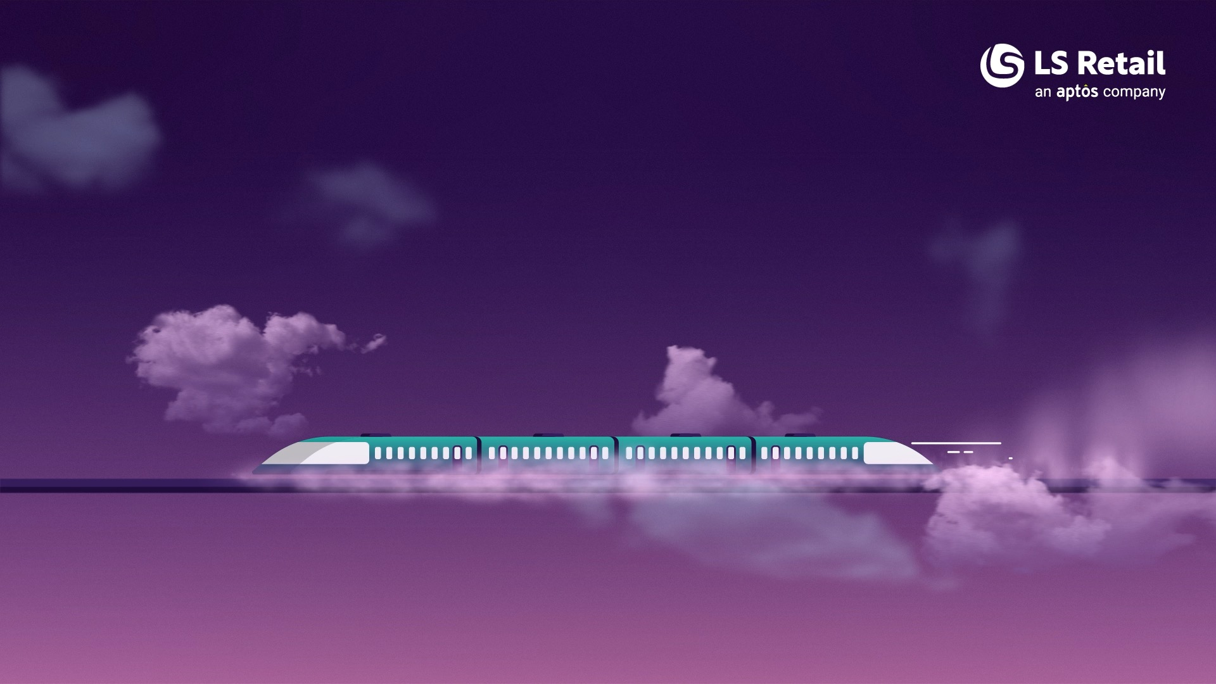
How we support you

Slide 8
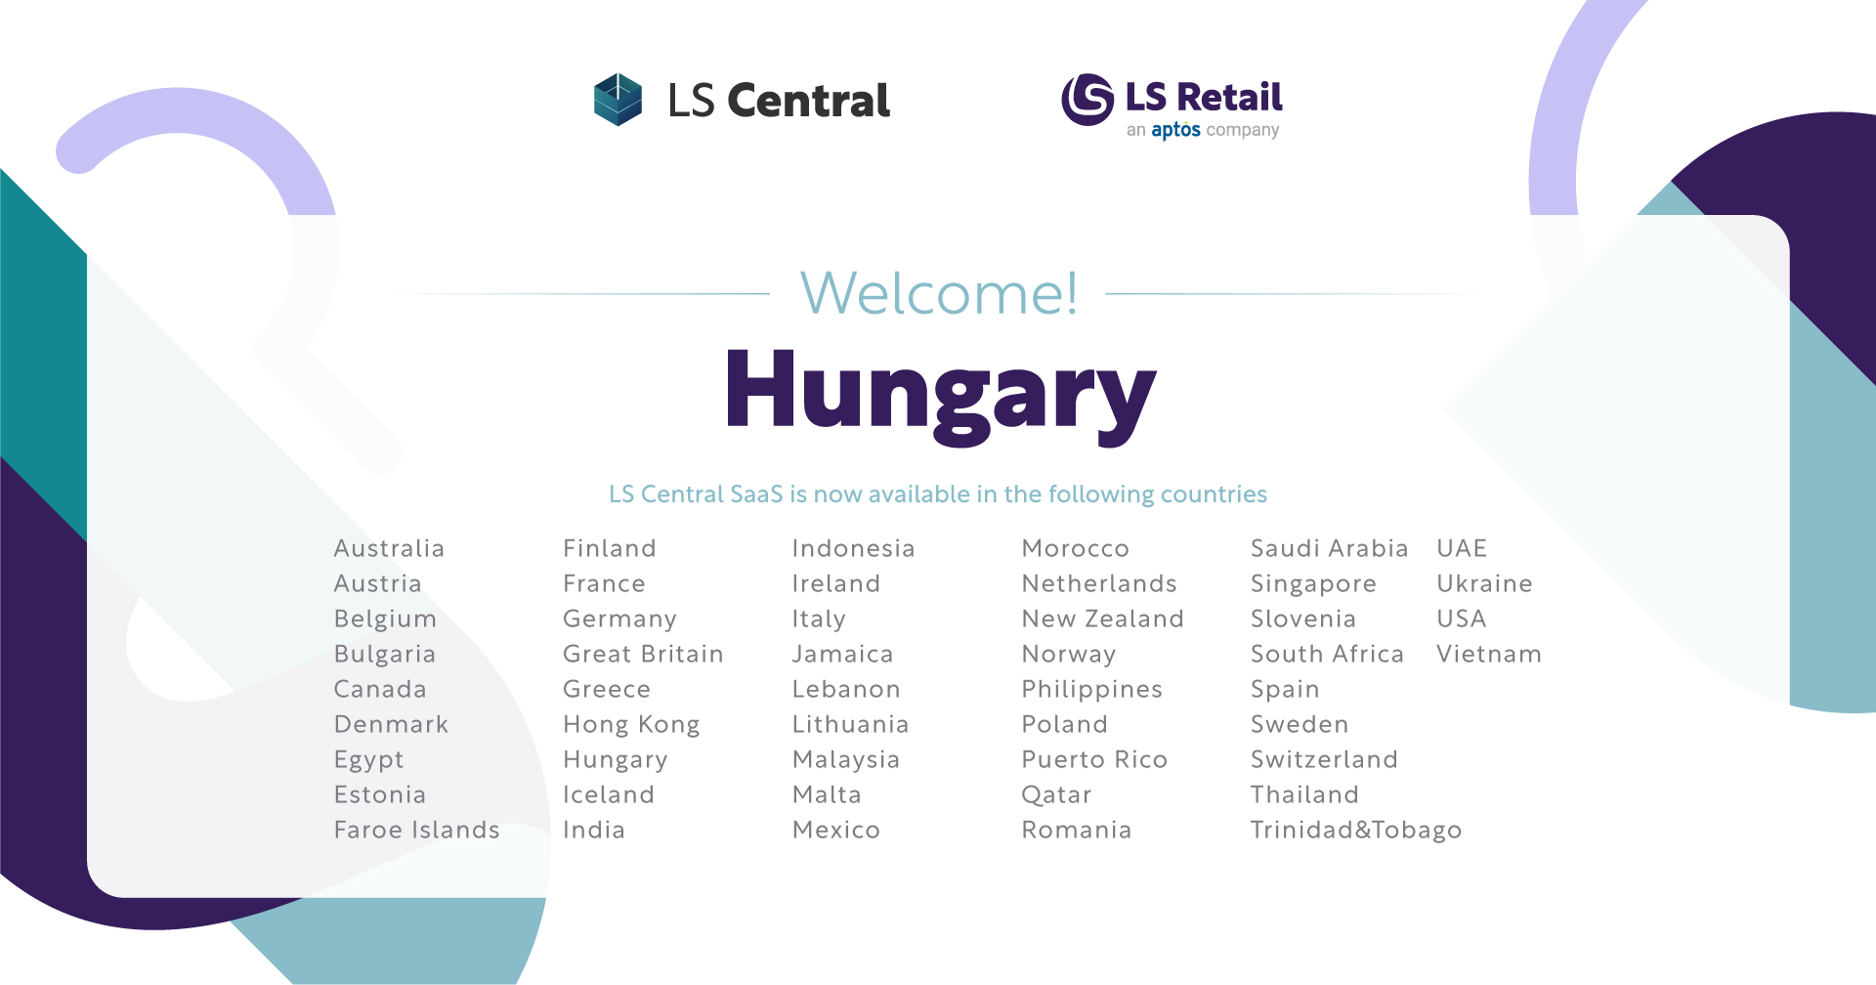
Localization
43 countries
49 countries

Slide 9
Your journey to LS Central SaaS
Overview session
Onboarding guide
Implementation guide
SaaS training
Onboarding buddy and CAP

Slide 10

Book a session with the Onboarding Team
Book your overview session when it fits you
Use link
https://calendly.com/lsconboarding/onboarding
Do you need a 30-minute session to ask any SaaS-related questions
Use link
https://calendly.com/lsconboarding/30minsession

Slide 11
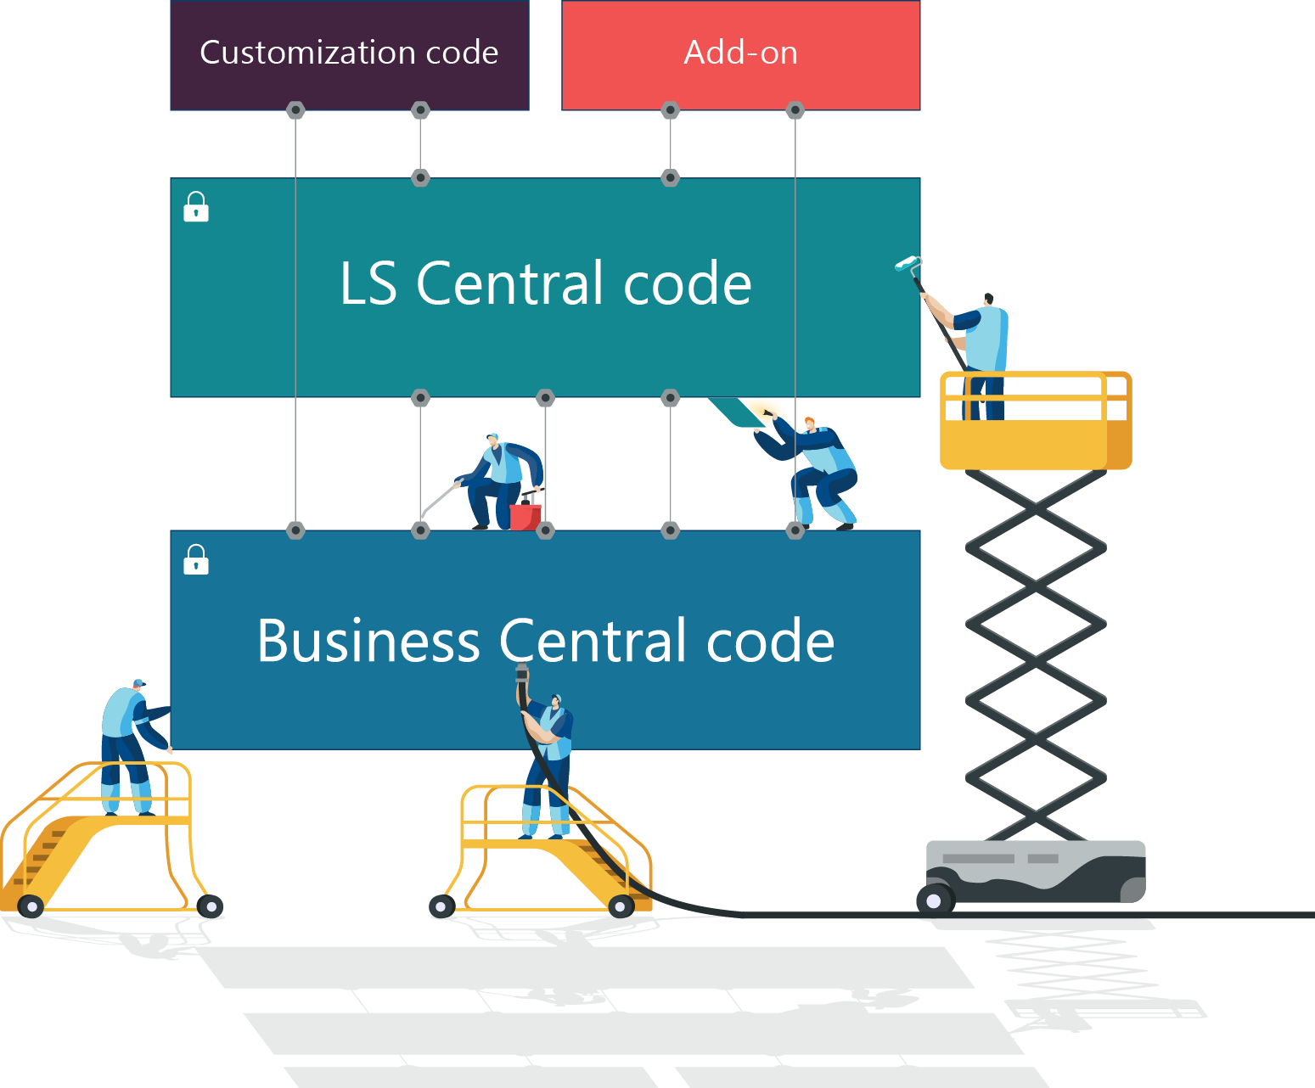
Extensibility framework
Coding with Events & Extensions
New modular development environment
Built for upgradability
Makes migration easier, simpler and faster
Still keeping the ability to extend functionality
This technology has ability to stay current without projects

Slide 12
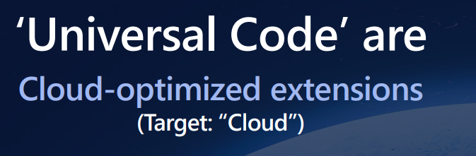
Universal code compliancy
Enforced in BC version 21 (3rd of October 2022)
Only on-premise
Only licenses purchased or transitioning after the 3rd of October 2022
LS Central has TWO outstanding issues with Microsoft
Windows authentication of web-services support discontinued in LS Central 22 release (use web-key)
XML definition accessibility for client web-services

Slide 13
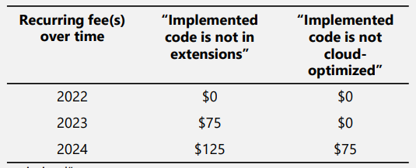
Universal code compliancy
Not executable if not compliant
Implemented code is not cloud-optimized (109110138) Implemented code is not in extensions (109110140)
Per full users (Premium or Essential)
Included in the Customer Enhancement Plan (annually)

Slide 14

Universal code compliancy
No DLL’s
Hardware station
EFT
Fiscalization
Other integration @POS

Slide 15
LS Central journey to shared SaaS
LS Central
app in AppSource
Dedicated SaaS
cluster to
Public SaaS cluster
LS Central
universal code
compliant

Slide 16
LS Central journey to shared SaaS
Same environment/clusters
Microsoft runs both
Same Apps (LS Central and Microsoft)
Should I wait for Public SaaS Cluster?
No - there is no reason to wait
Moving from Dedicated to Public is the same effort as monthly upgrades
Move done by Microsoft
Will be done in stages
Test sandbox
Move single companies
Move single countries
Move multiple countries
Dedicated
SaaS
Cluster
Public
SaaS
Cluster

Slide 17

What is the journey for partners to SaaS
AL code
Extended tables
Changes in extension
No SQL access
Communication SaaS

Slide 18
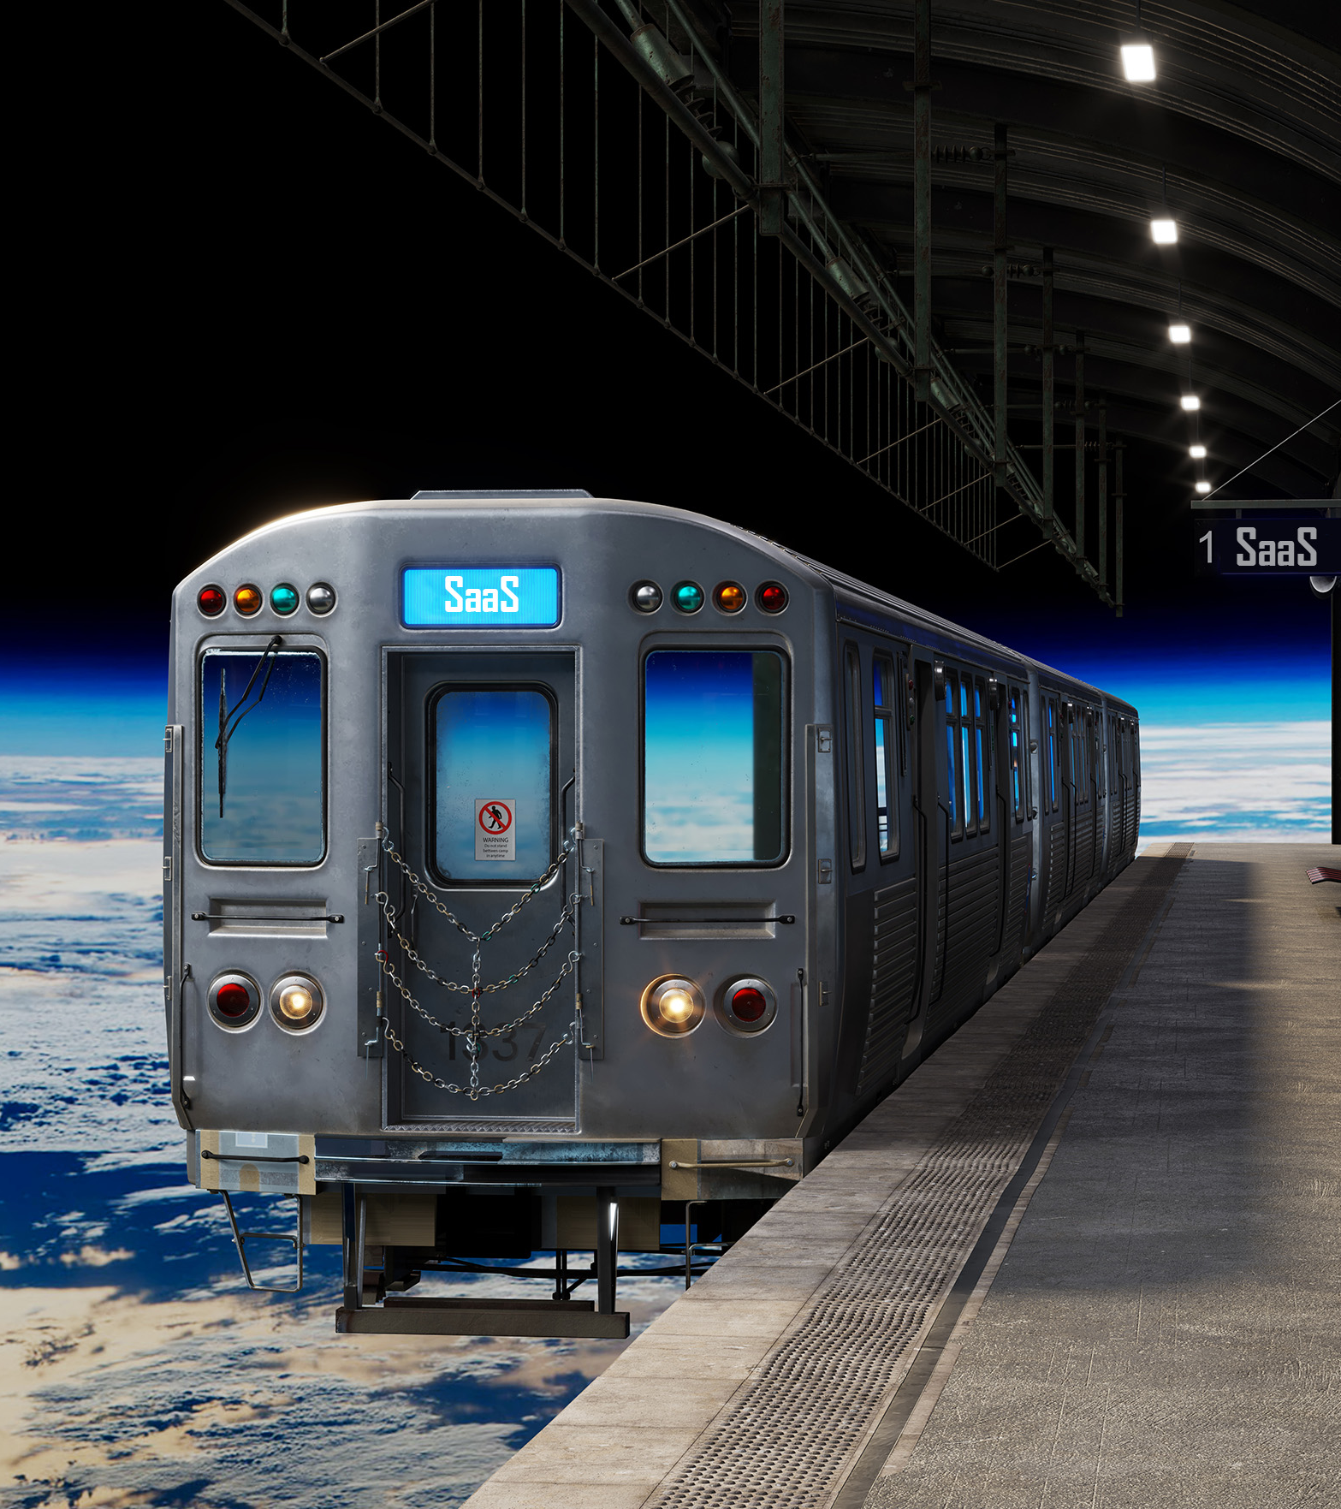
Steps in moving to SaaS
Big bang – all at once
1st Head Office and then POS
1st POS and the Head Office
What are the challenges

Slide 19

Performance
Microsoft wants feedback on performance issues
Microsoft will analyze and solve
LS Retail performance improvement initiatives
Analyzes identified POS process
Improve batch/heavy Backoffice processes
Stress/Load tests
Milestones for the development process
Feedback for the sales process
Telemetry and monitoring in Azure
Preventive
Development process
Analytical tools by partners

Slide 20

Releases / Requests
Highest priority by development teams
Event request
Internal/Global scope
SaaS critical bugs
HotFixed to SaaS
Release every week
Major/Minor releases (BC updates)
Hotfix with events + internal/global
Pull requests from partners

Slide 21

Focus Groups
Replenishment
Hospitality (Restaurants & Hotels)
Unified Commerce
POS & Devices

Slide 22

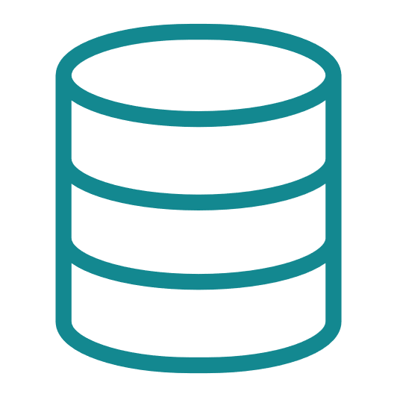


SaaS Replication
Dynamics 365 cloud
Web replication
Architecture
Data Director
SaaS?
Web Replication
What is it?
SaaS Replication & Azure Services
Introduction
HQ
Hybrid component server
Store
Online POS
Offline POS
Offline POS Service

Slide 23
SaaS Replication
Dynamics 365 cloud
Web replication
Architecture
Data Director
SaaS?
Web Replication
What is it?
SaaS Replication & Azure Services
Introduction
Hybrid Component Server
Offline POS and SaaS
Hybrid component server
HQ
Hybrid component server
Store
Online POS
Offline POS
Offline POS Service

Slide 24

Stay Current
SaaS monthly upgrading
UI auto-tests for POS
Verify business-critical processes
Keep POSes current
Online POSes
Use Update Service
Hardware Station and AppShell
Monthly if feasible
Offline POSes
Use Update Service
All apps
Maybe every 6 months

Slide 25

Partners SaaS
24/7 support for production environments
Outage = Customer/Partner can’t log into a tenant on SaaS through Admin Center
No user can log in to Business Central 365
Customer/Partner that has Delegate administrator must report directly to Microsoft and then share the support incident number with LS Partner Support.
Blocker = Customer can’t trade on any POS in a Store in a Live environment on SaaS
ONLY for issues when customer can’t trade on any POS in a Store in a LIVE environment.
If the issue turns out not being a blocker, then the partner can expect to be invoiced, for the hours spent on the issue.
Critical = Will be reviewed by the Partner Support team in their stand-up meeting at 8:15 GMT and 13:00 GMT
Partners need to share a business case if the issue should be handled to be a Hotfix request

Slide 26

The world is changing
New trends
This Photo by Unknown Author is licensed under CC BY

Slide 27
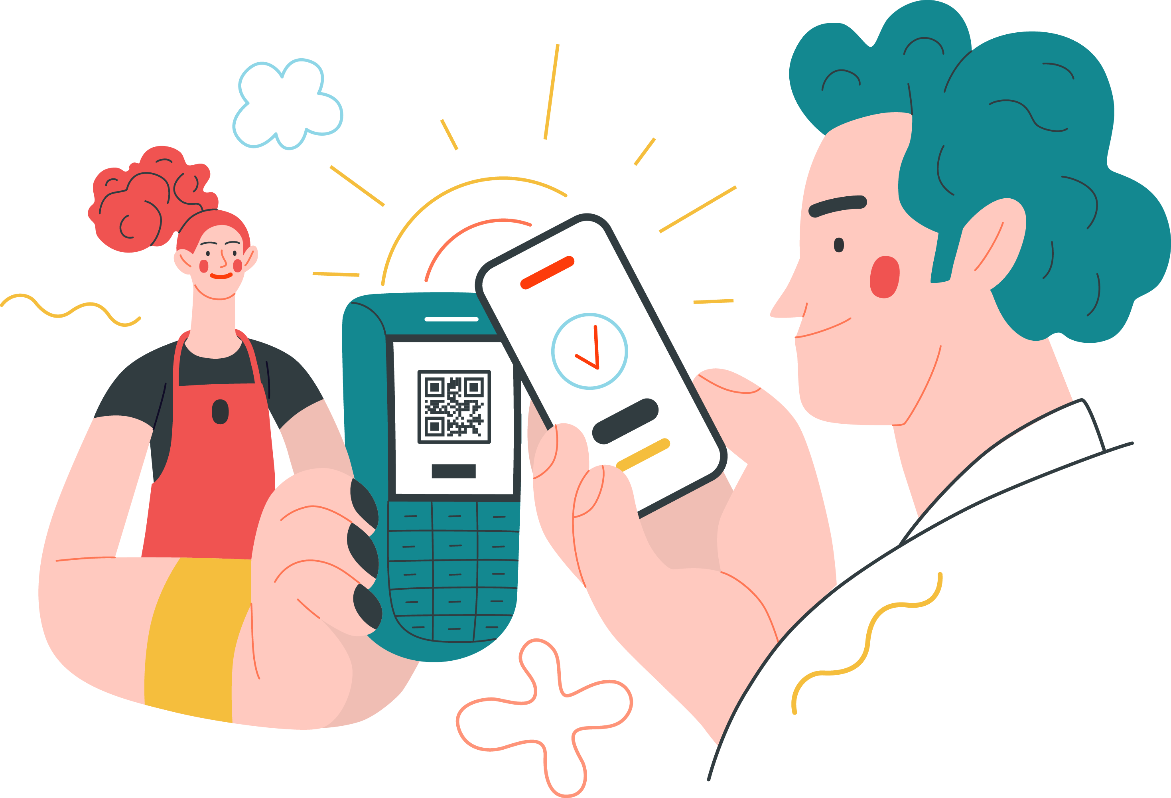
Contactless shopping
Self Ordering in hospitality
Self Checkouts
3rd party self-checkouts
LS Central POS
Scan Pay Go (SPG)
Customer app
Self-scanning
Pay on phone

Slide 28


Slide 29

Create the future
with us

Slide 30

We are just getting started

Slide 31
Thank you

